Slide 1
Federal Proposal Submission
Kathleen M. Kreidler
Associate Vice President
Carmen Martinez
Director, Grants & Contracts

Slide 2
Sponsors Changing
Federal sponsors are enforcing their rules:
NIH – Application Withdrawal Letters
  In FY18 YTD – SPA has received 31 notices of application withdrawal
  Across all schools and many departments
    5% of our federal proposals
    totaling $40 million requested budgets

Slide 3
Sponsors Changing
Reasons for Withdrawals:
Adding non-compliant/unallowable appendix material (2)
Missing required attachments (5)
Missing appendix material (1)
Incorrect/unallowable attachments (1)
Submitting under the wrong RFA (5)
Non-responsive to RFA (did not address priority area) (2)
Missing eligibility letter (1)

Slide 4
Sponsors Changing
Reasons for Withdrawals:
Same proposal submitted more than once (3)
Non-compliant budget (1)
Application breached required anonymity of applicant (1)
Second Resubmission (1)
Late - submitted after 5:00PM deadline (4)
Non compliant (3)
  FDA documentation for IND
  Submitted animal model not allowed under RFA
  Included unallowable preliminary data

Slide 5
Sponsors Changing
Reasons for Warnings:
Biosketch errors
Submitted to wrong RFA
Common Biosketch errors:
- too many publications
- research projects > three years old
- wrong template version

Slide 6
Sponsors Changing
NIH Grants Policy Director has confirmed that warnings will become withdrawals.
National Science Foundation
  - Research.gov went live 4/30/18
  - New system will automatically reject proposals with errors

Slide 7
Self Submit Transition
Federal proposal submission will transition back to SPA starting with 6/5/18 deadline:
- Transition schedule by department
- Will continue through 11/5/18 deadline
SPA DEADLINES HAVE NOT AND WILL NOT CHANGE.

Slide 8
SPA Deadlines
Due 10 Days Before
All Proposals
Due 7 Days Before
Progress Reports
Due 3 Days Before
Final Science
DEADLINE
FINAL SCIENCE = RESEARCH STRATEGY, ABSTRACT, SPECIFIC AIMS ONLY
Proposals received in accordance with deadlines: guaranteed full review and successful submission
Proposals received by 5:00pm, day before deadline: limited review and guaranteed submission
Proposals received on deadline day:
  Before 2:00pm: will be submitted - cannot guarantee error correction
  After 2:00pm: first in/first out basis – cannot guarantee submission
Notes:
Deadlines will become critical. When we remove self submit then SPA could bottleneck if we receive a lot of proposals at the last minute. Especially the first time around because reviews will take longer as we will be reviewing the entire proposal and all attachments.

Slide 9
Transition Schedule
Additional Support to Faculty and Staff:
Carmen and Kathy available evenings and weekends via phone and email
    two weeks preceding deadlines
    emails go to phones
    Three highly experienced authorized officials available to submit – can expand if needed.
    SPA sees the same RFAs repeatedly

Slide 10
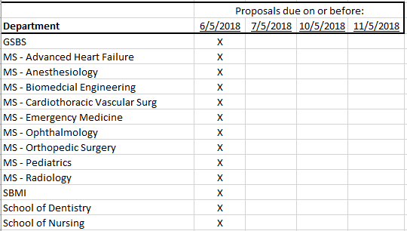
Transition Schedule
Notes:
Why aren’t we waiting? We will begin designing the new system in June. That design includes a lot of workflow development so we want to have our process in place so that we can
work on designing it correctly in the new system.

Slide 11
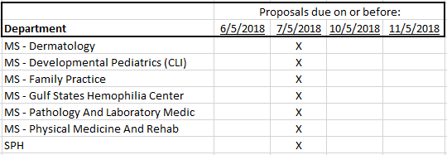
Transition Schedule

Slide 12
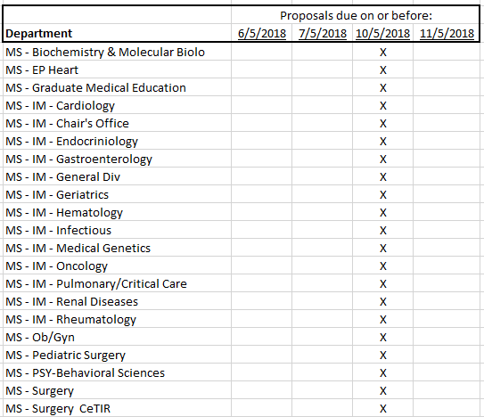
Transition Schedule

Slide 13
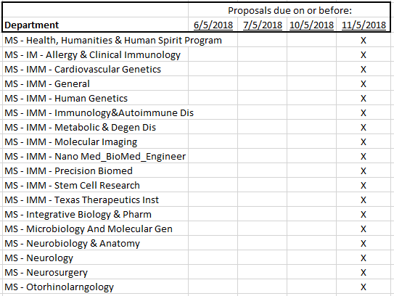
Transition Schedule

Slide 14
How you can prepare
Meet with your faculty to discuss upcoming submissions
Prioritize applications
Establish internal deadlines
Gather documentation early
Ask for HELP!

