Slide 1

LEADING YOUR PI TO SUCCESS:
Managing Research Projects from Proposal through Closeout

Slide 2
Goals of Today’s Session:
A Case Study for…
Setting yourself and your PI up for success…
From proposal through closeout….
And handling “sticky” situations along the way….

Slide 3
Proposal
Award
Manage and Report
Closeout
Notes:
Four-part teardrop graphic in perspective
(Advanced)
To reproduce the effects on this slide, do the following:
On the Home tab, in the Slides group, click Layout, and then click Blank.
On the Home tab, in the Drawing group, click Shapes, and then under Basic Shapes click Teardrop (second row, fourth option from the left). On the slide, drag to draw a teardrop shape.
Select the teardrop shape. Under Drawing Tools, on the Format tab, in the Size group, do the following:
In the Shape Height box, enter 2.45”.
In the Shape Width box, enter 2.45”.
On the Home tab, in the bottom right corner of the Drawing group, click the Format Shape dialog box launcher. In the Format Shape dialog box, click Fill in the left pane. In the Fill pane, select Solid fill, click the button next to Color, and then click White, Background 1, Darker 35% (fifth row, first option from the left).
Also in the Format Shape dialog box, click Line Color in the left pane, and then select No line in the Line Color pane.
Also in the Format Shape dialog box, click 3-D Format in the left pane, and then do the following in the 3-D Format pane:
Under Bevel, click the button next to Top, and then under Bevel click Circle (first row, first option from the left). Next to Top, in the Width box, enter 10 pt, and in the Height box, enter 10 pt. Click the button next to Bottom, and then under Bevel click Circle (first row, first option from the left). Next to Bottom, in the Width box, enter 10 pt, and in the Height box, enter 10 pt.
Under Surface, click the button next to Material, and then under Standard click Warm Matte (second option from the left). Click the button next to Lighting, and then under Neutral click Balance (first row, second option from the left).
Select the teardrop shape. Press and hold CTRL and SHIFT (to duplicate and constrain the duplicate shape to a perpendicular axis), and then drag the teardrop shape to the right on the slide to create a duplicate.
Select the duplicate teardrop shape. On the Home tab, in the Drawing group, click Arrange, point to Rotate, and then click Flip Horizontal.
Press and hold SHIFT and select both teardrop shapes.
Press and hold CTRL and SHIFT (to duplicate and constrain the duplicate shapes to a perpendicular axis), and then drag the teardrop shapes to the right on the slide to create two duplicate teardrop shapes.
Press and hold SHIFT and select the two new teardrop shapes. On the Home tab, in the Drawing group, click Arrange, point to Rotate, and then click Flip Vertical.
On the slide, drag the two new duplicate teardrop shapes directly above the original teardrop shapes.
Select the top left teardrop. Under Drawing Tools, on the Format tab, in the bottom right corner of the Size group, click the Size and Position dialog box launcher. In the Format Shape dialog box, click Position in the left pane, and in the right pane, under Position on slide, do the following:
In the Horizontal box, enter 2.5”.
In the Vertical box, enter 0.83”.
On the Home tab, in the Drawing group, click Shapes, and then under Basic Shapes click Oval (first row, second option). On the slide, drag to draw an oval.
Select the oval. Under Drawing Tools, on the Format tab, in the Size group, do the following:
In the Shape Height box, enter 2.11”.
In the Shape Width box, enter 2.11”.
Select the oval. Under Drawing Tools, on the Format tab, in the bottom right corner of the Size group, click the Size and Position dialog box launcher. In the Format Shape dialog box, click Position in the left pane, and in the right pane, under Position on slide, do the following:
In the Horizontal box, enter 2.67”.
In the Vertical box, enter 1”.
On the Home tab, in the Drawing group, click the arrow next to Shape Fill, and then under Theme Colors click Olive Green, Accent 3, Darker 25% (fifth row, seventh option from the left).
On the Home tab, in the Drawing group, click the arrow next to Shape Outline, and then click No Outline.
On the Home tab, in the Drawing group, click Shape Effects, point to Shadow, and then under Inner click Inside Diagonal Top Right (first row, third option from the left).
Right-click the oval and click Edit Text.
Enter text in the text box, select the text, and then on the Home tab, in the Font group, select Trebuchet MS from the Font list, select 28 from the Font Size list, click the button next to Font Color, and then under Theme Colors click White, Background 1, Darker 5% (second row, first option from the left).
On the Home tab, in the Paragraph group, click Center to center the text in the oval.
Select the top right teardrop shape. Under Drawing Tools, on the Format tab, in the bottom right corner of the Size group, click the Size and Position dialog box launcher. In the Format Shape dialog box, click Position in the left pane, and in the right pane, under Position on slide, do the following:
In the Horizontal box, enter 5.2”.
In the Vertical box, enter 0.83”.
Select the oval on the top left teardrop shape. Press and hold CTRL and SHIFT (to duplicate and constrain the duplicate shape to a perpendicular axis), and then drag the oval onto the top right teardrop shape to create a second oval.
Select the second oval. Under Drawing Tools, on the Format tab, in the bottom right corner of the Size group, click the Size and Position dialog box launcher. In the Format Shape dialog box, click Position in the left pane, and in the right pane, under Position on slide, do the following:
In the Horizontal box, enter 5.33”.
In the Vertical box, enter 1”.
On the Home tab, in the Drawing group, click the arrow next to Shape Fill, and then under Theme Colors click Purple, Accent 4, Darker 25% (fifth row, eighth option from the left).
Click the text in the second oval, and then edit as needed.
Select the bottom left teardrop shape. Under Drawing Tools, on the Format tab, in the bottom right corner of the Size group, click the Size and Position dialog box launcher. In the Format Shape dialog box, click Position in the left pane, and in the right pane, under Position on slide, do the following:
In the Horizontal box, enter 2.5”.
In the Vertical box, enter 3.53”.
Select the oval on the top left teardrop shape. Press and hold CTRL and SHIFT (to duplicate and constrain the duplicate shape to a perpendicular axis), and then drag the oval onto the bottom left teardrop shape to create a third oval.
Select the third oval. Under Drawing Tools, on the Format tab, in the bottom right corner of the Size group, click the Size and Position dialog box launcher. In the Format Shape dialog box, click Position in the left pane, and in the right pane, under Position on slide, do the following:
In the Horizontal box, enter 2.67”.
In the Vertical box, enter 3.7”.
On the Home tab, in the Drawing group, click the arrow next to Shape Fill, and then under Theme Colors click Blue, Accent 1 (first row, fifth option from the left).
Click the text in the third oval, and then edit as needed.
Select the bottom right teardrop shape. Under Drawing Tools, on the Format tab, in the bottom right corner of the Size group, click the Size and Position dialog box launcher. In the Format Shape dialog box, click Position in the left pane, and in the right pane, under Position on slide, do the following:
In the Horizontal box, enter 5.2”.
In the Vertical box, enter 3.53”.
Select the third oval on the bottom left teardrop shape. Press and hold CTRL and SHIFT (to duplicate and constrain the duplicate shape to a perpendicular axis), and then drag the oval onto the bottom right teardrop shape to create a fourth oval.
Select the fourth oval. Under Drawing Tools, on the Format tab, in the bottom right corner of the Size group, click the Size and Position dialog box launcher. In the Format Shape dialog box, click Position in the left pane, and in the right pane, under Position on slide, do the following:
In the Horizontal box, enter 5.33”.
In the Vertical box, enter 3.7”.
On the Home tab, in the Drawing group, click the arrow next to Shape Fill, and then under Theme Colors click Orange, Accent 6, Darker 50% (sixth row, 10th option from the left).
To edit the text in the fourth oval, right-click the oval and click Edit Text.
Press CTRL+A to select all of the shapes on the slide. On the Home tab, in the Drawing group, click Arrange, and then click Group.
On the Home tab, in the bottom right corner of the Drawing group, click the Format Shape dialog box launcher. In the Format Shape dialog box, click 3-D Rotation in the left pane, and then do the following in the 3-D Rotation pane:
Click the button next to Presets, and then under Perspective click Perspective Front (first row, first option from the left).
In the X box, enter 325°.
In the Y box, enter 325°.
In the Z box, enter 40°.
In the Perspective box, enter 40°.
Also in the Format Shape dialog box, click Shadow in the left pane. In the Shadow pane, click the button next to Presets, and then under Outer click Offset Center (second row, second option from the left).
To reproduce the background on this slide, do the following:
Right-click the slide background area, and then click Format Background. In the Format Background dialog box, click Fill in the left pane, select Gradient fill in the Fill pane, and then do the following:
In the Type list, select Linear.
Click the button next to Direction, and then click Linear Diagonal (first row, first option from the left).
In the Angle box, enter 45°.
Under Gradient stops, click Add gradient stop or Remove gradient stop until two stops appear in the slider.
Also under Gradient stops, customize the gradient stops that you added as follows:
Select the first stop in the slider, and then do the following:
In the Position box, enter 0%.
Click the button next to Color, and then under Theme Colors click White, Background 1 (first row, first option from the left).
Select the last stop in the slider, and then do the following:
In the Position box, enter 100%.
Click the button next to Color, and then under Theme Colors click White, Background 1, Darker 35% (fifth row, first option from the left).

Slide 4
Proposal

Slide 5
Getting Started:
Ask the right questions
  When is it due?
  Who is the sponsor?/RFA# or instructions
  Are there external collaborators?
  Are their human subjects?
  Who is the PI?
  What is the project?

Slide 6
The Case Study
We are preparing a multi-faceted NIH application:
Partnership between 3 institutions; 1 in Mexico
GMP at 4th institution added in year 3
Total budget is limited to $5 million (± $1 mil/yr).
Multi PI
Simple clinical study, 1 blood draw, 300 patients

Slide 7

Define Responsibilities
  PI
  Department
  OSR
  Anyone else?
Go Team!

Slide 8
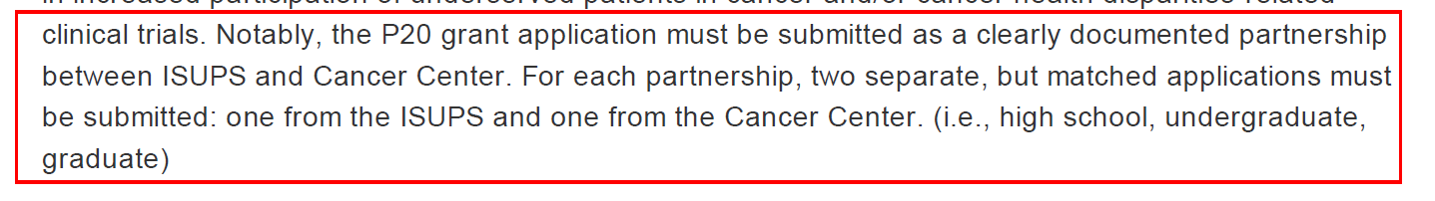
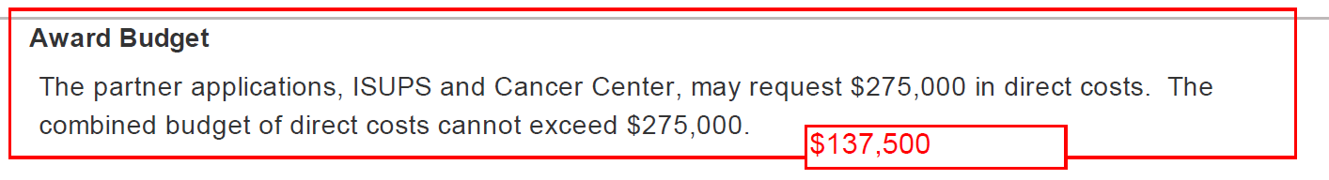
Arm yourself with Info and Q’s
Read the RFA/Instructions
- ID the usual and THE UNUSUAL
Know the budget limitations
Note your questions for the PI

Slide 9
Make a plan
Work backwards from due date
Fill in dept/non-science items first
Expand or contrast into the time available
  5 days, 5 weeks, or 5 months
  The shorter the time the more help you will need.
Set rules but be flexible
Long lead times first
  Sub documents, quotes, clinical pricing

Slide 10
Sample Timeline for Junior Faculty

Slide 11
Sample Timeline for Sr/Experienced PI Investigator

Slide 12
Get everyone on board
Create an email to PI
Outline who will do what with timeline
  Consider PI level and experience
  Be prepared to modify your template based on the RFA and the PI
Include your PI questions from the RFA
Decide level of assistance needed from OSR/others
Ask PI to agree to the plan

Slide 13
Create an email to PI
Hint: in the email subject, always state what you need. For example: URGENT: NIH Proposal - Info needed from you to proceed
Dear Dr. X
I have reviewed the RFA for your application due XX/XX/XXXX. Attached is a plan outlining what needs to be completed, by whom and by when so that we can meet the deadline. Please confirm that this plan is acceptable. In addition, please provide the following by XX/XX: (list your questions and immediate needs):
1. Collaborator name and contact info at [sub institution name]
2. Enrollment plan by site by year.
3. List of employees/Investigators who will work on project with project role and estimated effort.
I am scheduling a meeting for us on XX/XX/XXXX to discuss and finalize the budget and justification.
Happy to address any questions you may have about specific sections or the proposal preparation process.

Slide 14

Keep frustrations to a minimum all around
Develop a tool kit
  Templates of emails, budgets, forms
  Use your calendar/reminders/tasks
Work the plan
Touch base 1 week and 1 day before something is due.
Let the PI write
  Scheduled, targeted meetings/talks

Slide 15
Working with Subs
Be clear about what you need from your PI and what you need from the subs:
- Have you worked with them before?
Contact info?
Have the PI’s worked together before?
Budget Target?
Draft email template with specific list of required documents and due dates.
Foreign sites or smaller institutions may need additional assistance/guidance.

Slide 16
Working with Subs
Email to sub:
Dr. Smith has agreed to participate as a PI on Dr. Brown’s grant proposal that is due to NIH on XX/XX/XXXX. Please provide the following sub contract documents for Research University by XX/XX/XXXX:
Dr. Smith and Dr. Brown have agreed that Dr. Brown’s effort will be 20% for all years.
Project Title: | Drug Development and Precision Medicine Training: A UCR-CoH partnership
Program Announcement | P20 PAR-16-084 https://grants.nih.gov/grants/guide/pa-files/PAR-16-084.html
Project Period: | 09/01/2017-08/31/2021
Signed letter of intent to enter into a consortium (attached)
Complete attachment 3B (attached)
Detailed budget not to exceed $200,000 total per year
Biosketch for Dr. Brown and any other key personnel
Sr./Key Profile information (attached worksheet)

Slide 18
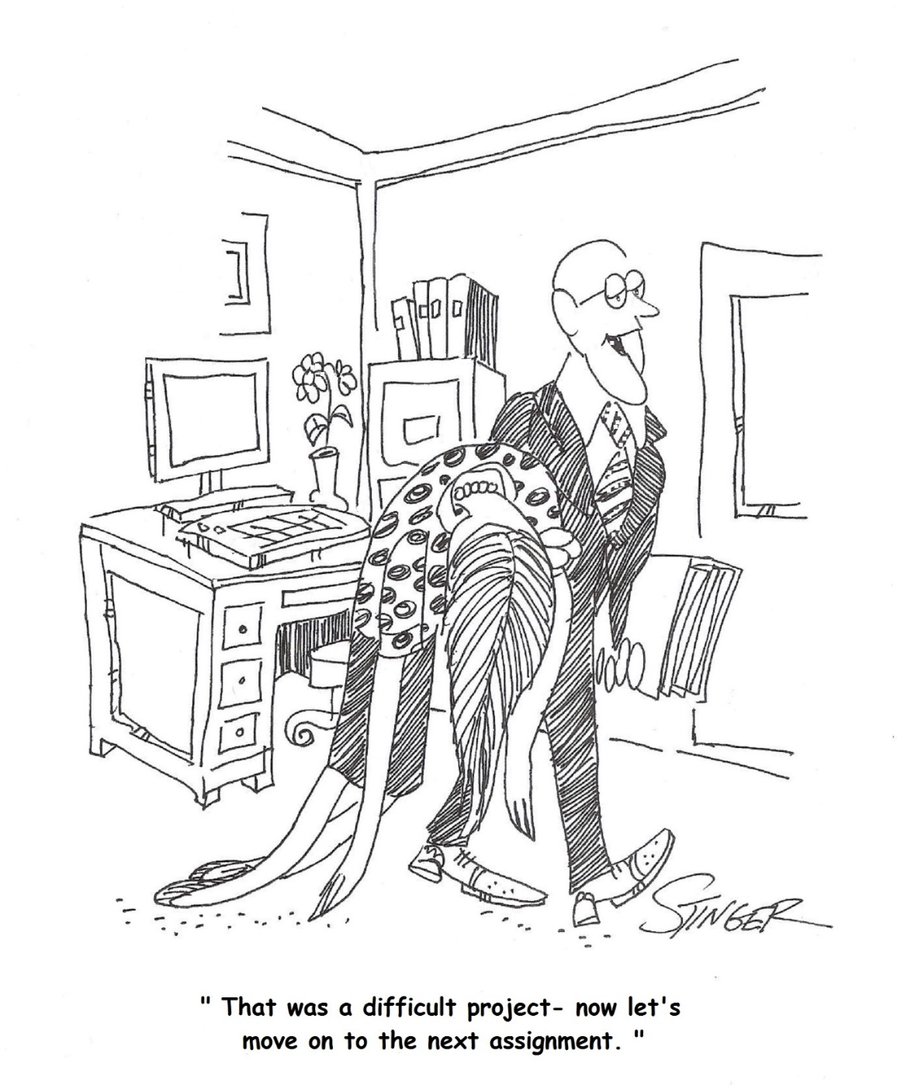
“Nice work Doris. I have another one
to submit in two weeks.”

Slide 19
Award

Slide 20


It’s here, It’s here!
Yippie! 4 months after submitting JIT documents, we receive the Notice of Award…
It has a 14% budget cut and requires quarterly reporting.

Slide 21
What races through your mind?
Need to revise the budget
    What do we cut?
    Are Specific Aims affected?
    Is enrollment affected?
    Is effort reduced for anyone?
  Sub-Awards
  - Strict schedule for reporting and invoicing
  - Risk level for Mexico

Slide 22
Helping yourself and your PI:
Offer budget options
Discuss with PI frequency for communicating with Subs
Set up reminders for yourself to contact subs for invoices/reports.
The telephone is an amazing tool.

Slide 23
Manage and Report

Slide 24
Preventative Maintenance:
Know your terms and conditions
Be Proactive
- Effort Distribution
- Reconcile and Analyze
- Check the burn rate
- Check in with your PI
Verify expenses are appropriate
When in doubt, ask for help

Slide 25
Manage the subs:
Make sure the PI’s know their responsibilities
Know how to identify an issue with a sub, more importantly who can help resolve?
    OSR, PI’s, legal?
    Find your administrative partner at the sub site.
Notes:
How many of you withhold the continuation amendment because you haven’t received an invoice?

Slide 26
Closeout

Slide 27
If you have been proactive and timely, closeout will be easy:
Start 60-90 days before end date
Again, contact subs that it is ending, invoices current
Plan where all your personnel are moving to before the last day
Clear outstanding obligations, encumbrances, blanket PO’s
Don’t order anything in the last month
Finalize the reconciliation
Make sure PI knows deadlines for final report and invention statement
Work closely with your grants accounting for FSR

Slide 28

Leading you and your PI to success:
Stick to the plan
Be proactive
Strong relationships with your sub partners
ID issues early
Then everyone
is happy.

