Slide 1

AURA
Assembly of University research administrators
September 13, 2022
Sponsored Projects Administration

Slide 2
AGENDA
New Staff Introductions Kathleen Kreidler
NIH Data Management and Sharing Policy Maria Garcia-Villarreal
Carmen Martinez
Child Care Costs on Training Grants Kathleen Kreidler
Expense Transfers and Deficit Clearing Loren Turner
Effort Reporting Tips and Reminders Kim Vanzant
  Hung Huynh

Slide 3
NEW STAFF INTRODUCTIONS

Slide 4
New staff introductions
  If this is your first AURA meeting:
  Unmute yourself, turn on your camera, and please tell us
  your name
  department
  role/title
  anything else you’d like to share

Slide 5
Nih Data Management & Sharing policy

Slide 6
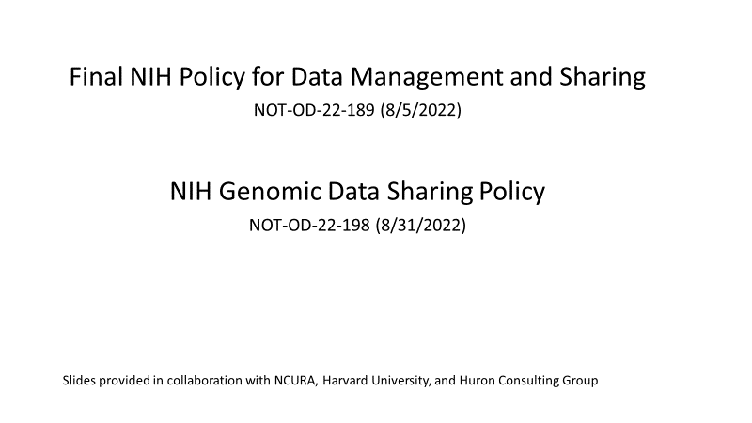
NIH Data management & Sharing policy

Slide 7
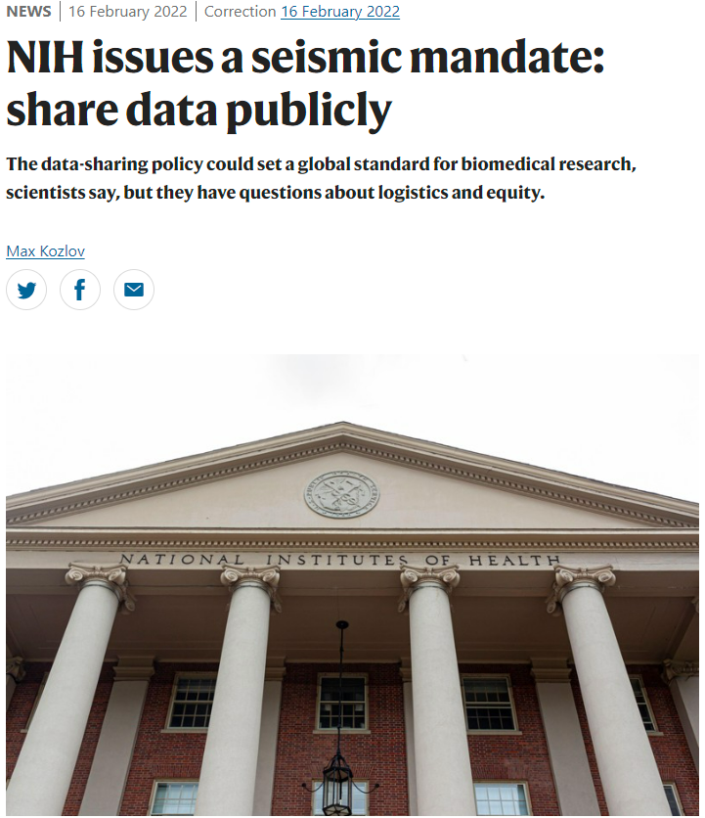
NIH Data Management and Sharing Policy
Rigor and Reproducibility
“The mandate, in part, aims to tackle the reproducibility crisis in scientific research.”
- NIH issues a seismic mandate: share data publicly, Max Kozlov, Nature, 16 February 2022
Notes:
In February, Nature published an article about the new policy. I encourage all of you to take the time to read it because it talks about the importance of reproducibility and the impact it can have in the lab, among personnel. One of the things it talks about is who is going to organize, curate and manage data. It will likely fall to researchers early in their career, taking time away from doing actual research.
More importantly for today, it also talks about an 8-year $2mm project to replicate some significant cancer research findings. Fewer than half of them were successful. Given that these were influential studies, it is not hard to imagine how that was taken.
This is not limited to the medical and life sciences.

Slide 8
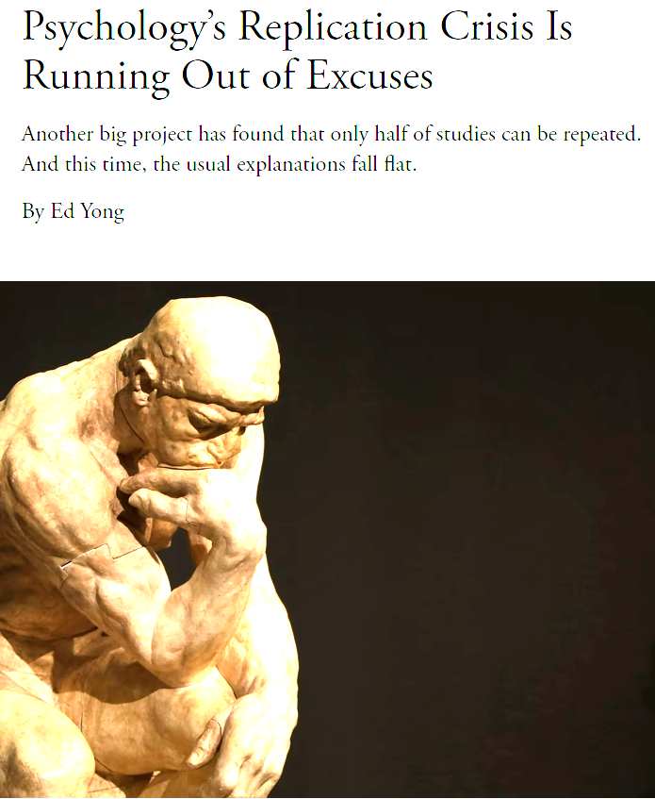
NIH Data Management and Sharing Policy
Rigor and Reproducibility
“One by one, researchers have tried to repeat the classic experiments behind these well-known effects—and failed.”
- Psychology’s Replication Crisis is Running Out of Excuses, Ed Yong,
The Atlantic,
November 19, 2018
Notes:
This second article, is one of the most cited along with the Nature article. (data on that?) As you can see from the title, it is about reproducibility in Psychology.
Similar to the Nature article, it involves an attempt to replicate significant or influential studies. What is different is that critics of the “reproducibility crisis” argued in that in psychology,
First, the replication attempts themselves might be too small. Second, the researchers involved might be incompetent, or lack the know-how to properly pull off the original experiments. Third, people vary, and two groups of scientists might end up with very different results if they do the same experiment on two different groups of volunteers. The studies used to attempt to replicate the findings, addressed all of these criticisms in their design.

Slide 9
NIH Data Management and Sharing Policy
Overview
2023 Data Management and Sharing Policy
Purpose
“making the results and outputs of NIH-funded research available to the public through effective and efficient data management and data sharing practices.”
Application
“applies to all research, funded or conducted in whole or in part by NIH, that results in the generation of scientific data”
Proposal/Plan
“required to submit a Plan to the funding NIH ICO” as part of the proposal – varied by funding instrument – and “should explain how scientific data generated by research projects will be managed and which of these scientific data and accompanying metadata will be shared.”
Enforcement
“non-compliance with the NIH ICO-approved Plan may be taken into account by NIH for future funding decisions for the recipient institution”
Source: NIH NOT-OD-21-103
Notes:
The purposes of the 2003, 2015 and 2017 policies all hinged on the expectation of making data available or promoting “responsible dissemination.”
PURPOSE: The 2023 policy drops the expectations and simply states it is about making data available to the public.
APPLICATION: If you compared the 2003 and 2023 policies only, it looks like a big shift from only projects with $500,000 in a single year to all projects that will generate scientific data. (The policy defines “scientific data” as data of “sufficient quality to validate and replicate research findings.”) But when compared to the 2015 Genomic Data Sharing Policy and 2017 Policy on the Dissemination of Clinical Trial Information, you can see that it is following a predictable arc. The culture shift then is applying this standard to all NIH funded projects instead of those discrete programs.
PROPOSA/PLAN: In the prior policies the directions were to contact the IC for further instructions or to discuss the dissemination plan. The directions for plans submitted in January and after are much more specific in that they “should explain how scientific data be managed.” By putting this in the policy it sets a minimum criteria for all IC’s that data plans should cover how data will be managed and which metadata will be shared.
ENFORCEMENT: This represents a major shift for institutions. In prior policies, enforcement, if there was any, would be applied to the project by withholding funding or terminating it altogether. That is to say, the PI was responsible for plan compliance and would suffer any consequences. After January, the PI’s failure to comply with plan could affect future funding decisions for the institution and other by extension, other researchers.

Slide 10
NIH Data Management and Sharing Policy
Overview
2023 Data Management and Sharing Policy
Specifically, the new policy is effective for…
Competing Grant Applications submitted for
Jan 25, 2023, receipt dates
Proposals for Contracts submitted to NIH on or after Jan 25, 2023
NIH Intramural Research Projects conducted on or after Jan 25, 2023
Other Funding Agreements that are executed on or after Jan 25, 2023
Source: NIH NOT-OD-21-013
Notes:
What is meant by “effective” depends on the type of funding instrument and project. The details matter.

Slide 11
NIH Data Management and Sharing Policy
Overview
2023 Data Management and Sharing Policy
Potential Issues
Identifying which proposals need a Plan
Proprietary Data
Submission of Plan
Sharing Timeline
Monitoring &
Enforcement
Notes:
Identifying which proposals require a DMS plan
“The DMS Policy does not apply to research and other activities that do not generate scientific data, including training, infrastructure development, and non-research activities.” DMS Section 3 – Scope.
Is administrative personnel capable of making this determination? Can a business process/system solution protect the institution? These are unknown. One possible preventive step is to work with data librarian/IT AND start identifying list of PIs who will or are likely to generate scientific data.
Addressing proprietary data in the application
NIH acknowledges some data may be proprietary (e.g, SBIR, STTR, pharma, etc.) and needs to be addressed. NIH Scientific Data Sharing site.
Submission of plans.
Expect NIH to update forms and system requirements.
UPDATE: New Aug 8, 2022: NIH “FORMS-H” Grants Applications Forms and Instructions Coming for Due Dates on or after January 25, 2023 (https://grants.nih.gov/grants/guide/notice-files/NOT-OD-22-195.html).
Sharing timeline
Data is to be shared at time of publication or by end of the award for unpublished data, whichever comes first. Policy does not set a minimum timeline for how long data should remain available, however other sources set minimums and NIH expects recipients to follow those (e.g., repositories).
Monitoring awards with reportable scientific data
Reporting frequency and timing is done on an award-by-award basis and will be addressed in the terms and conditions for extramural award and contract. Intramural awards and other agreements will follow NIH policies. DMS Section VIII – Compliance and Enforcement
Generally, expect reporting to be during the normal reporting cycle/frequency or sooner.
Institutional enforcement of PIs reporting scientific data
“After the end of the funding period, non-compliance with the NIH ICO-approved Plan may be taken into account by NIH for future funding decisions for the recipient institution” DMS Section VIII – Compliance and Enforcement

Slide 12
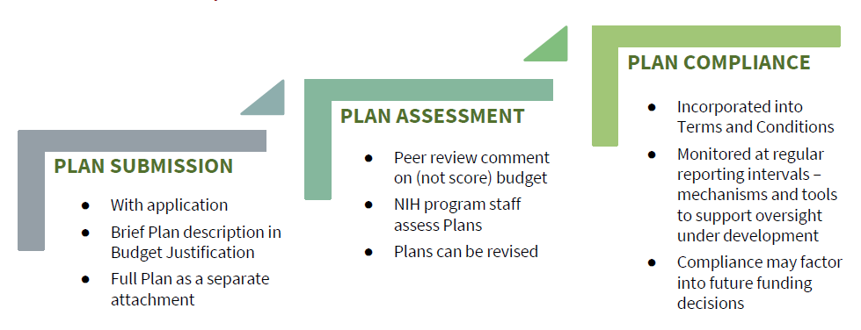
NIH Data Management and Sharing Policy
DMS Plan Elements
Submission and Review
Source: Sept 2021 NIH Office of Science FDP presentation
Notes:
Include the full plan, incorporating details as then known, at proposal application. A brief description should also be included within the Budget Justification. NIH reviewers will assess and comment on the plan as part of the proposal review process; the plan may need to be revised based on the NIH’s review.
At award, the final, agreed upon plan is incorporated into the award terms and conditions and compliance monitored throughout the life of the project. Agency-level oversight mechanisms remain under development but are likely to include review as part of the RPPR process/other periodic assessments. NIH has emphasized that failure to comply with the final plan as memorialized in the award could result in enforcement actions, and that non-compliance may affect future funding decisions.

Slide 13
NIH Data Management and Sharing Policy
Assessing Allowable Costs
Categories of Reasonable, Allowable Costs
Curating data and developing supporting documentation
Local data management considerations
Preserving and sharing data through established repositories
Source: NIH NOT-OD-21-015
Notes:
UPDATE: New Aug 8, 2022: Implementation Details for the NIH Data Management and Sharing Policy
(https://grants.nih.gov/grants/guide/notice-files/NOT-OD-22-189.html)
“A brief summary of the DMS Plan and a description of the requested Data Management and Sharing Costs must be included within the budget justification attachment, with details on what information to include incorporated into the NIH Application Form Instructions by Fall 2022; refer to NIH Grants Policy Statement Section 7.1 Cost Considerations for additional guidance on determining appropriate costs:
o R&R Budget Form: embedded within the section L. Budget Justification attachment
o PHS 398 Modular Budget Form: embedded within the Additional Narrative Justification”
GPS Section 7.1: https://grants.nih.gov/grants/policy/nihgps/html5/section_7/7.1_general.htm

Slide 14
NIH Data Management and Sharing Policy
Assessing Allowable Costs
Unallowable Costs
Collecting Research Data
Accessing Research Data
Costs inconsistently charged as DC or IDC, or doubled-charged
Source: NIH NOT-OD-21-015
Notes:
Collecting and Accessing data is inherent to scientific inquiry.
Costs should be charged consistently as direct or indirect, and cannot be comingled or otherwise double-charged.
Do not forget costs must also be reasonable and allocable.

Slide 15
NIH Data Management and Sharing Policy
Resources
NIH
Relevant notices (NOT-OD-21-013, NOT-OD-21-014, NOT-OD-21-015, NOT-OD-21-016)
NIH Office of Science Policy FAQs
NIH Office of Science Policy website on Scientific Data Sharing: https://sharing.nih.gov
Professional Community
AAU/APLU: Guide to Accelerate Public Access to Research Data
COGR/ARL: NIH Data Management and Sharing Readiness Guide
Wilkenson, et al. (Nature): The FAIR Guiding Principles for scientific data management and stewardship
Notes:
NIH:
series of notices
FAQs to be regularly updated by the Office of Science Policy.
OSP’s new Scientific Data Sharing website, which includes presentations/slides relevant to the new policy.
New forms package
Upcoming Webinars – 8/11 and another in September
COGR/ARL – DMSP Readiness Guide

Slide 16
NIH Data Management and Sharing Policy
Resources
Institution-specific templates
Onboarding/offboarding checklists
DUA resources
Storage and security tools
Electronic lab notebook (ELN) resources
Metadata guides
Repository resources
FAQs
Institutional Resources
Notes:
Materials to consider making available include:
Institution specific templates – annotated to provide clarifications or highlight intersections w/institutional policy
Onboarding/offboarding checklists – help establish SOPs and provide an onboarding tool
DUA resources – provide guidance on when a DUA may be needed, and considerations when obtaining data for use under an NIH project
Storage and security tools – consider aligning DSLs with available storage solutions/platforms
ELN resources – can assist researchers in documenting and organizing their data
Metadata guides – outline common metadata schemes and standards by discipline
Repository resources – consider developing a list of institution-recommended repositories or linking to existing online directories such as re3data.org.
FAQs – maintain a list of institution specific FAQs that supplement the NIH version
As a parallel, consider whether there are forums or existing websites into which these resources can be integrated. Having a ‘one stop shop’ can help, however incrementally, combat some of the information fatigue.

Slide 17
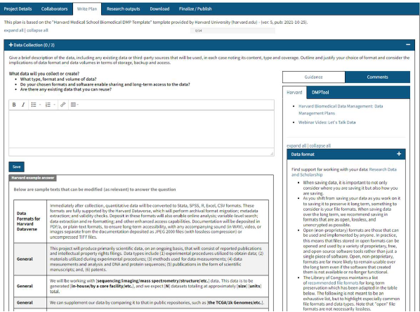

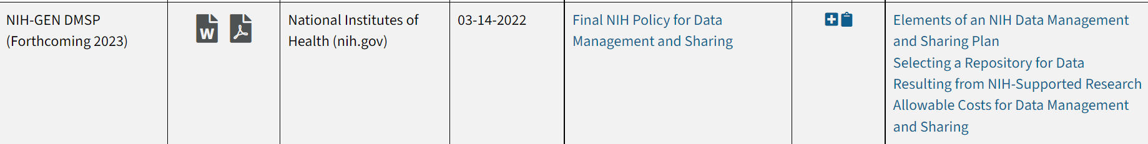
NIH Data Management and Sharing Policy
Resources
DMP Tool
A free tool to create data management plans that fulfill the requirements of different funders
Notes:
DMPTool is a publicly available (free) resource.
DMPTool.org

Slide 18
Implementation of Changes for Genomic Data Sharing Policy
Overview
2023 NIH Genomic Data Sharing Policy
Purpose
“In an effort to reduce the burden of duplicative reporting expectations, NIH is information the research community of its intent to establish a single Plan requirement for both the NIH Genomic Data Sharing and the Data Management and Sharing”
Application
“applies to all applications submitted to NIH requesting support for research subject to the GDS Policy beginning with receipt dates on or after January 25,2023”
Proposal/Plan
“applicants should complete the DMS Plan anticipating sharing according the the criteria of the Institutional Certification. Institutional Certifications are expected for human genomic data subject to the GDS Policy and or Genomic Summary Results (GSR)”
Enforcement
“GDS Plans will no longer be reviewed by peer reviewers. NIH Program Staff will assess the adequacy of the DMS Plans. Compliance and Enforcement will be handled in accordance with the terms in the DMS Policy ”
Source: NIH NOT-OD-21-103
Notes:
The purposes of the 2003, 2015 and 2017 policies all hinged on the expectation of making data available or promoting “responsible dissemination.”
PURPOSE: The 2023 policy drops the expectations and simply states it is about making data available to the public.
APPLICATION: If you compared the 2003 and 2023 policies only, it looks like a big shift from only projects with $500,000 in a single year to all projects that will generate scientific data. (The policy defines “scientific data” as data of “sufficient quality to validate and replicate research findings.”) But when compared to the 2015 Genomic Data Sharing Policy and 2017 Policy on the Dissemination of Clinical Trial Information, you can see that it is following a predictable arc. The culture shift then is applying this standard to all NIH funded projects instead of those discrete programs.
PROPOSA/PLAN: In the prior policies the directions were to contact the IC for further instructions or to discuss the dissemination plan. The directions for plans submitted in January and after are much more specific in that they “should explain how scientific data be managed.” By putting this in the policy it sets a minimum criteria for all IC’s that data plans should cover how data will be managed and which metadata will be shared.
ENFORCEMENT: This represents a major shift for institutions. In prior policies, enforcement, if there was any, would be applied to the project by withholding funding or terminating it altogether. That is to say, the PI was responsible for plan compliance and would suffer any consequences. After January, the PI’s failure to comply with plan could affect future funding decisions for the institution and other by extension, other researchers.

Slide 19
New Application Requirements
“Resource Sharing Plans” no longer uploaded in applications.
New “Other Plans” field will be added to the FORMS-H package to allow for DMS document.
DMS document has a 2-page limit.
NIH has a “Data Management and Sharing Plan” template as a guide.
Requested Direct Costs should be included in the budget as “Data Management and Sharing Plan” costs in the “Other Direct Costs” section of the SF424.
Description of requested costs AND summary of DMS plan should be included in Budget Justification.
NIH will release further instructions in Fall 2022. SPA will include any templates/links on our website.

Slide 20
Child care costs on training grants

Slide 21
NIH child care reimbursement
  NIH is providing $2,500 per trainee per year for all NRSA (T32, TL1, and Individual Fellowships) awards:
  Restricted – use it or lose it. Cannot be rebudgeted
  Please help by notifying current trainees of their eligibility
  Notice includes all the rules and how to request funds in proposals
  https://grants.nih.gov/grants/guide/notice-files/NOT-OD-21-074.html

Slide 22
NIH child care reimbursement
  NIH is providing $2,500 per trainee per grant year for all NRSA (T32, TL1, and Individual Fellowships) awards:
  Restricted – use it or lose it. Cannot be rebudgeted
  Please help by notifying current trainees of their eligibility
  Taxable income for trainees
  Notice includes all the rules and how to request funds in proposals
  https://grants.nih.gov/grants/guide/notice-files/NOT-OD-21-074.html

Slide 23
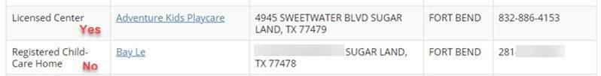
NIH child care reimbursement
  Reimbursement to Trainee:
  Submit expense to ERT & Disbursements via Coupa
    Proof of payment
    Proof of Licensed Child Care Center
      https://www.dfps.state.tx.us/Child_Care/Search_Texas_Child_Care/ppFacilitySearchDayCare.asp

Slide 24
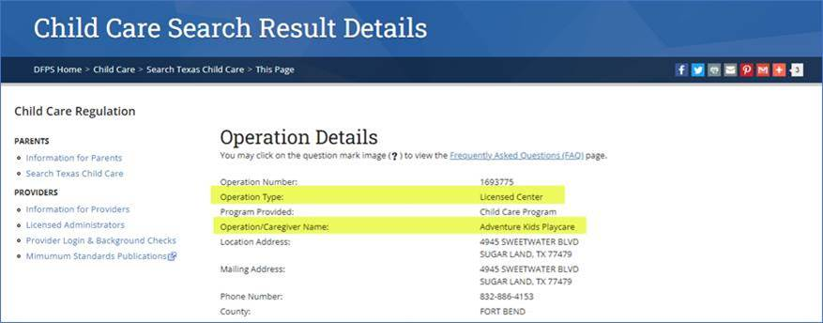
NIH child care reimbursement
Printout from Texas’s website will suffice as proof of Licensed Childcare

Slide 25
NIH child care reimbursement
  Behind the scenes:
  ERT will insert PAF into the Coupa workflow for approval.
  PAF is tracking expenditures to esure $2,500/yr per trainee is not exceeded.
  ERT will transfer expense information to SDR to process as additional income. This is taxable income to the trainee.

Slide 26
Expense transfers and deficit clearing

Slide 27
Deficit Clearing and Closeouts
  Timely financial statements/invoices and deficit clearing are required:
  Transfers/corrections needed up to $100
  PAF will just process
  send an email to the department contact/DMO/PI stating what was cleared
  to:
    PI’s contract residual or, if funds are not available, to
    Department’s IDC account

Slide 28
Deficit Clearing and Closeouts
Transfers/corrections needed $101 - $5,000
1st email to department contact/DMO/PI – request CFS, CTM or other resolution
2nd email to department contact/DMO/PI (one week later) - Indicating how PAF will process (contract residual or Dept IDC) if no response within one week.
3rd email to department contact/DMO/PI (one week after 2nd email) - Indicating how PAF cleared the project and that the expense cannot be moved back onto a sponsored project.

Slide 29
Deficit Clearing and Closeouts
Transfers/corrections needed > $5,000
1st email to department contact/DMO/PI – request CFS, CTM or other resolution
2nd email to department contact/DMO/PI/Mike Tramonte (two weeks later) - Indicating how PAF will process (contract residual or Dept IDC) if no response within two weeks.
3rd email to department contact/DMO/PI/Mike Tramonte (two weeks after 2nd email) - Indicating how PAF cleared the project and that the expense cannot be moved back onto a sponsored project.

Slide 30
Deficit Clearing and Closeouts
Transfer expenses from old to new project # of same grant award
Must be same grant award or same contract
Transfer via Journal Entry. No CTM needed.
Journal entry does not get loaded to ECC but PAF adds a note to each effort report stating “Sal expenses were transferred to the new project # (include the new number)”
No CTM is needed to transfer expenses between expense accounts on same project

Slide 31
Effort reporting – tips and reminders

Slide 32
Effort Time line
            SPA Effort Team is currently preparing the system:
              Confirming Automatic Email language and timing
              Data load Validation
              InfoEd preparing Effort Commitment extract
SPA Effort Team
August 31, 2022
September 7, 2022
Process & Reconcile Effort Statements *
Period of Performance ends
Final Payroll loads to ECC
Pre-Review Period Opens
Effort Period Opens
Review and Prepare Effort Statements
Effort Coordinators
Certify Effort & Project Statements
Primary Individuals

Slide 33

How does the retro process impact Effort
  When are CTMs posted to ECC?
  CTMs go through the following steps before posting to ECC:
  Ensure your department’s financial staff have submitted a PASS form
Department submits CTM to PAF
PAF approves CTM then notifies the Department
Department submits PASS form in PeopleSoft HCM
PAF approves PASS form in PeopleSoft HCM
SDR Team processes Retro PASS forms once a month
Retro transactions load to ECC

Slide 34
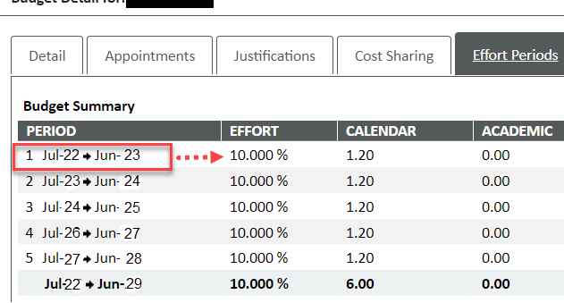
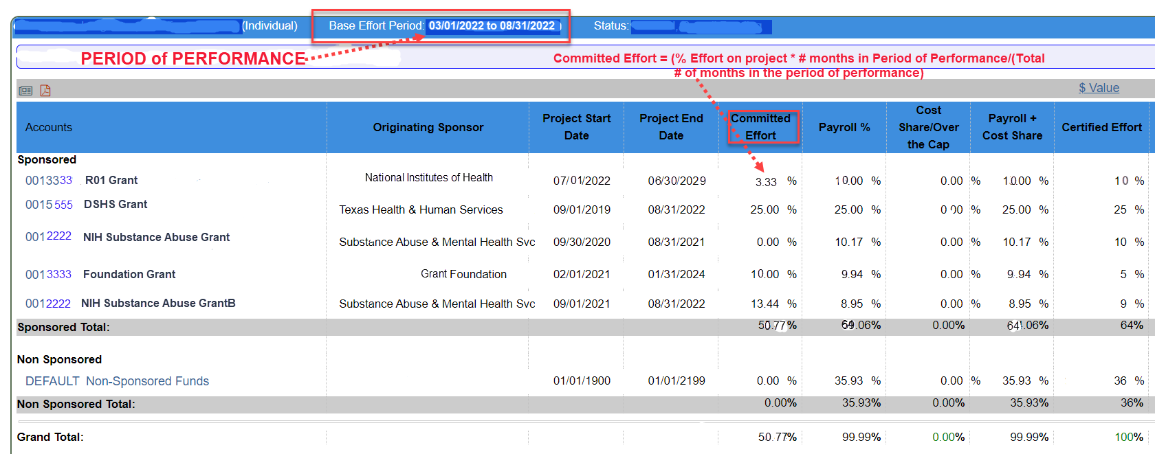
Effort Commitment
Common Questions/Concerns
  Common Questions/Concerns
  Pay attention to overlapping budget dates….see example below
My effort commitment on NIH Grant is supposed to be 10% so why is it 3.33%?
  Effort Commitment is 10% on NIH Grant (0013333) but in ECC it is 3.33%. ECC calculates the 10% over the Period of Performance based on when the Projects begins.
  EFFORT as it appears in START COMMITTED EFFORT as it appears in ECC

Slide 35
Committed effort vs certified effort
Common Questions/Concerns
START is the system of record for Effort Commitment
Effort Commitment is to be used as reference in ECC but does NOT drive other columns in ECC
ECC pre-populates the Certified Effort column based on Payroll + Cost Share NOT Committed Effort
Contact effort@uth.tmc.edu when the Committed Effort:
  Committed effort is 0%
  Project is not listed on the statement
    Has the project been setup? Is there a Chartfield String in FMS?
    Was the individual paid on the Project?
  Is captured on the wrong project
    Split Account – NOTE: If the project was initially awarded in START but split to several projects in FMS, ECC will still list Effort Commitment on the initial project not the Split projects. In most cases, payroll will be on the split project along with the corresponding Certified Effort column. The initial and Split projects will still be treated as the same award.

Slide 36
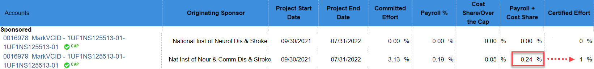
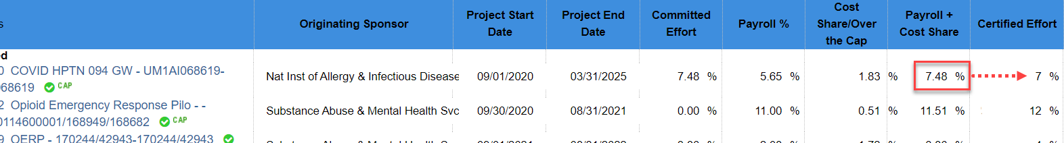
ROUNDING & Salary cap
ALL PRIMARY INDIVIDUALS paid over the CAP should be reviewed/updated during PRE-REVIEW
WATCH ROUNDING FOR INDIVIDUALS OVER THE CAP
  ECC rounds up the Certified Effort column to 1% when the Payroll + Cost Share values fall between 0.00% to 0.49%
  All other rounding follows standard Math Rules

Slide 37
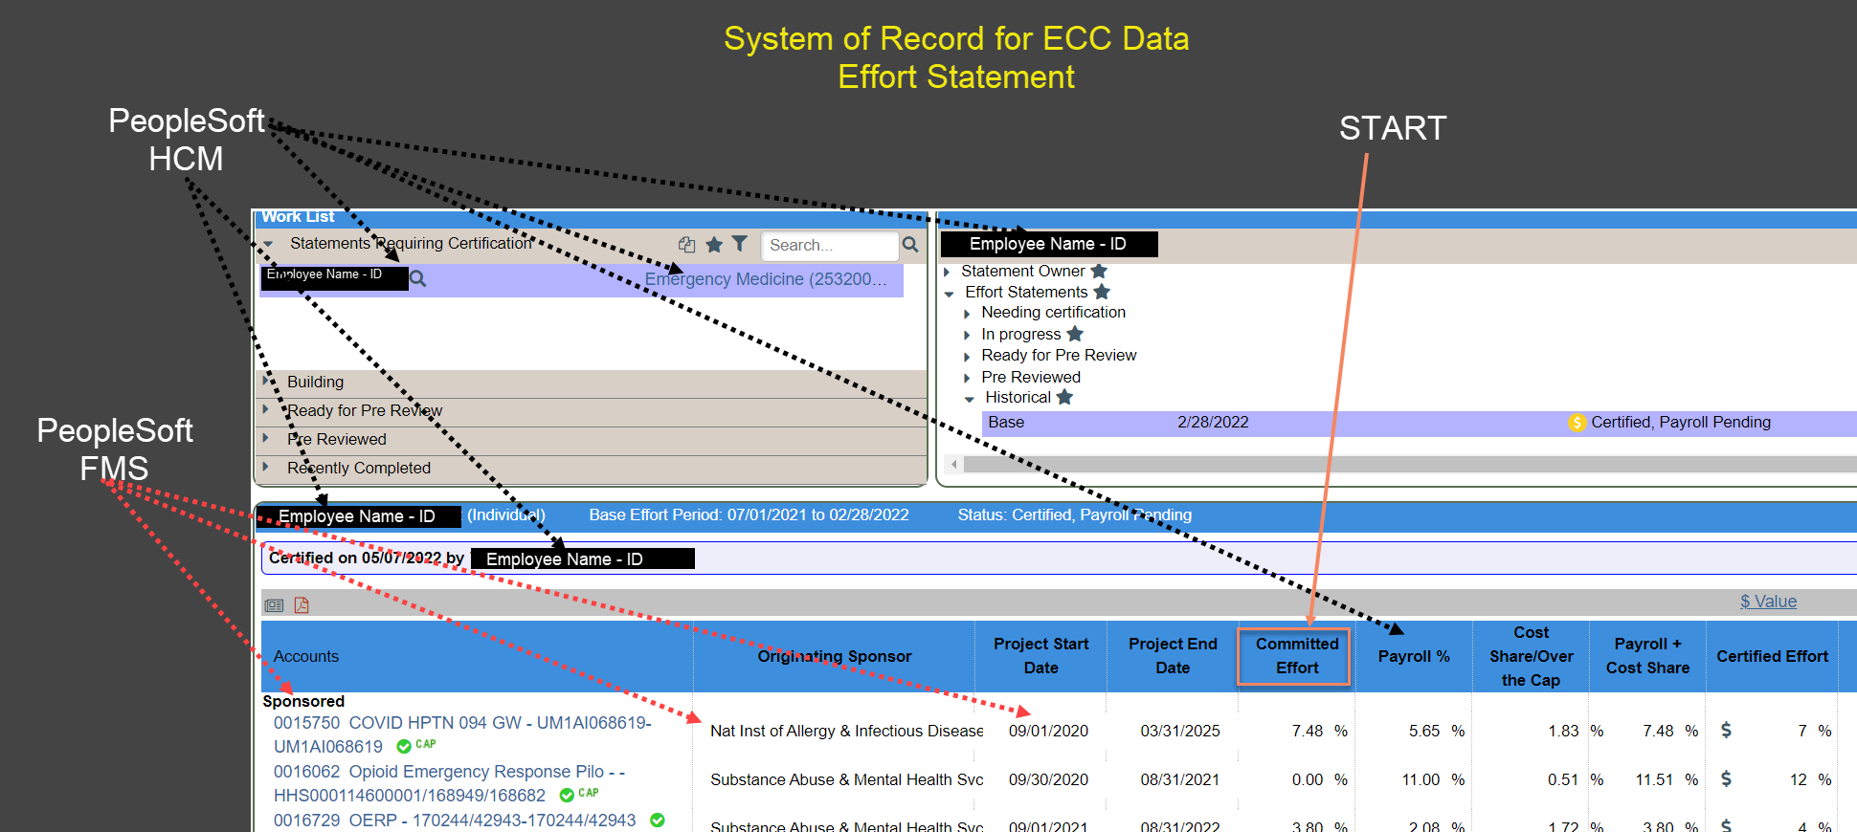
MISSING PERSONNEL & Other Data ISSUES

Slide 38
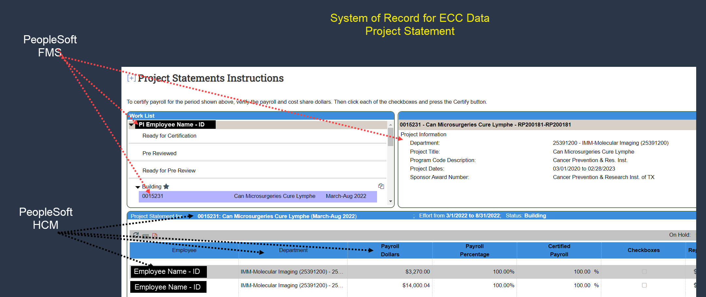
MISSING PERSONNEL & Other Data ISSUES

Slide 39
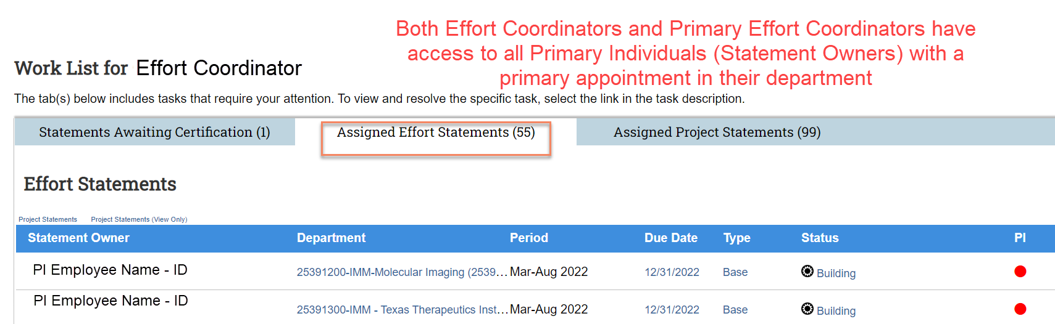
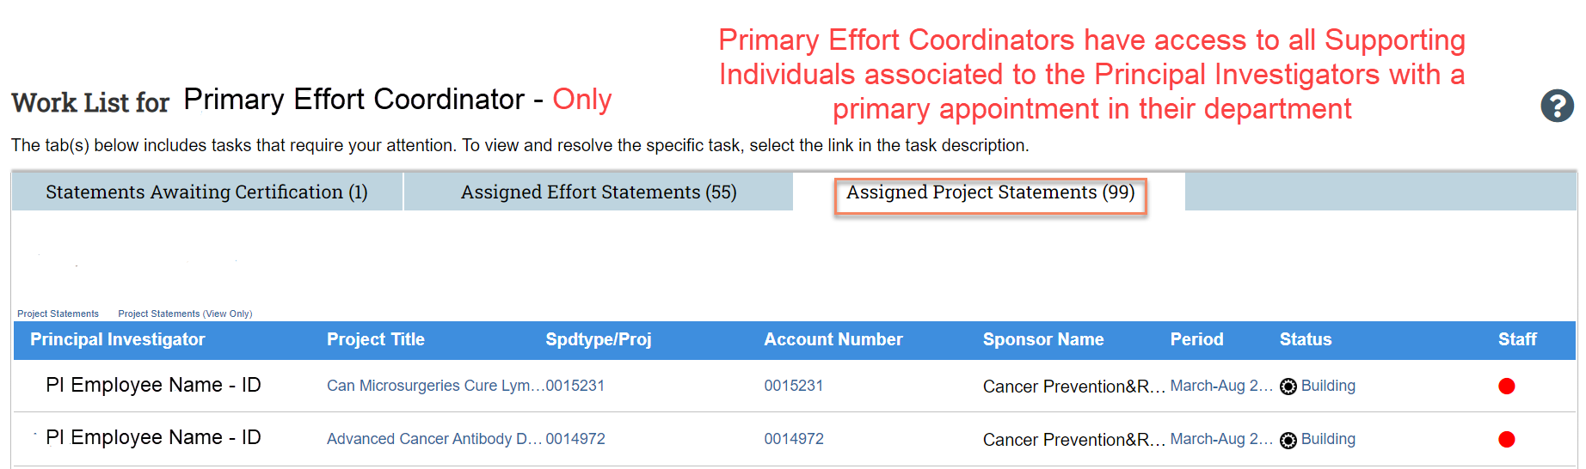
MISSING PERSONNEL & Other Data ISSUES
Issues with your Work List
Why are there missing employees on my Assigned Effort Statements work list?
  Is my User Profile setup correctly in ECC
  Do I have access to all the correct departments
Why are there missing employees on my Assigned
Project Statements work list?
  Have all supporting individuals been funded to my PIs projects (i.e. PASS Forms)
Notes:
Add copy of the email

Slide 40
FUNDING & retro process impact on Effort
  The Deadline to submit Retro-active PASS Forms (CTMs) to adjust FY22 individual funding has ENDED!!!!! FY22 has closed!

Slide 41
FUNDING & retro process impact on Effort
  When are CTMs posted to ECC?
  CTMs go through the following steps before posting to ECC:
  Ensure your department’s financial staff have submitted a PASS form
Department submits CTM to PAF
PAF approves CTM then notifies the Department
Department submits PASS form in PeopleSoft HCM
PAF approves PASS form in PeopleSoft HCM
SDR Team processes Retro PASS forms once a month
Retro transactions load to ECC

Slide 42
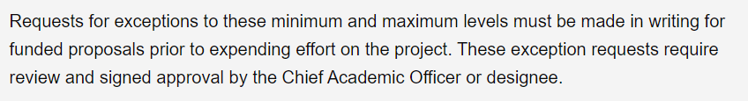
Hoop policy 93 – EFFORT COMMITMENT WAIVER (DRAFT)
Per HOOP Policy 93, prior approval for waivers in the minimum and maximum levels of Effort Commitment are to be made before effort on the project has been expended.
Effort Commitment Waiver Form (draft)

Slide 43
Q & A

