Slide 1
AURA
May 1, 2019

Slide 2
Agenda
Introductions
Grant and Contract Management System Update
IRB & Start Up fees – New Invoicing Process
Re-examining Other Support Document requirements

Slide 3
Grant and Contract Management System Update
Valerie Bomben
Supervisor, Specialized & Collaborative Research Agreements
Training and Communications Subgroup

Slide 4
IRB and Start Up Fees:
New Invoicing Process
Kristin Parks
Director, Clinical Research Finance & Administration

Slide 5
Clinical Trial Fee Invoicing
SPA and EVP reviewed IRB and Start Up fee invoicing practices for clinical trials to:
  Address PI concerns of delayed revenue that impacts ability to conduct study
  Ensure proper and timely billing and revenue allocation between study and IRB
  Reduce administrative burden on CPHS and departments
  Reconfirm that CPHS is a service center. When the service is used, the PI/department is responsible for the associated fee.

Slide 6
Current State:
IRB fees have been invoiced centrally since 2015
If payment is identified as solely an IRB fee payment, it is deposited directly into CPHS service center account
    Individual projects are not credited for the revenue
    Indirect costs associated with the IRB fee revenue are not being captured in IDC allocation back to the schools/departments
      $2,600 IRB fee = $2,000 IRB fee + $600 Indirects
      $1,300 IRB fee = $1,000 IRB fee + $300 Indirects

Slide 7
Current State: (Continued)
IRB fee payments
If payment is mingled with start up/clinical payments, it is deposited into the study project.
    CHPS financial manager talks with department to confirm IRB fee has been received Then charges the study project for either :
      The full amount, including the indirect cost portion.
      The full amount, minus the indirect cost portion
        Time consuming for CPHS as well as Departmental staff ( a large % of billing manager’s time is spent on this activity alone)
          Many departments do not have infrastructure/defined processes to track work completed for ISCTs for the purpose of reconciling data with payments
          Staff turnover allows for breakdown in process and improper revenue/fee allocation

Slide 8
Proposed Changes – Effective 7/1/19
1. All IRB fee payments will be deposited directly to the study project
  IRB fees will continue to be billed by CPHS upon execution of agreement
  SPA will provide signed agreement to CPHS
  Revenue is recognized for each study project
  Associated IDC will be properly allocated to school/department
  CPHS will charge (via journal entry) the IRB’s portion of the fee to the study project 120 days after the invoice is sent to the sponsor
    Fee will post regardless of available funds
Notes:
Ensures credit is given for revenue and IDC earned for each PI, for each departments.

Slide 9
Proposed Changes – Effective 7/1/19
3. CPHS will invoice study start-up fees upon execution of the agreement
  Centralizes and expedites invoicing (eliminates missed/late invoicing)
  Removes burden from department/study team
  Creates a trackable receivable for easy identification when payment is received
  Revenue will be deposited to study project
Notes:
Decrease workload for departmental financial staff/study teams
Increase knowledge level of the staff responsible for invoicing startup
Understands process
Invoices out of PeopleSoft /InfoED
Decrease missed invoicing due to:
Departmental staff turn over
Lack of infrastructure/internal processes to communicate study activity completion to the staff responsible for invoicing.

Slide 10
CPHS Responsibilities
Timely invoicing of IRB and start-up fees in accordance with signed agreement
Copy study coordinator and department financial contact on all invoices emailed to sponsors
Processing monthly journal entry to charge IRB fees to study project
Maintain Accounts Receivable/Aging reports
Notes:
Note- If having issues receiving payments for services rendered, contact SPA/CRF

Slide 11
Department Responsibilities
Ensuring contracted budget includes all start-up, administrative fees and IRB fees
Reconciling payments from sponsor to ensure they are paid for all services rendered
Resolving study deficits (resulting from over-expenditure/lost revenue)
Notes:
Note- If having issues receiving payments for services rendered, contact SPA/CRF

Slide 12
Communication Plan
CHPS SOP updates to reflect changes
Email communications
  AURA list serve
  CPHS Researcher list serve
  Website changes
    CPHS website
    SPA web site

Slide 13
Re-examining Other Support Document Requirements
Kathleen Kreidler
Assoc. Vice President
Sponsored Projects Administration

Slide 14
What do the rules say?
Other Support includes all financial resources, whether Federal, non-Federal, commercial or institutional, available in direct support of an individual's research endeavors, including but not limited to research grants, cooperative agreements, contracts, and/or institutional awards. Training awards, prizes, or gifts do not need to be included.

Slide 15
Why?
to ensure there is no scientific, budgetary, or commitment overlap

Slide 16
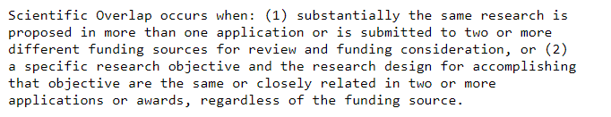
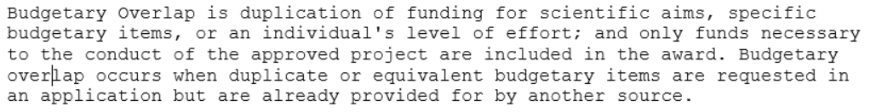
Why?

Slide 17
What’s New?
Increased attention on activities with foreign entities.

Slide 18
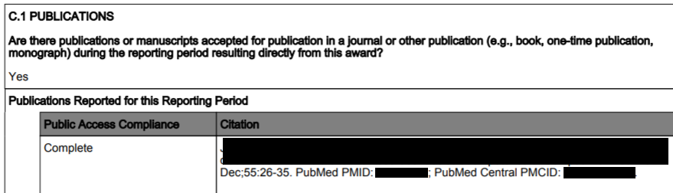
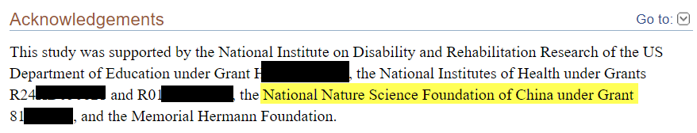
How does NIH know there is foreign grant support?

Slide 19
What does NIH do with this information?
Sends a letter to Grantee Institution asking for review and response.
Places responsibility on Grantee Institution to ensure Other Support documents are correct when submitted.
Notes:
How many of our faculty members have listed foreign grants on their other support documents in the past year? Zero

Slide 20
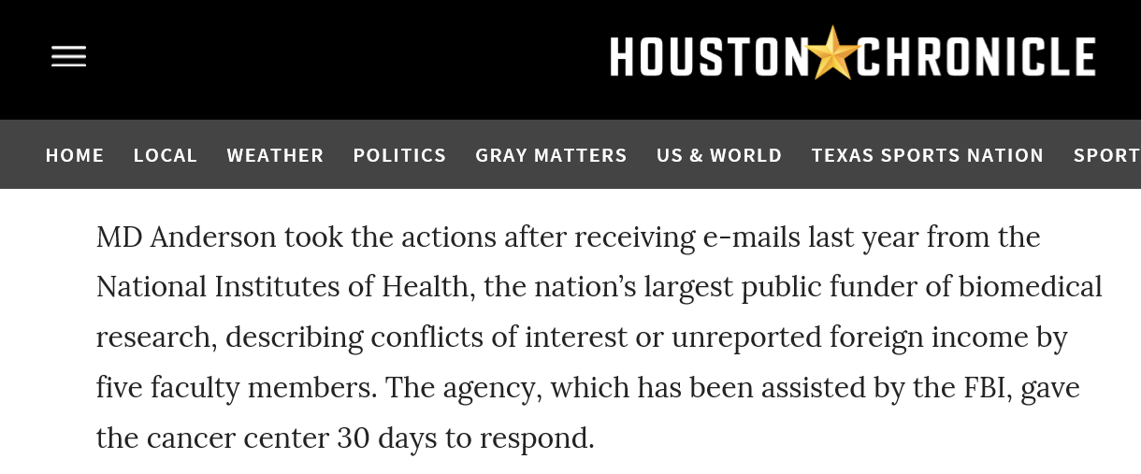
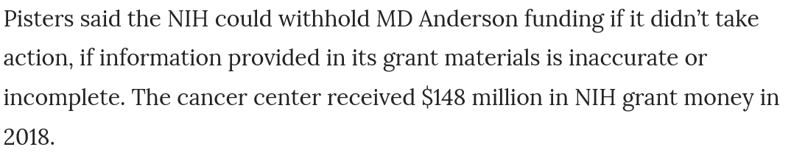
What’s New?
Notes:
How many of our faculty members have listed foreign grants on their other support documents in the past year? Zero
Theft of IP

Slide 21
What will UTHealth do?
Executive Level Committee working on developing new policies and procedures and training plans
Departments can help by making sure Other Support documents include all financial support as required
Notes:
Additional questions regarding foreign activities were added to the annual conflict of interest disclosure form.
Reconcilation between RCOI responses and grant information/other support/RPPR

Slide 22
Next Meeting:
AUGUST 7, 2019
See you then!

