Slide 1
AURA
February 6, 2019

Slide 2
Agenda
Introductions
Grant and Contract Management System Update
2018 A133 Federal Audit

Slide 3
Grant and Contract Management System Update
Tiffany Sagers
Manager, Grants and Contracts
Training and Communications Subgroup

Slide 4

New System Name

Slide 5
2018 A133 AUDIT
Victoria Briscoe
Assistant Director
Post Award Finance

Slide 6
ISSUE 1: Subrecipient Monitoring
Remember the new Risk Level requirements when subcontracting and ensure you are reviewing for these when receiving invoices for payment.
Determination of Risk Level
  If the subrecipient is determined to be at lower risk, there will not be any additional measures needed.
  If the subrecipient is determined to be at medium risk, the subrecipient will need to submit detailed invoices.
  If the subrecipient is determined to be at higher risk, in addition to detailed invoices, the subrecipient will need to submit quarterly technical progress.

Slide 7

ISSUE 2: Effort Reporting (and Key Personnel)
PAY COMMITMENT
Effort should be => pay (usually =)
Salary cap individual’s pay MUST BE LESS than commitment on
most Federal Awards
Navy, Army, DOD, and DOE have no salary cap unless so indicated
due to the particular nature of the award

Slide 8
ISSUE 2: Effort Reporting (and Key Personnel)
Key Personnel
  Even if there is no pay on the project, committed effort MUST be met as usual.
  If there is an effort change exceeding the maximum allowed of 24.99%, agency approval for the effort change must be obtained.

Slide 9
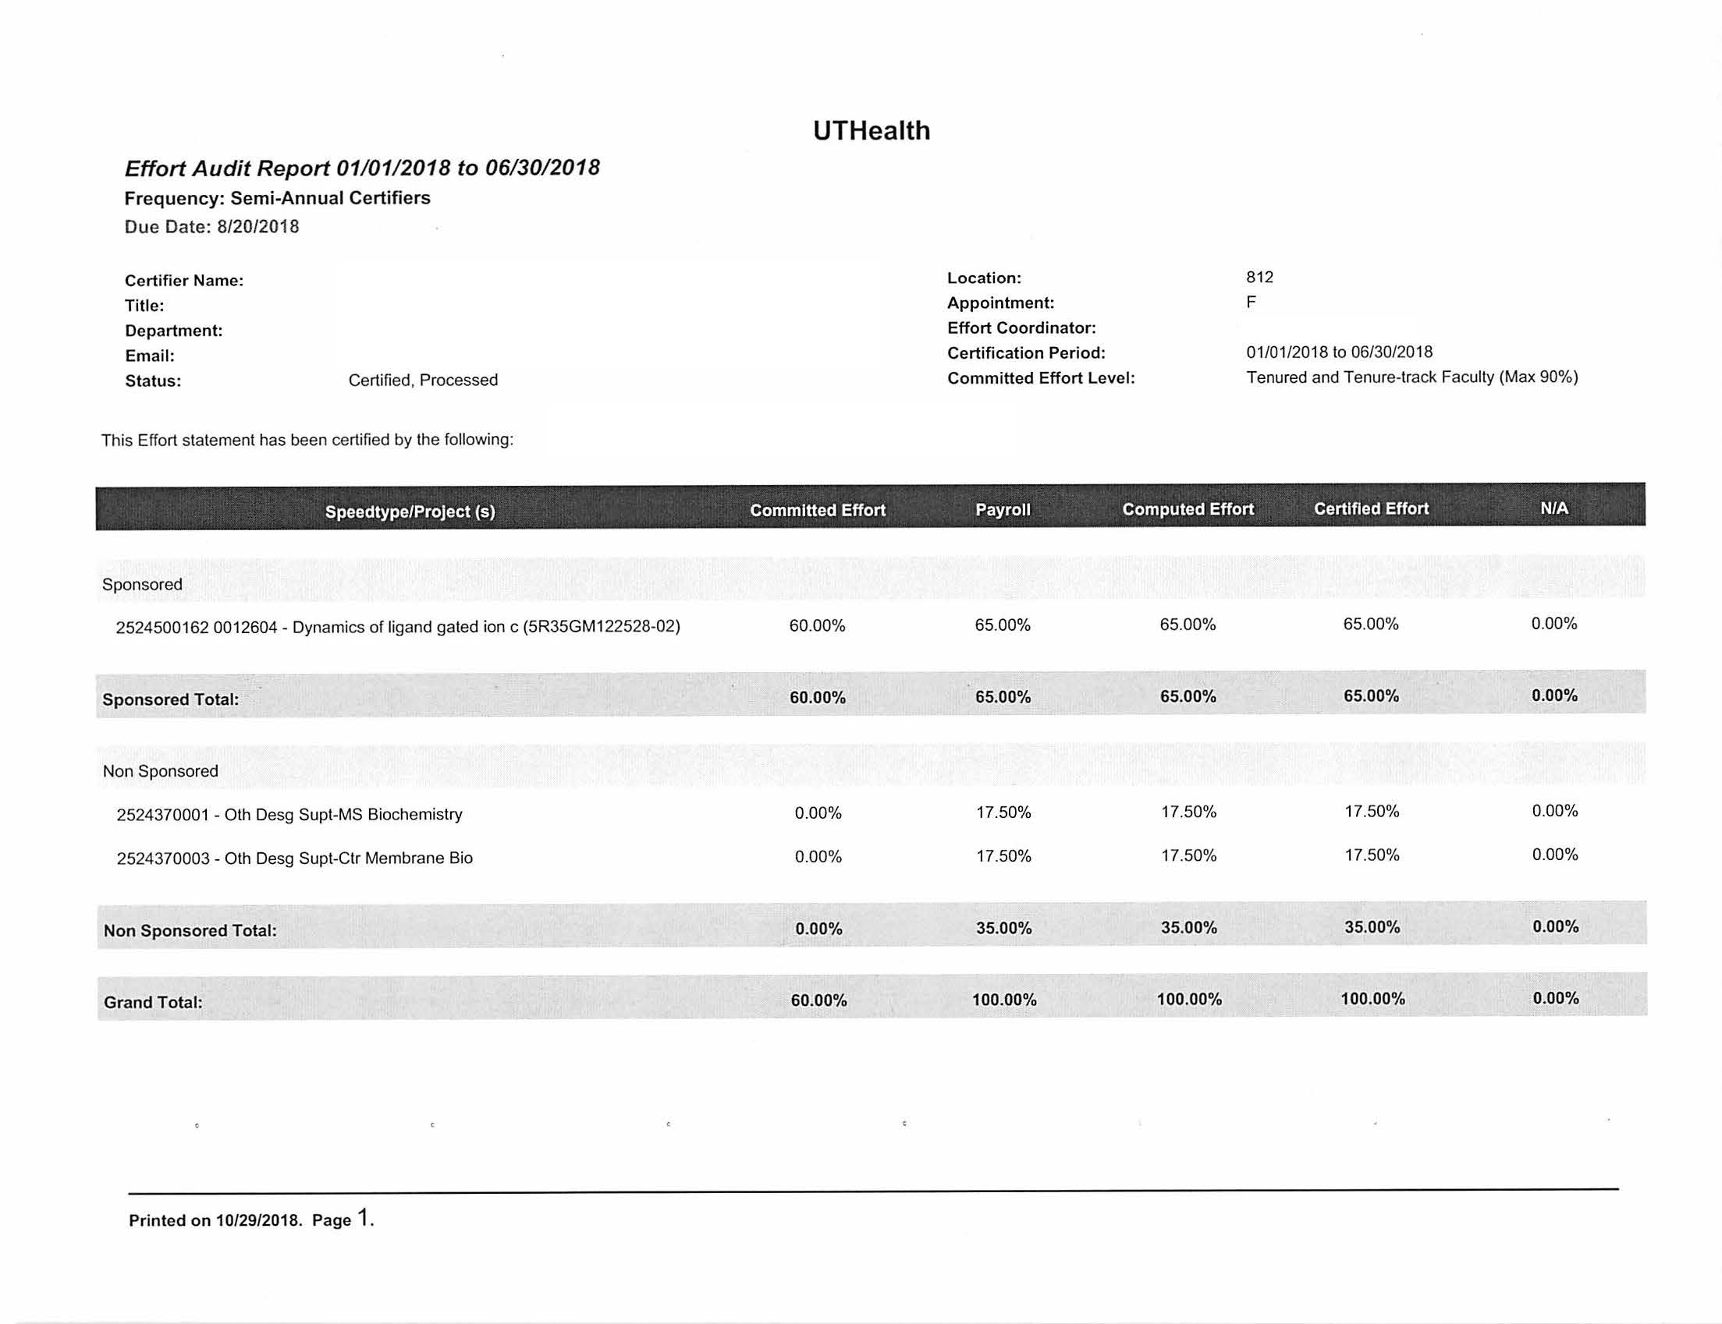
Effort Reporting Example 1
Missing project!!!

Slide 10
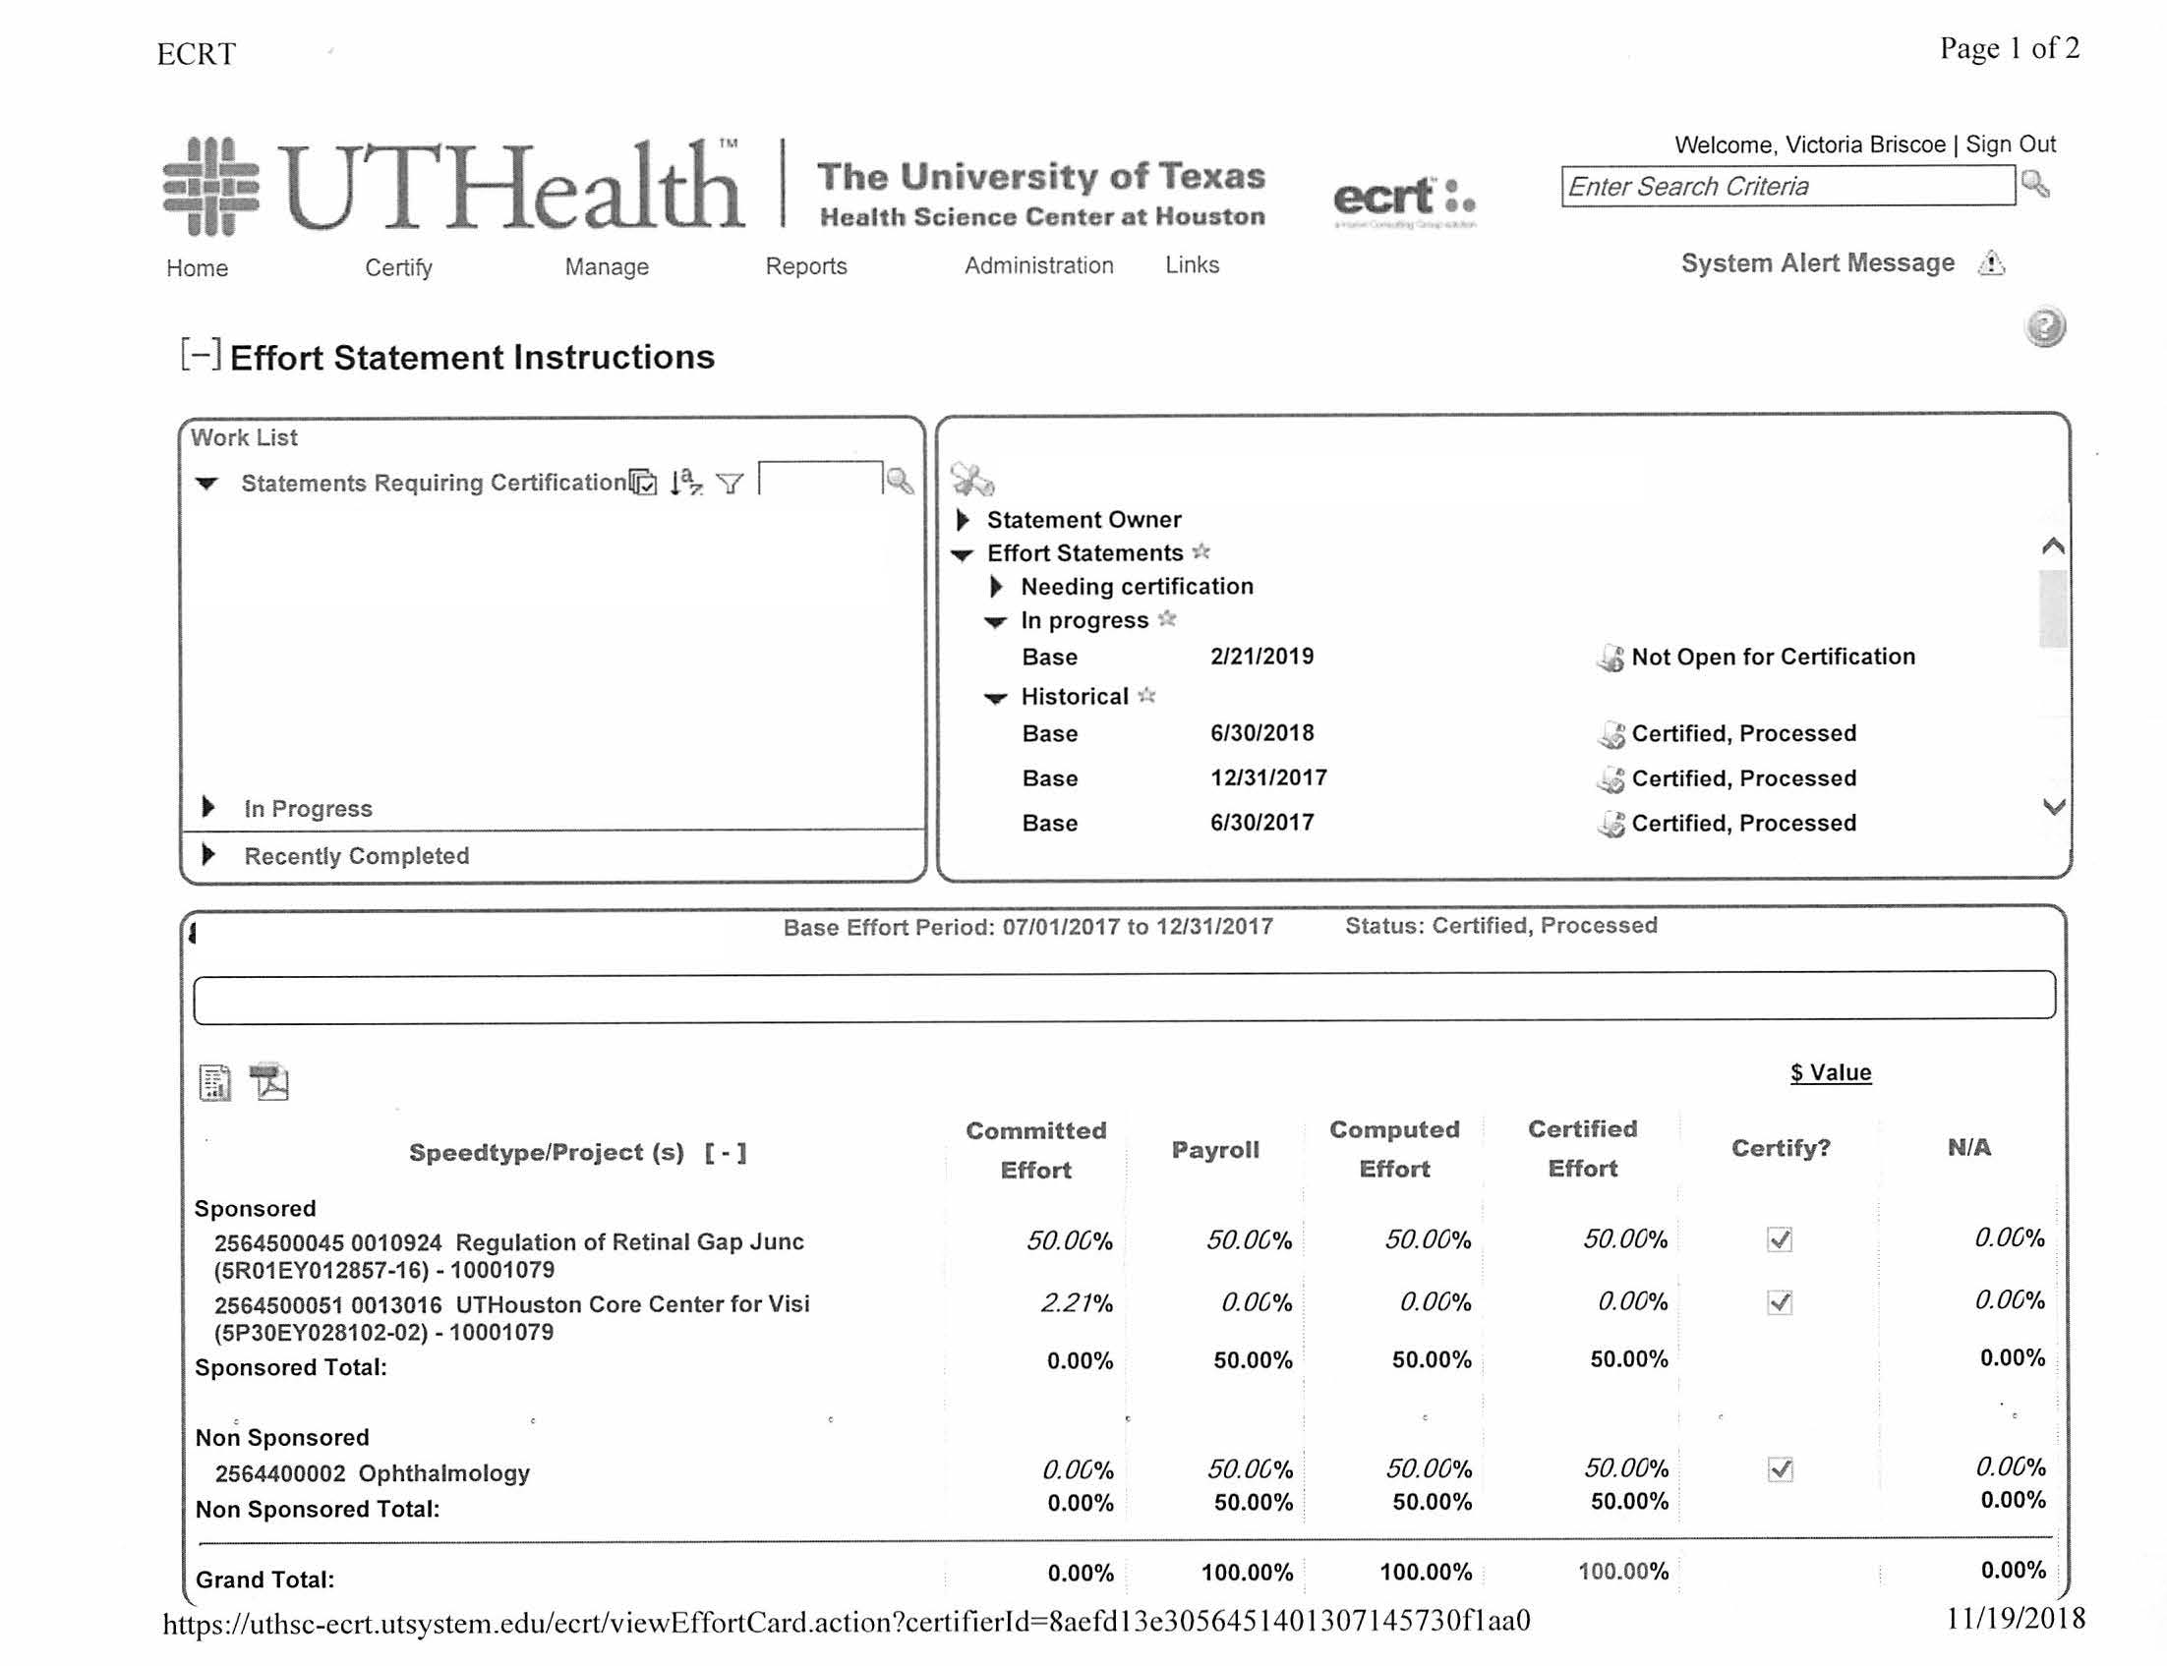
Effort Reporting Example 2

Slide 11
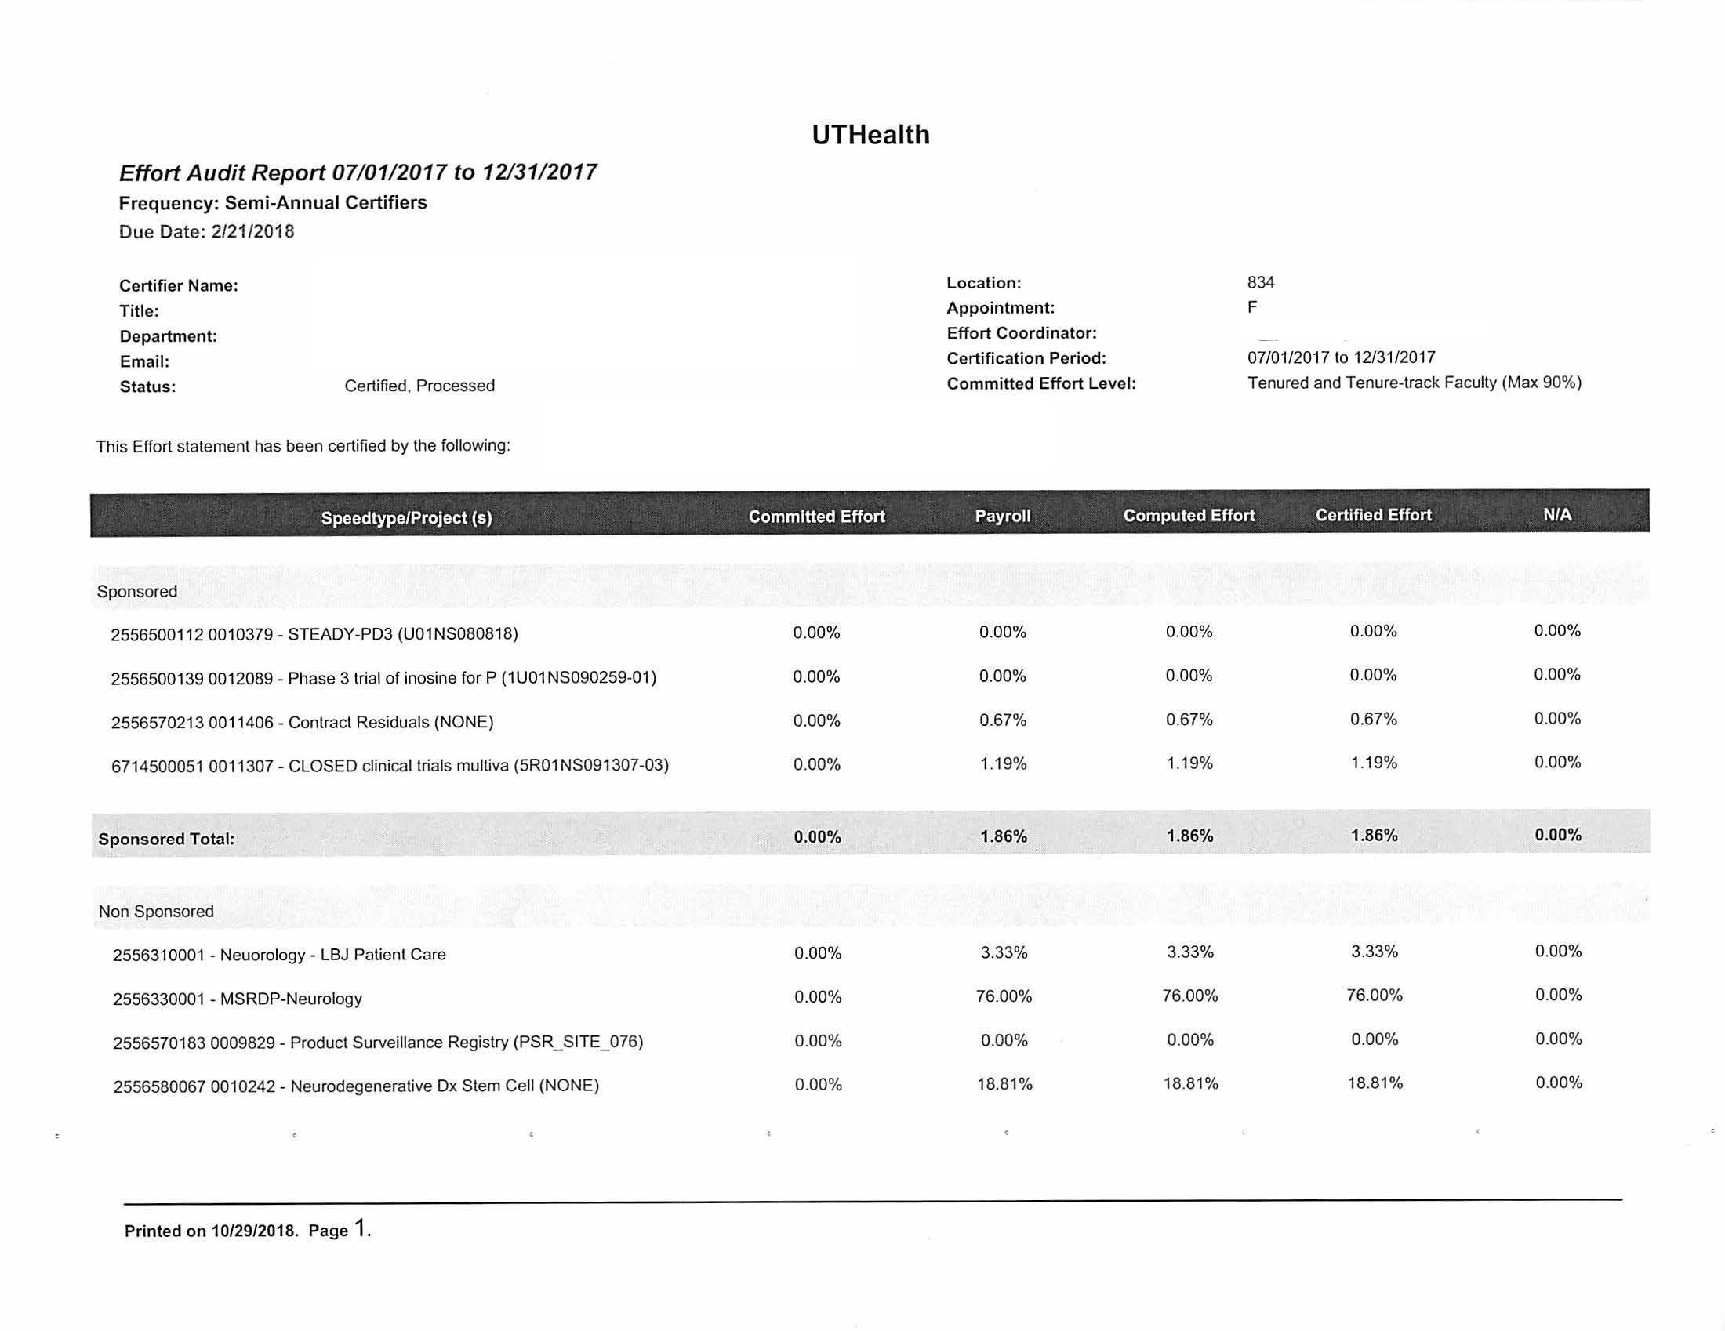
Effort Reporting Example 3

Slide 12
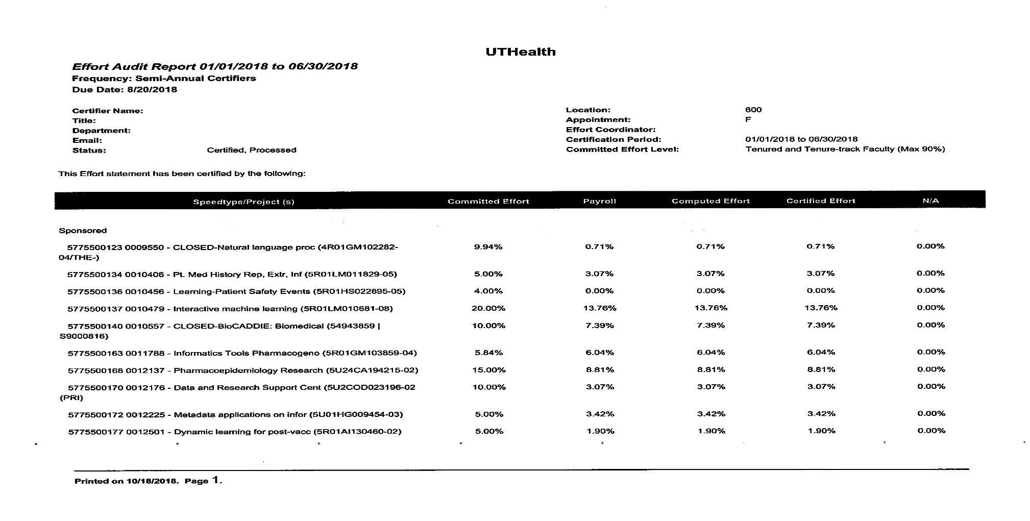
Effort Reporting Example 4

Slide 13
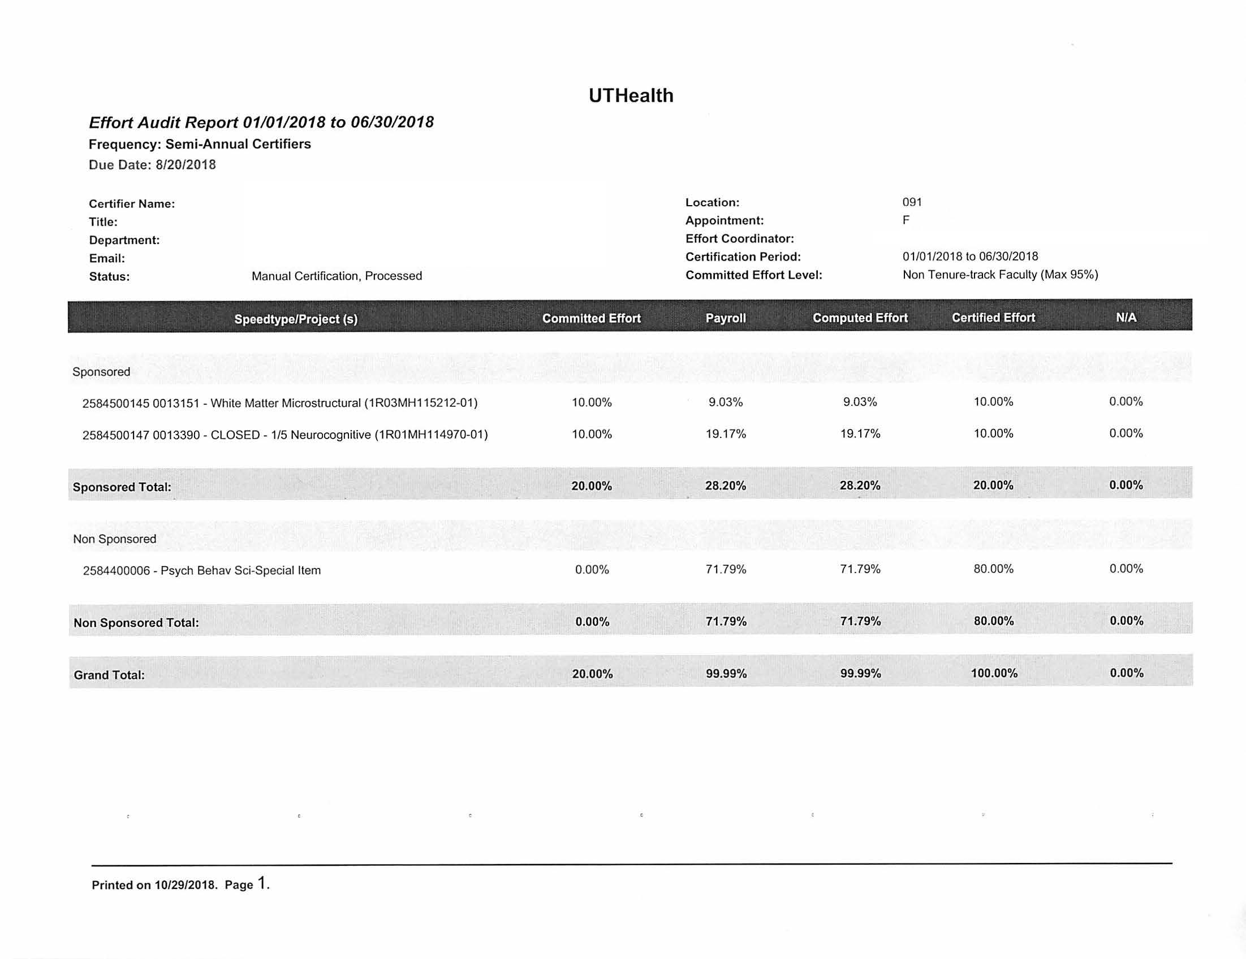
Effort Reporting Example 5

Slide 14
Next Meeting:
APRIL 1, 2019
See you then!

