Slide 1
AURA
Assembly of University research administrators
Sponsored Projects Administration
November 19, 2024

Slide 2
AGENDA
New Staff Introductions Tiffany Sagers
Data Management Sharing Plan Updates Amy Hazen
Effort Reporting Hung Huynh
Cost Transfer Process Hung Huynh
DocuSign Closeout Process Valerie Bomben
MTA/DUA Process Change Valerie Bomben
Initial Audit Findings Teresa Flores
Q & A All

Slide 3
New Staff Introductions

Slide 4
New Staff Introductions
  If this is your first AURA meeting:
  Unmute yourself, turn on your camera, and please tell us
  your name
  department
  role/title
  anything else you’d like to share

Slide 5

DMS plan compliance and DEPUT
Amy Hazen, PhD
Senior Director, Research Operations
November 2024

Slide 6
NIH 2023 POLICY:
The NIH Policy requires all grant applications that generate scientific data to include a robust and detailed plan for how the data will be managed and shared during the entire funded period.
Based on FAIR principles, ensuring Findability, Accessibility, Interoperability, and Reusability of experimental data.
DSMP : Data Safety and Monitoring Plan

Slide 7
NIH RPPR UPDATES:
NIH will require progress reports to address NIH DMS activities, including updates on data sharing, repositories, and unique identifiers for data that has been shared.
The updated NIH RPPR Instruction Guide with specific information related to DMS plan reporting can be found here.

Slide 8
What is included in a DMS plan:
Element 1: Types and amount of scientific data expected to be generated in the project
Element 2: Related tools, software and/or code
Element 3: Common data standards or if applicable, indicate that no consensus standards exist
Element 4: Data repository, unique identifiers and timeline for sharing
Element 5: Access, distribution, or reuse considerations (typically related to privacy restrictions)
Element 6: Oversight of Data Management and Sharing = standard institutional language
1. Data Type
6. Oversight of Data Management and Sharing
2. Related Tools, Software and/or Code
DMS Plan
5. Access, Distribution or Reuse Considerations
3. Standards
4. Data Preservation, Access, and Associated Timelines

Slide 9
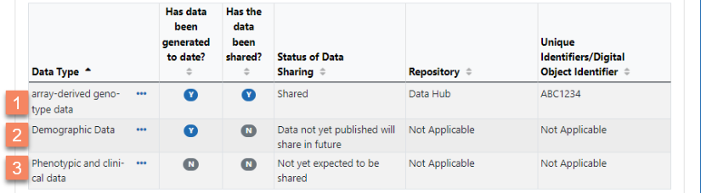
Please screen for the following items in the DMS plan (these are the common elements that most funding agencies expect):
What to look for in a DMS plan:
Element 1:
Source of data (i.e., species: human, mouse, zebra fish, primary tumor, etc.) helps determine access/distribution/reuse considerations
Different types of data (e.g., imaging data, genomic data, survey data, clinical data, etc.)
Amounts of data (e.g., 2TB of imaging data or 6000 surveys nested within 2000 participants, etc.)
Some program officers have requested a table. This can also be helpful as the RPPR will require a table each year for reporting data sharing status.
Summary of the RPPR in the table format that may be adopted for Element 1

Slide 10
What to look for in a DMS plan:
Element 4A:
An existing repository has been identified in Element 4. (DEPUT [Data Ecosystem Portal for UTHealth Houston] does not currently support data storage and can NOT be listed as a repository). Check that the repository is appropriate for the type of data that is being collected (e.g., Cell Image Library may be used for imaging data).
SELECTING A REPOSITORY
“NIH strongly encourages the use of established repositories to the extent possible for preserving and sharing scientific data.”
1st option: NIH and/or IC policy may designate specific repositories to be used
2nd option: Primary consideration should be given to data repositories that are discipline or data-type specific. NLM Domain-specific repositories
3rd option: If no appropriate discipline or data-type specific repository is available, consider using a generalist repository. NLM Generalist repositories
1
Check the FOA
2
NIH-supported domain-specific repositories
3
Consider a Generalist Repository

Slide 11
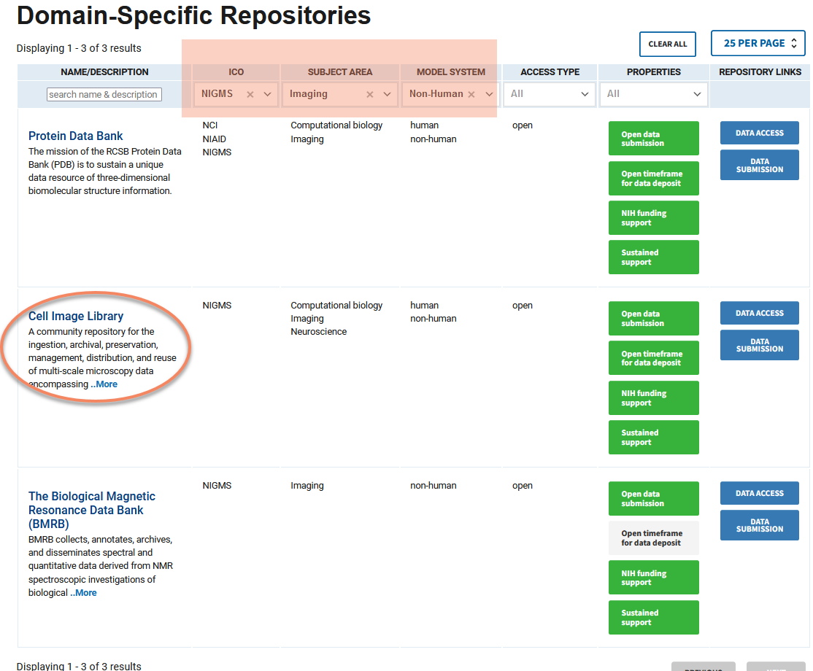
How to screen for the repositories:
Example: You receive a DMS plan for NIGMS grant application that proposed generating imaging data from mouse models. The plan lists “Cell Image Library” as the repository for data storage. You can visit the NLM Domain-specific repositories to check the validity
Filter by the right ICO (NIGMS in this example), subject area (imaging; as described in Element 1A) and model system.
Check whether the repository named in the DMS plan is listed in the results.

Slide 12
What to look for in a DMS plan:
Element 4B:
How scientific data will be findable and identifiable.
Look for the following:
Accession numbers
Digital object identifiers (DOI)
Unique persistent identifiers

Slide 13
What to look for in a DMS plan:
Element 4C:
Element 4C should indicate something similar to the following: ‘Data will be made available at the time of associated publication or end of project period, whichever is earlier. We will meet the data submission and release timeframes specified by the funding agency and policies.’
Note: The DMS plan becomes Terms and Conditions of the award so it’s best to keep it to a minimum. Do not overstate as you will need to adhere to what you have written.
For example: ‘we will share data every six months.’ - Although this is being a wonderful steward of data sharing, it creates an additional administrative burden as you will be required to upload data every six months. It would be better to state the minimum requirement but upload more often.

Slide 14
What to look for in a DMS plan:
Element 5:
In general, broad data sharing is highly encouraged. In cases where it is NOT possible, the plan should mention and justify why not.
In such cases, look for access restrictions or conditions for data reuse. The rationale should be well explained. Give specific reasons for withholding data (e.g., ethical considerations, intellectual property rights, informed consent, data licenses, etc).
If there is involvement of human participants, explain how the privacy and confidentiality of participants will be maintained. (e.g., “Data will be anonymized by removing the personal identifiers prior to deposit in the repository, in compliance with our institutional IRB-approval”).
If there are no restriction on sharing this section is very short. “All data access will be unrestricted upon deposition” or “No control for access to the scientific data” etc.

Slide 15
What to look for in a DMS plan:
Element 6: (insert standard institutional language)
The Office of the Executive Vice President & Chief Academic Officer (EVP/CAO) and The Office of Data Science (ODS) at UTHealth Houston will provide joint institutional oversight for the DMS plan. Datasets resulting from this research will be cataloged with in the institutional DEPUT. DEPUT is the institutional oversight management portal supported by UTHealth Houston for DMS validation and tracking. Project Contact PI will update data status in DEPUT, and the institutional office of Sponsored Projects Administration (SPA) will perform annual validation according to the DMS plan. Validation results will be maintained in DEPUT. Noncompliance with the DMS plan will be identified with appropriate correcting measures implemented. The PI will have overall responsibility for compliance with data collection, storage, and safety protocols.

Slide 16
Many sponsors have adopted a mandatory DMS policy
FOLLOW THE LEADER:
Alzheimer’s Association
American Diabetes Association
American Heart Association
Center for Disease Control
Department of Defense
National Science Foundation
Most follow a very similar format to the NIH

Slide 17

UTHEALTH HOUSTON:
DMS PLANS
ALL DMS plans will be housed in DEPUT.
Flagged in UTHealth Start as ‘DMS applicable’.
The institutional Data Ecosystem Portal for UTHealth Houston (DEPUT) will serve as the institutional research DMS plan catalog supported by UTHealth Houston.
DEPUT is NOT a DATA REPOSITORY.
It will store persistent identifiers for the datasets in each plan to support DMS validation, tracking and compliance.
Include budget for annual institutional oversight.

Slide 18
Funded Research
✓ DMS applicable
DMS plan cataloged in DEPUT
PI receives email notification prior to progress report due date
PI completes checklist in DEPUT
SPA is notified to review and approve
DMS COMPLIANCE:
DEPUT
RPPR
Institutional compliance
UTHealth Houston compliance requirement
NIH Funding agency compliance requirement
DMS Plan compliant

Slide 19
DMS Plan Reporting and Changes:
How do you Notify NIH about DMSP Changes?
At Just In Time, upload to the DMS Plan Revision attachment spot
At Progress Report: Notify via DEPUT and Section C.5.c
Ad Hoc: Submit Change Request in UTStart, a signing official must submit a Prior Approval request in Commons
Other agencies may have other ways to request changes, always start with a Change Request in the UTStart record
https://grants.nih.gov/grants/guide/notice-files/NOT-OD-24-175.html

Slide 20
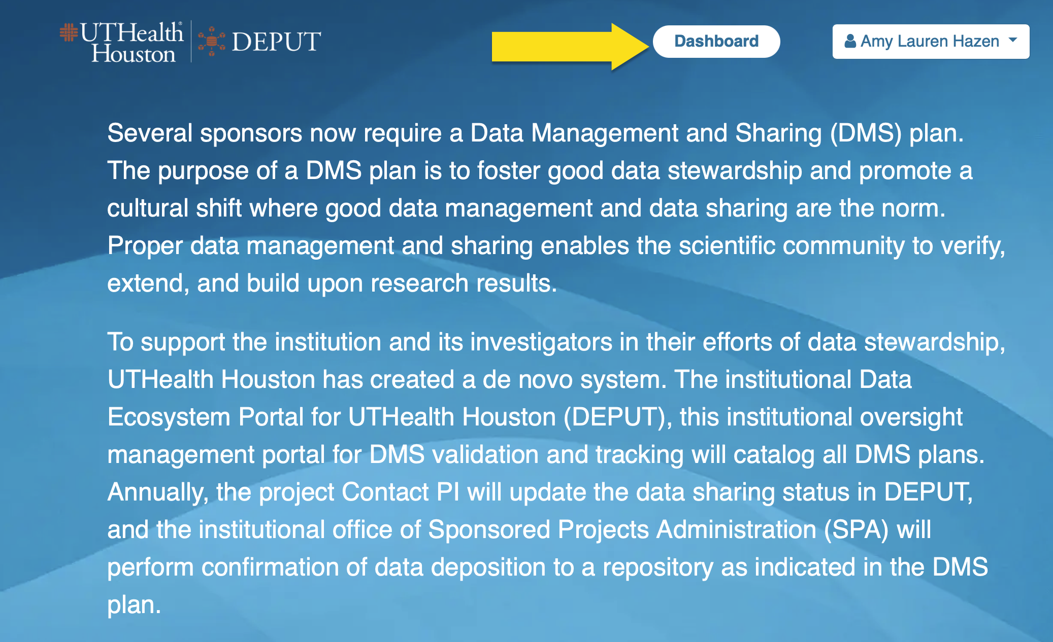
DEPUT LANDING PAGE:

Slide 21
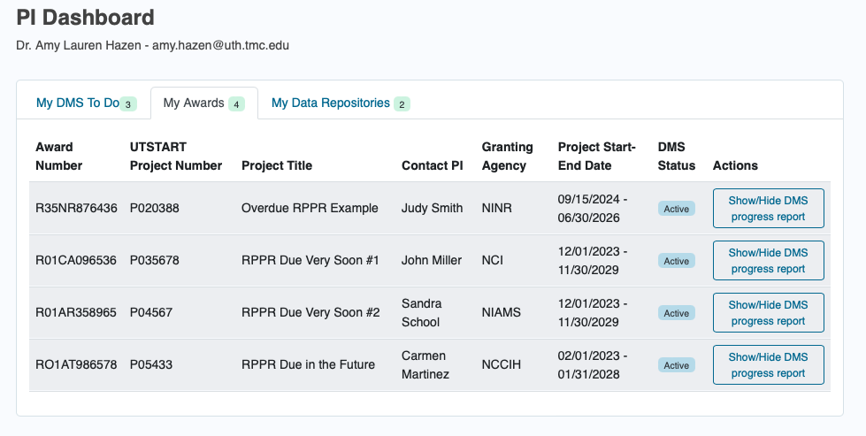
DEPUT PI DASHBOARD:

Slide 22
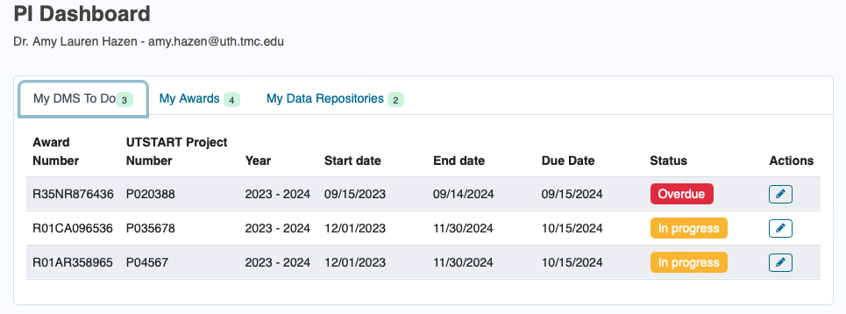
DEPUT PI DASHBOARD:

Slide 23
DEPUT next steps
DMS COMPLIANCE:
All DMS applicable RPPRs in 2024 will be completed with support.
Creating training materials for 2025

Slide 24

Contact us
ADDITIONAL INFORMATION:
Person
Email id
Telephone
Amy Hazen, Ph.D.
Senior Director, Research Operations
Caroline Dietz, Ph.D.
Manager of Institutional Wide Grants and Award Management
Amy.Hazen@uth.tmc.edu
Caroline.J.Dietz@uth.tmc.edu
713-500-3612
713-500-3023

Slide 25
Effort Reporting

Slide 26
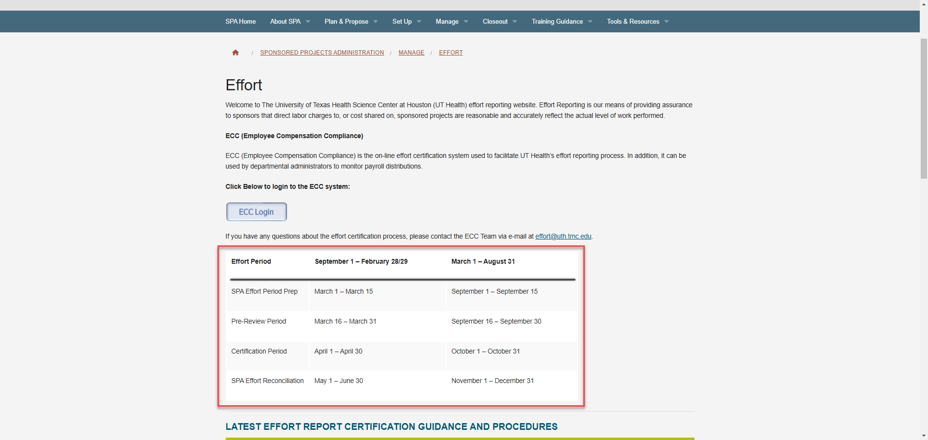
Effort Reporting
https://www.uth.edu/sponsored-projects-administration/manage/effort-reporting/

Slide 28
Cost Transfer Request Process

Slide 29
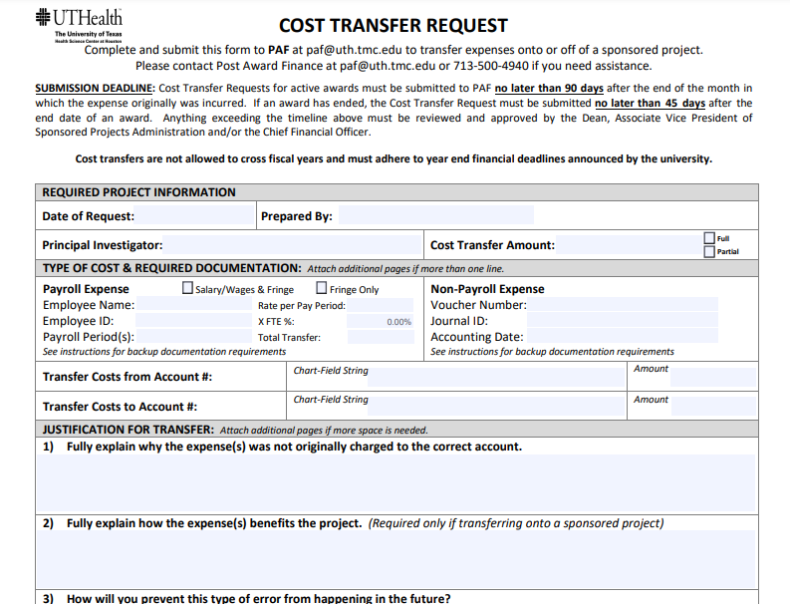
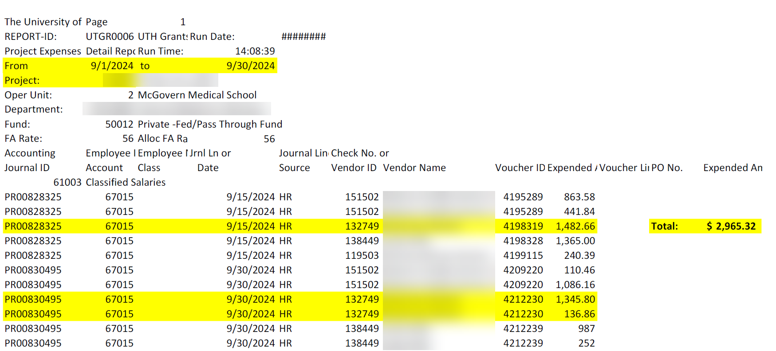
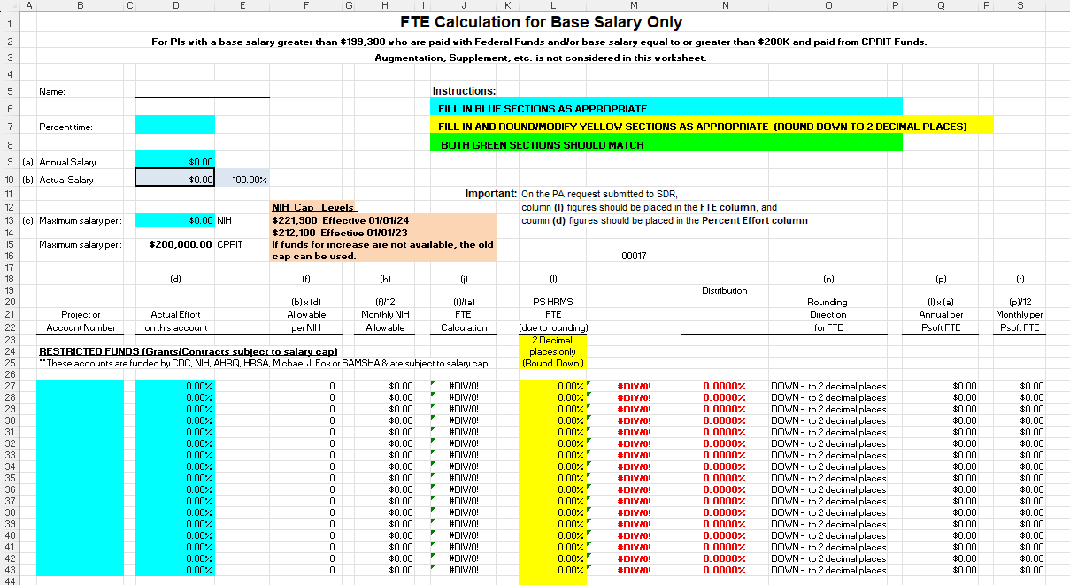
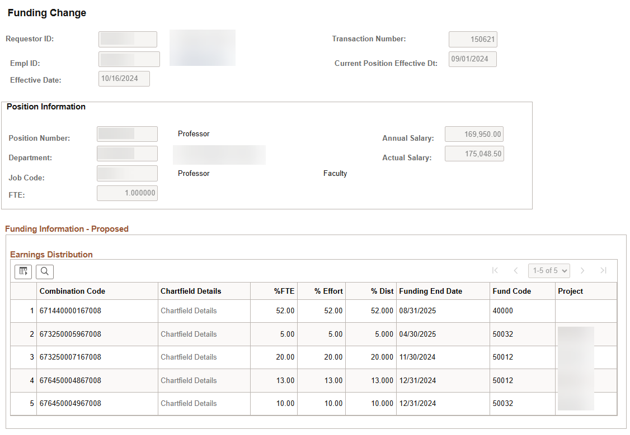

Slide 30
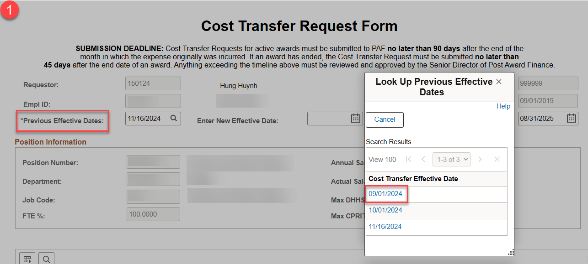
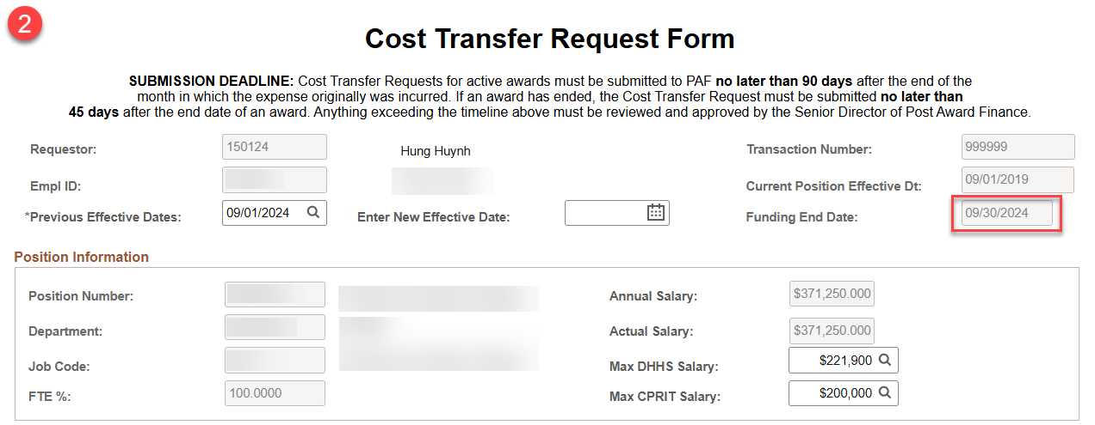

Slide 31
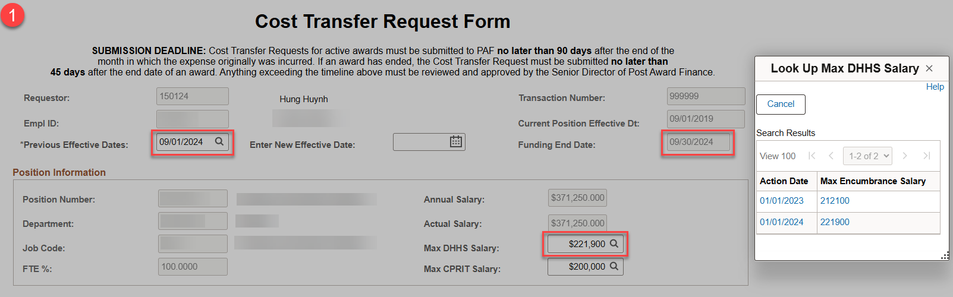
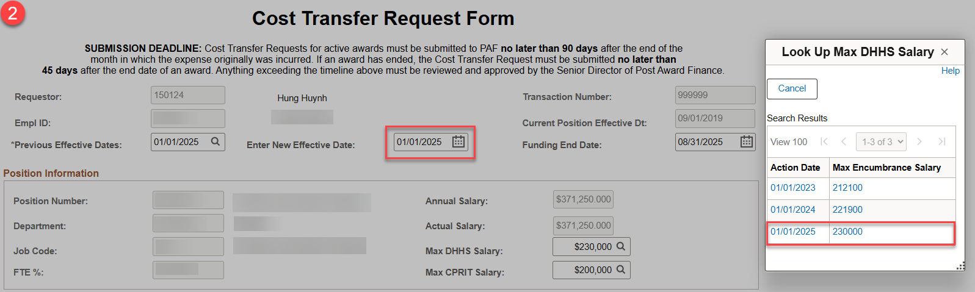

Slide 32
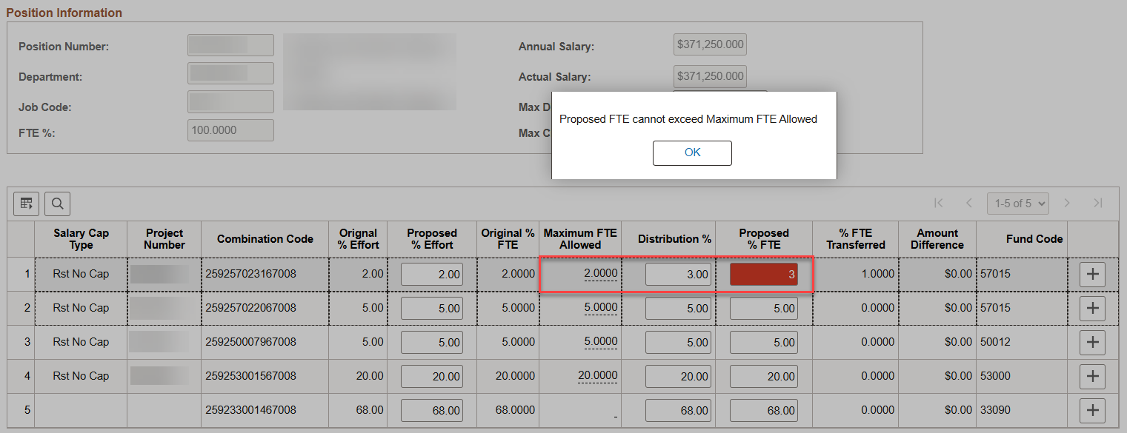
Compensation Control – General Example

Slide 33
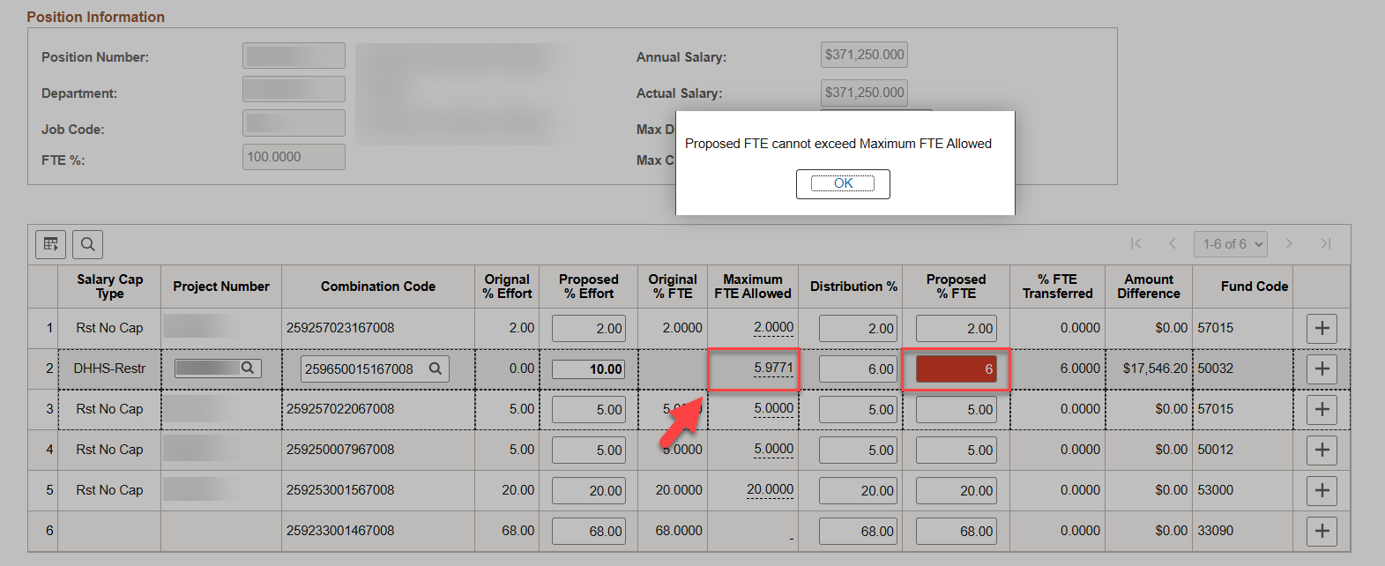
Compensation Control – Salary Caps

Slide 34
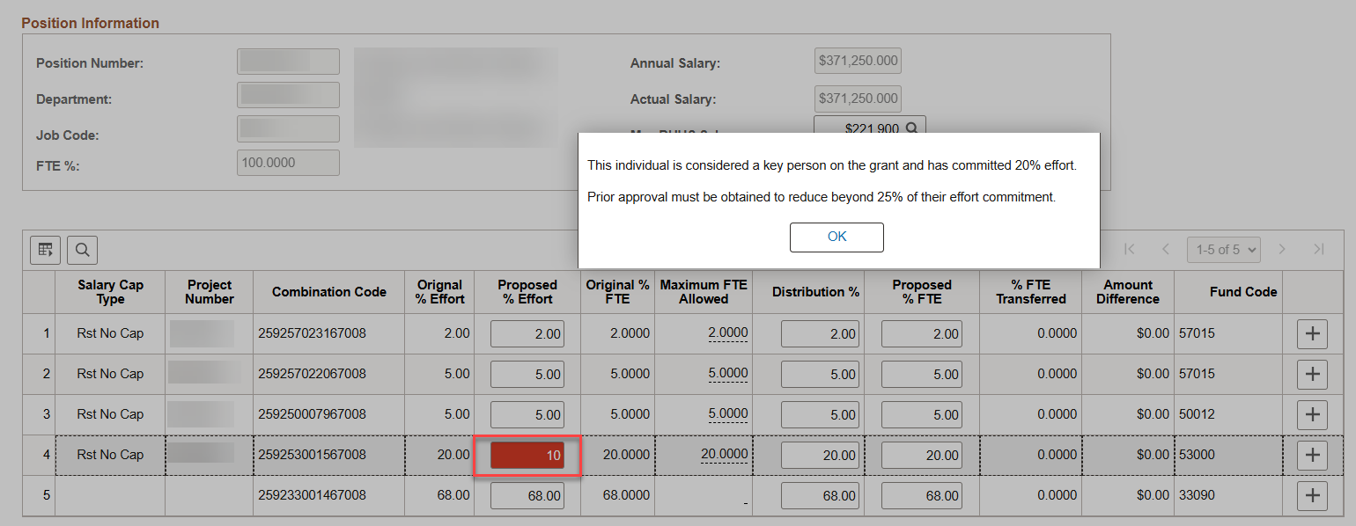
Effort Controls – General Example

Slide 35
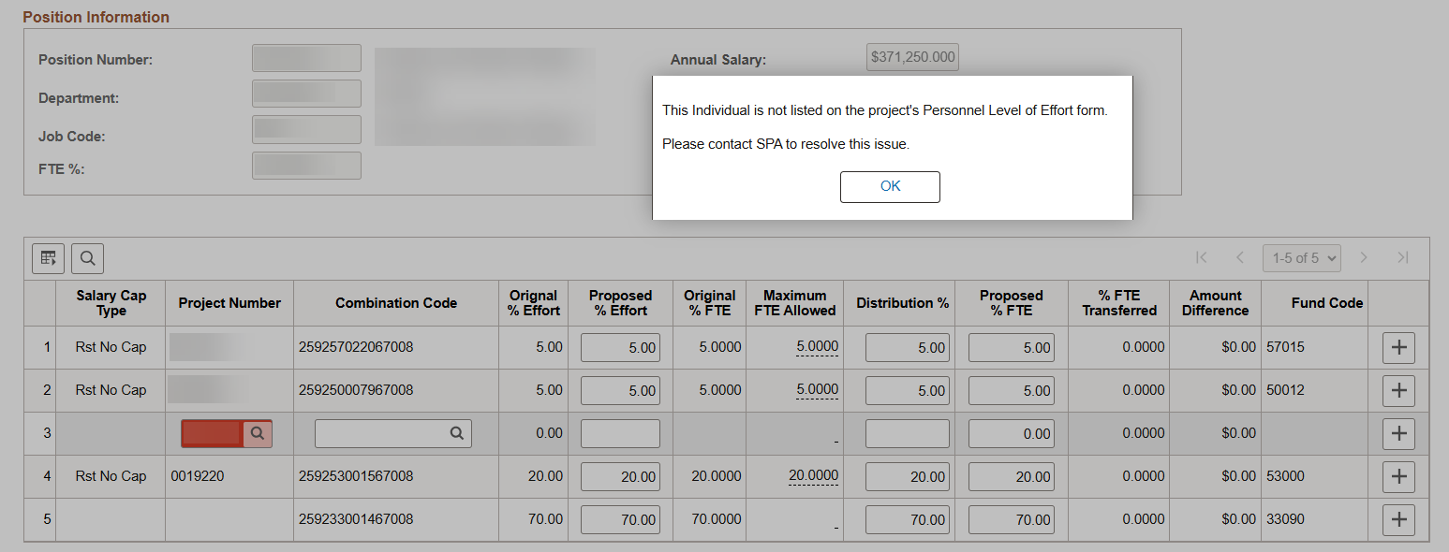
Effort Controls – CPRIT Example Pt.1

Slide 36
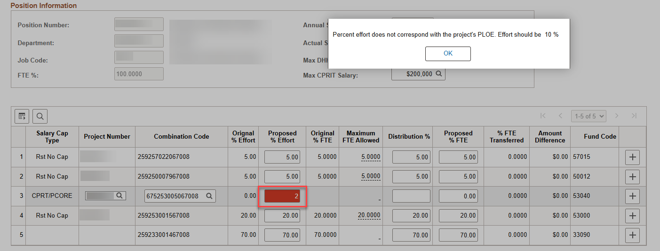
Effort Controls – CPRIT Example Pt.2

Slide 37
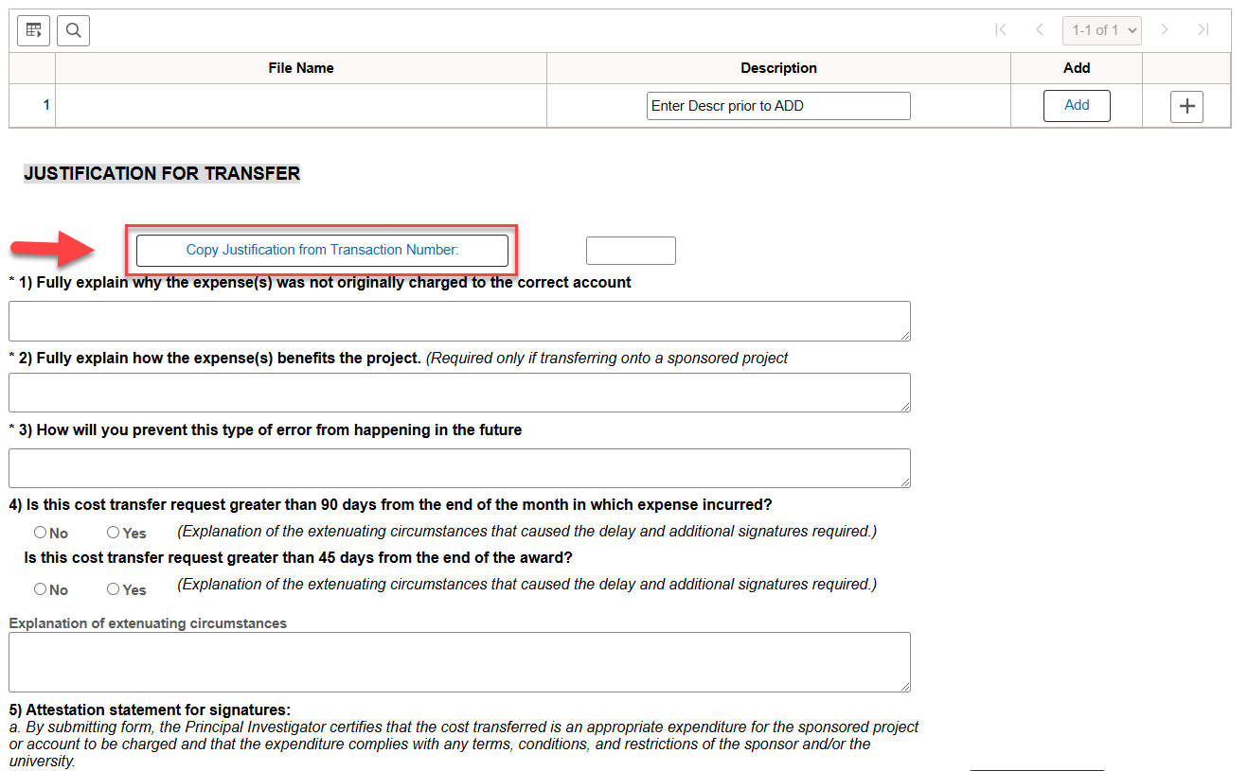

Slide 38
Cost Transfer Request Routing Process

Slide 39
Impact of New Process
No general ledger support
No salary cap worksheet
Reduction in transactions returned for minor corrections
Reduces manual review for SPA

Slide 40
Closeout Form Updates

Slide 41
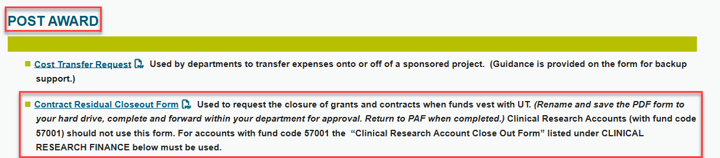
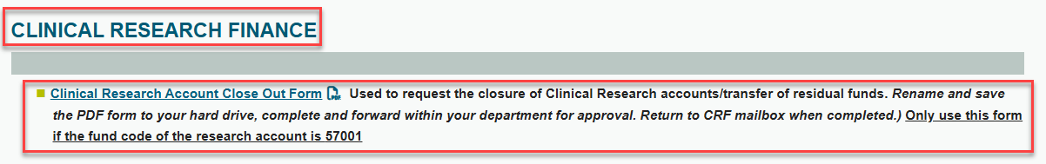

Closeout Form Updates
SPA Website - Forms & Templates
-------------------------------------------------------------------------------------------------------------------------------------------------------------

Slide 42
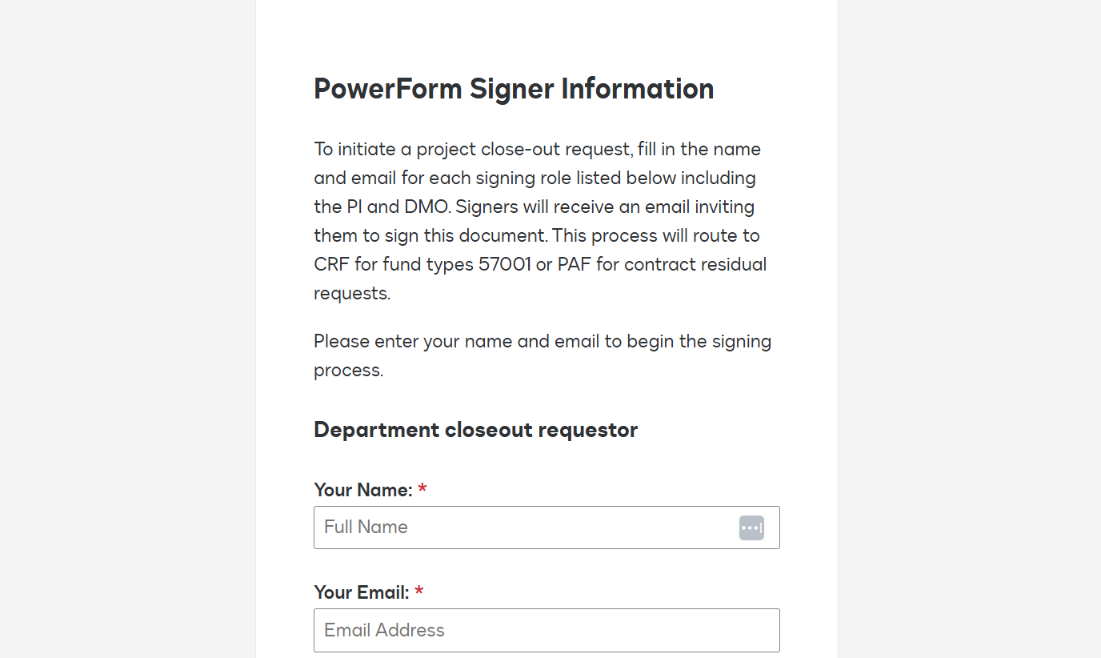
Consolidated Form
*Powerform via DocuSign to route for appropriate signatures
*Routes to CRF team or PAF depending on fund type question
Closeout Form

Slide 43
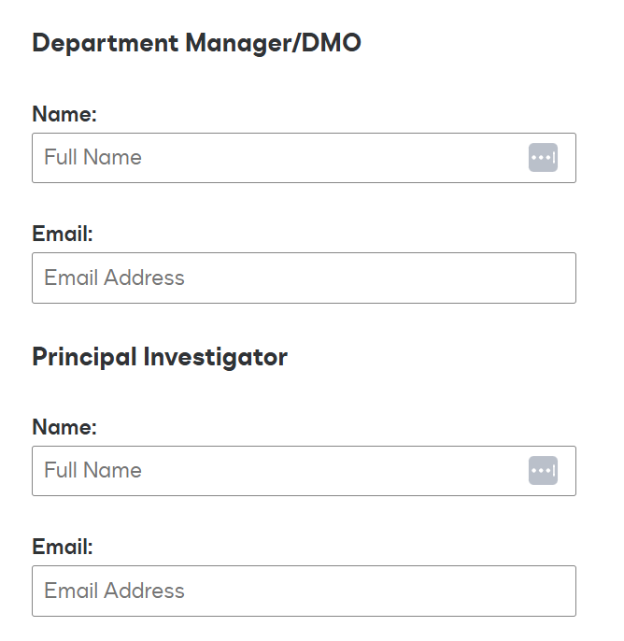
Consolidated Form
*Conditional Fields are also referenced, scroll to the following section
*Click “Begin Signing”

Slide 44
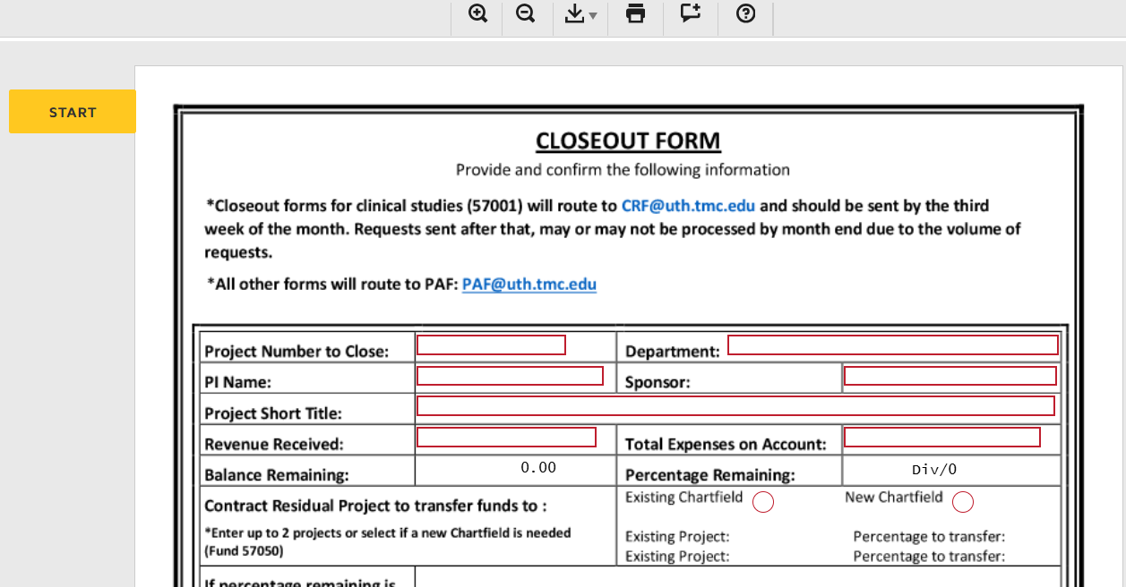
Consolidated Form

Slide 45
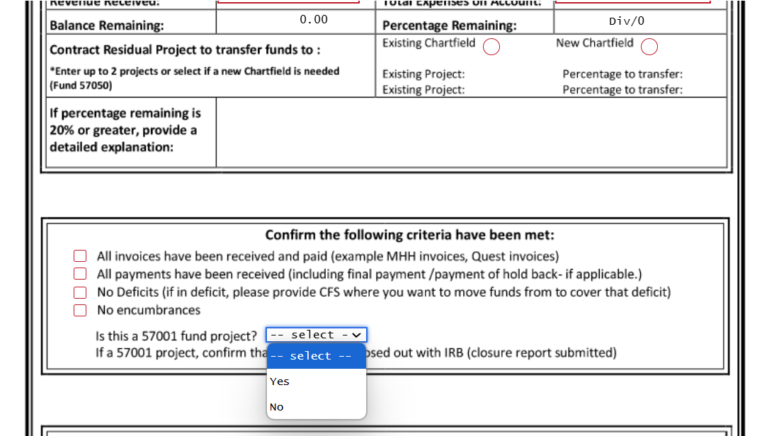

Slide 46
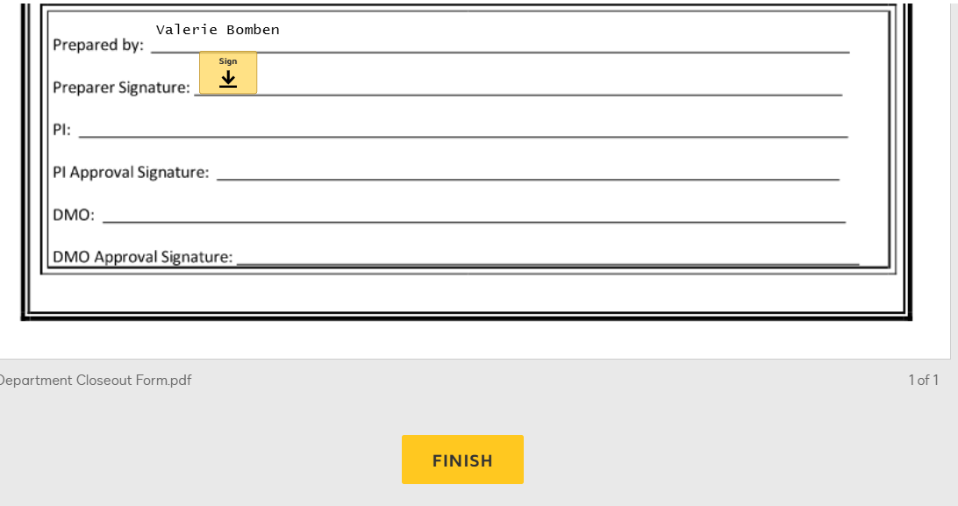

Slide 47
MTA/DUA Changes

Slide 48
Material Transfer and Data Transfer
Request Changes
*An email will follow when changes are live in Production site (anticipated by early December)*
*Necessitated by updates to questions on Transfer e-form
*Simplifies administrator’s ability to send the form to PIs so the information can be accurately filled out

Slide 49
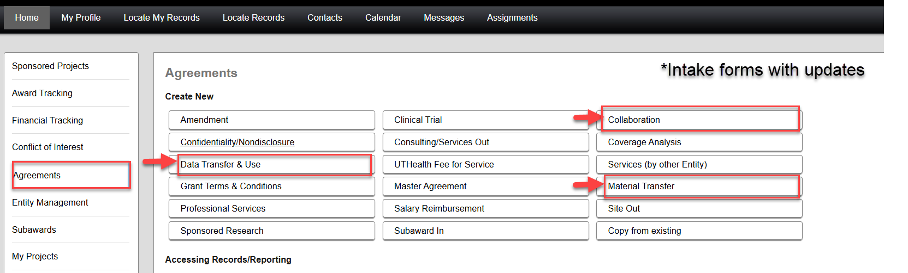

Slide 50
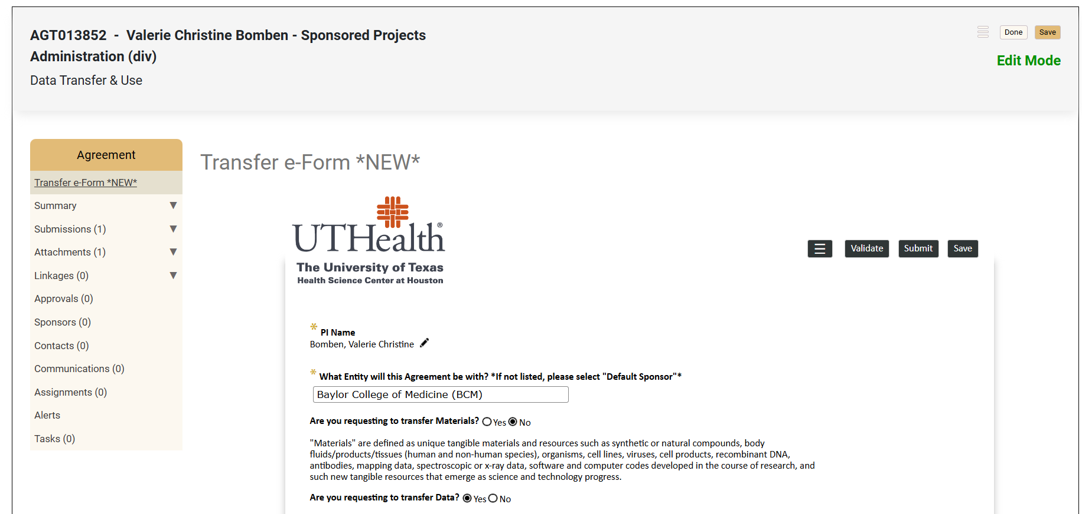

Slide 51
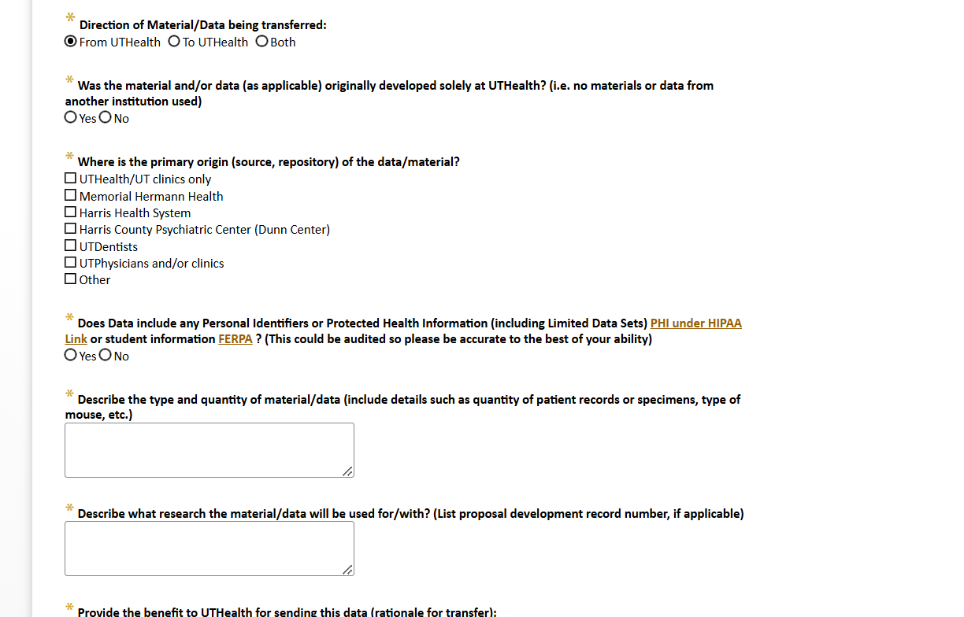

Slide 52
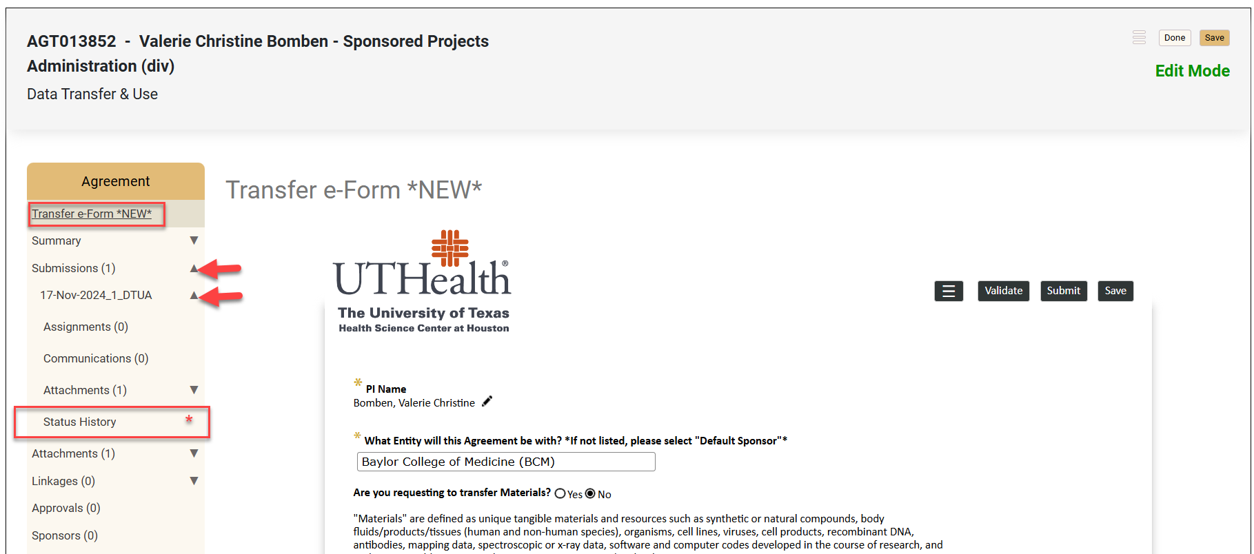

Slide 53
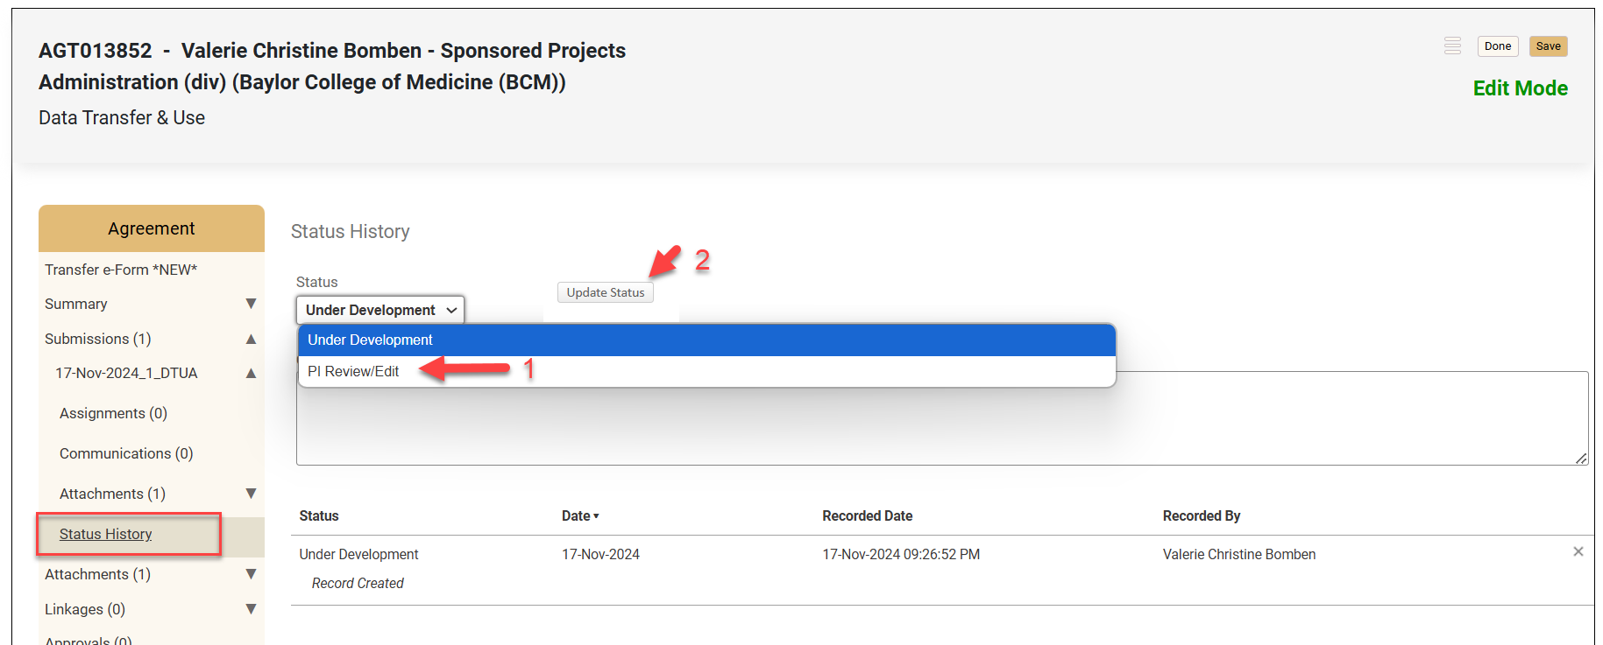

Slide 54
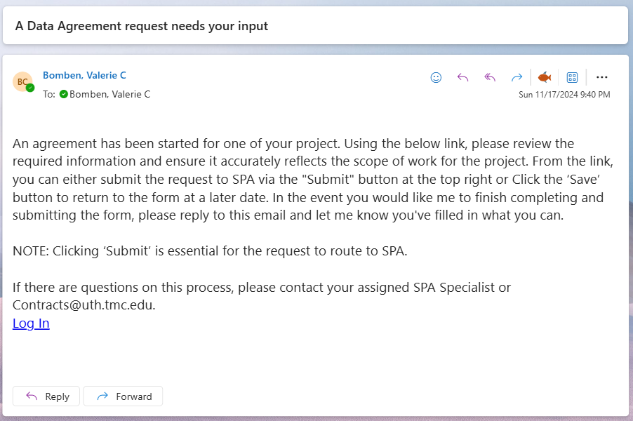
PI email:

Slide 55
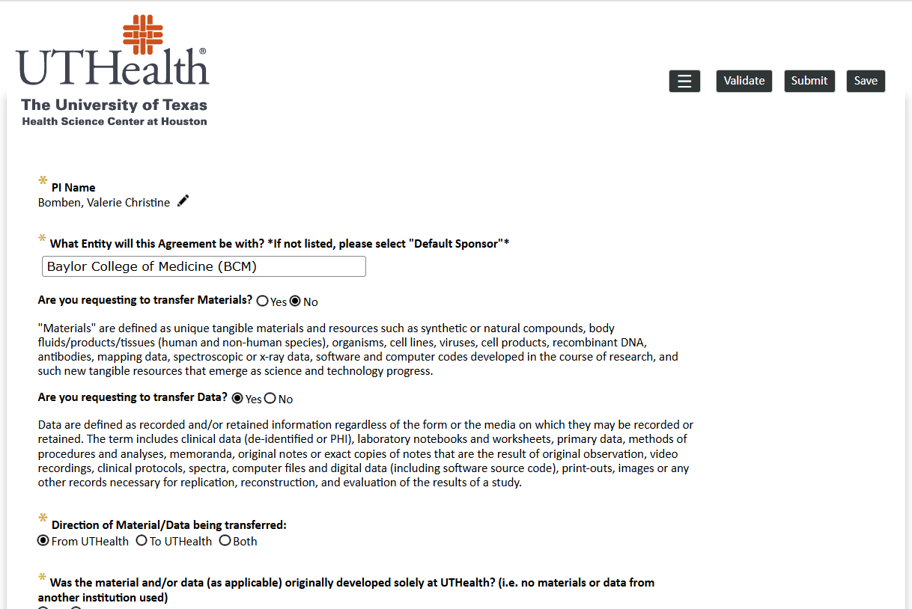
PI has direct log in to the form (bypasses additional “action item” layer)

Slide 56
Audit Findings

Slide 57
SAO (State Auditing Office) Audit
The Texas State Auditor's Office (SAO) conducts audits to investigate potential financial improprieties within state government agencies.
The Audit includes a financial review of subrecipient payments, indirect costs, in-service equipment, equipment disposition, and payroll.

Slide 58
SAO (State Auditing Office) Audit
The Audit also includes a compliance review of direct costs, such as non-payroll, cash management, period of performance, subrecipient monitoring, and key personnel.
The SAO Auditors were on site in PAF on November 11-15, 2024, to review requested samples of each category identified in these two slides.

Slide 59
SAO (State Auditing Office) Audit
On November 15th, the auditors held a meeting to summarize the preliminary findings of the detailed sampling review. They communicated that no issues had been found in these samples.
The Final Exit Conference is scheduled for December 6th.

Slide 60
Q & A

