Slide 1
AURA Assembly of University research administrators
June 27, 2023
Sponsored Projects Administration

Slide 2
AGENDA
New Staff Introductions Kathleen Kreidler
PO #s for Outgoing Subawards Carmen Martinez
START: TBD vs. TEMP profiles Valerie Bomben
Non-Compliant Effort Escalation Process Hung Huynh & Loren Turner
- Transfer to/From State Funds and Year End CTMs
Award Processing Team Update Caroline Dietz
SPA Financial Improvement Projects Kathleen Kreidler

Slide 3
NEW STAFF INTRODUCTIONS

Slide 4
New staff introductions
If this is your first AURA meeting:
Unmute yourself, turn on your camera, and please tell us
your name
department
role/title
anything else you’d like to share

Slide 5
PO#s for outgoing subawards

Slide 6
Why issue po #s for outgoing subawards?
Encumber subaward funds
Automate a manual process
No “lost” invoices
Strengthen subrecipient monitoring (2CFR200.332.d)

Slide 7
Requisition process
SPA Subaward Team submits requisition upon execution of subaward
SPA Director Approves
Budget Check
PO dispatched to SPA and funds encumbered
Agreement, PO# and PI responsibilities to review and approve invoices sent to PI (with copy to dept)
Agreement, PO#, and COUPA invoice instructions sent to subrecipient

Slide 8
Pi responsibility email
Effective 6/1/23, SPA will issue a Purchase Order Number for all outgoing subawards. This will encumber the subaward funds and automate invoice processing and approval.
The federal government requires the prime grant recipient to monitor subaward performance on a regular basis. As the PI of the prime grant, you are responsible for reviewing and approving all invoices received from the subrecipient.
Invoices will be sent to you via email from approvals@uth-tmc.coupahost.com
Your invoice approval means that you certify 1) the subrecipient is performing SOW as expected and 2) the subrecipient invoices are commensurate with the work completed. This replaces the annual questions from SPA regarding subrecipient performance.
If the subrecipient is not performing work as expected, please contact Carmen Martinez, Director of Grants and Contracts or Kathy Kreidler, Associate VP of Sponsored Projects to discuss.
Instructions for reviewing and approving invoices are attached. If your grant award has 5 or more subawards you may delegate invoice review and approval to another UT employee working on the grant (e.g. project manager) who has first-hand knowledge of sub performance. You may not delegate invoice review and approval to a department administrator or for a grant that has less than 5 subawards.

Slide 9
Other info
PO# will be for all years of subaward if auto carry forward
New annual PO# if no auto carry forward
SPA can amend PO as needed
PI invoice approval replaces annual performance questions
If a grant has 5 or more subawards, the PI may delegate approval to a project manager who has first hand knowledge of sub performance. (SPA must approve delegate.)

Slide 10
Invoice process
Subrecipient submits invoice via COUPA
Invoice sent to PAF for review
PAF inserts PI into Invoice Approval Process
PI Approves or Disapproves invoice
Invoice Paid
Approved for Payment
Disapproved invoices go back to subrecipient for correction

Slide 11
Implementation
New Subawards with a > 6/1/23 start date
Transition all existing subawards in FY24:
Continuation years with a > 9/1/23 start date
No PO for projects in NCE after 9/1/23

Slide 12
START: TBD vs TEMP Profiles

Slide 13
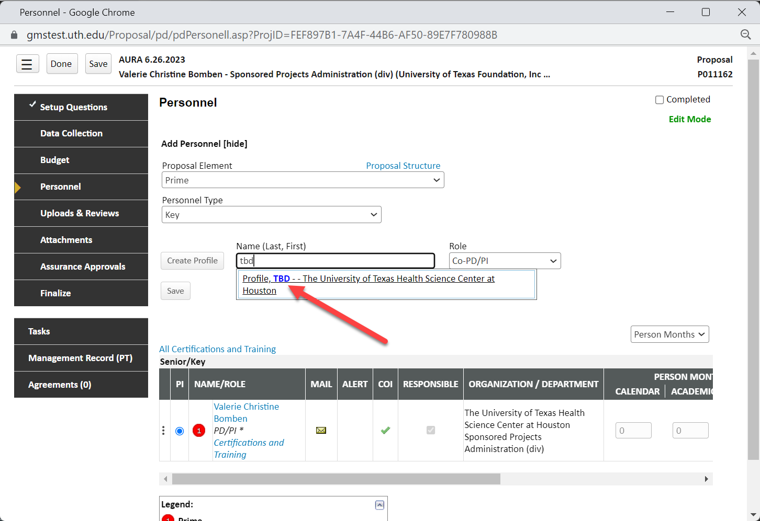
TBD Profile only “Loaded TbD” Profile

Slide 14
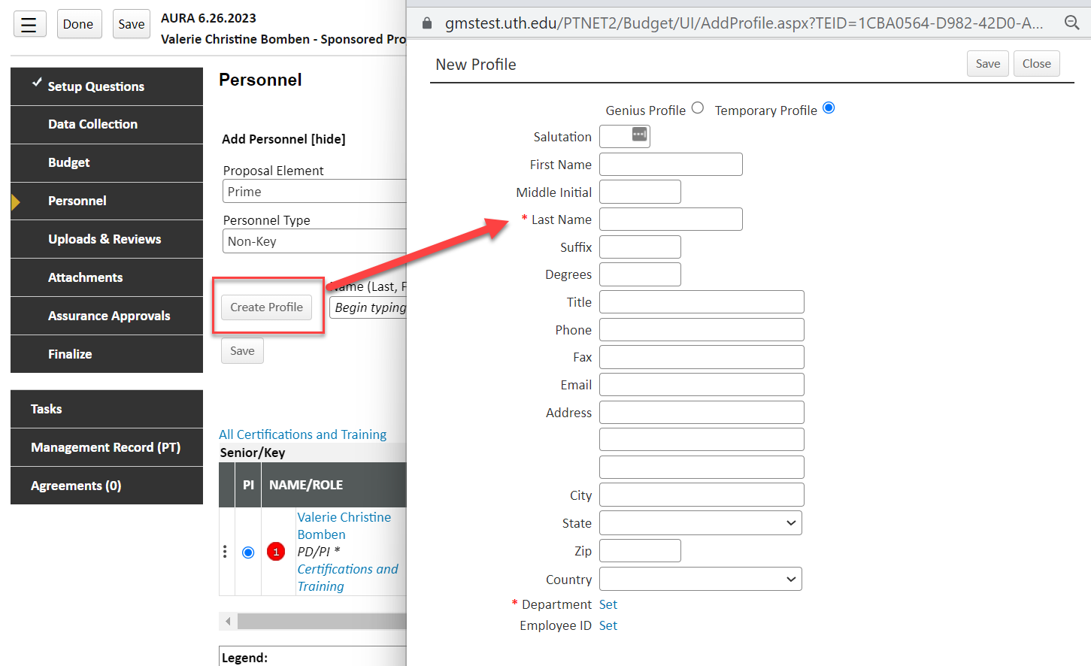
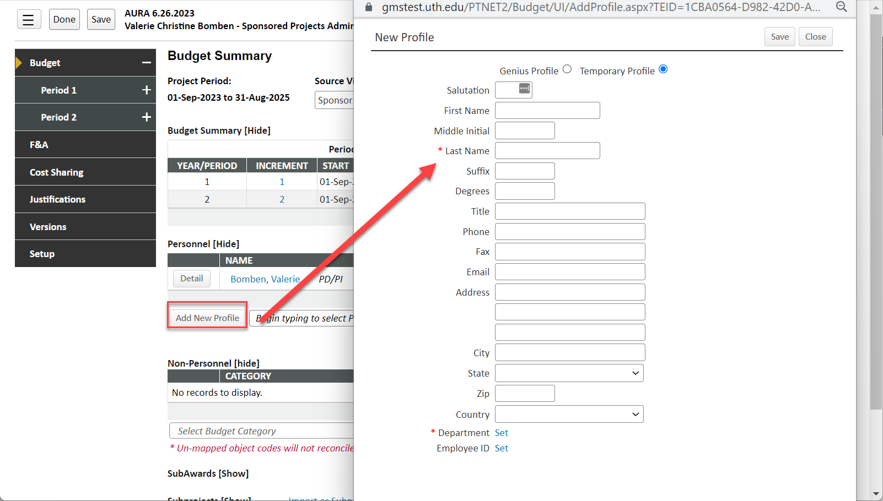
TBD profiles with more flexibility – TEMPORARY PROFILES

Slide 15
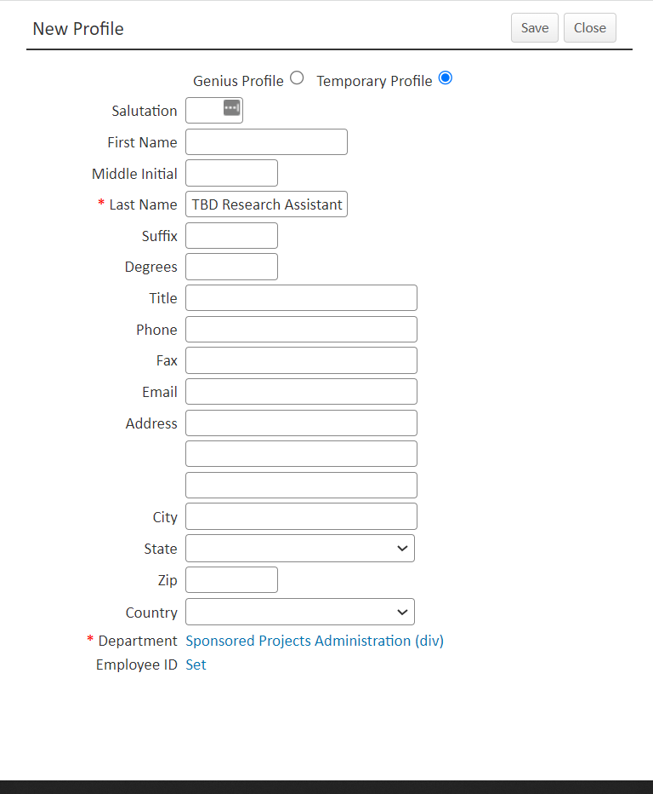
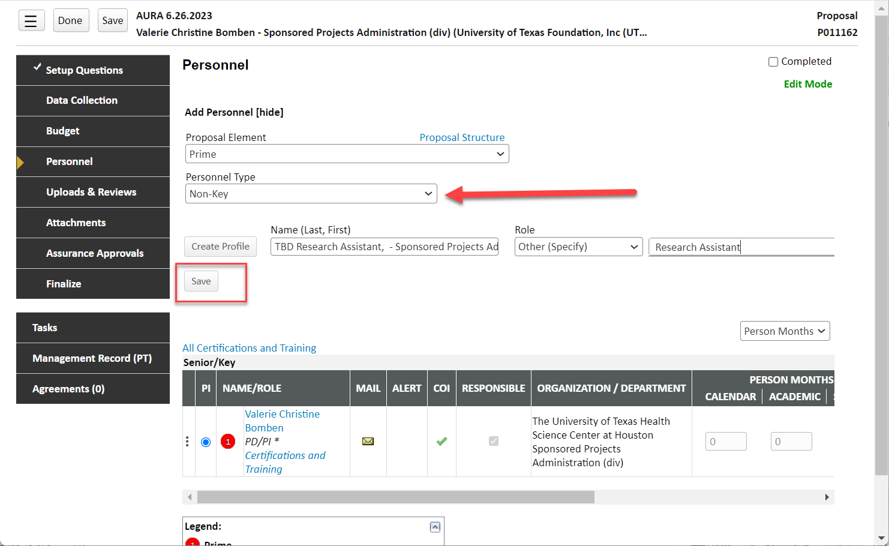

Slide 16
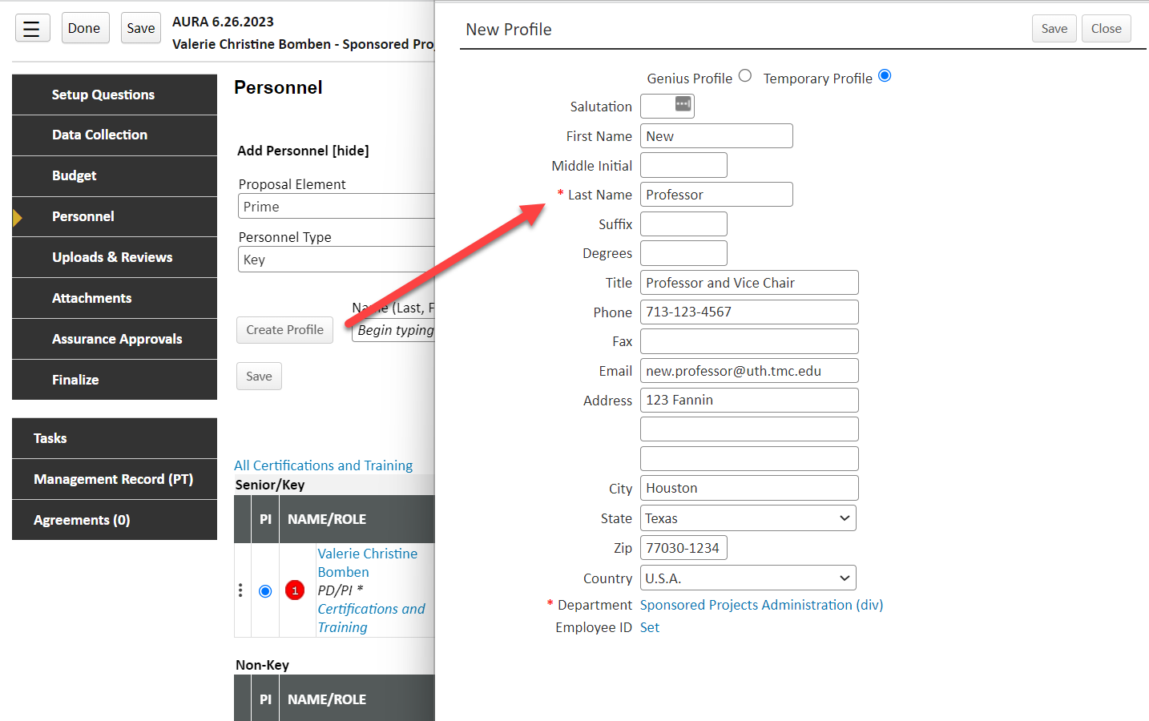
TBD profiles WITH KNOWN PERSONNEL– TEMPORARY PROFILES FOR INCOMING FACULTY OR KEY PERSONNEL

Slide 17
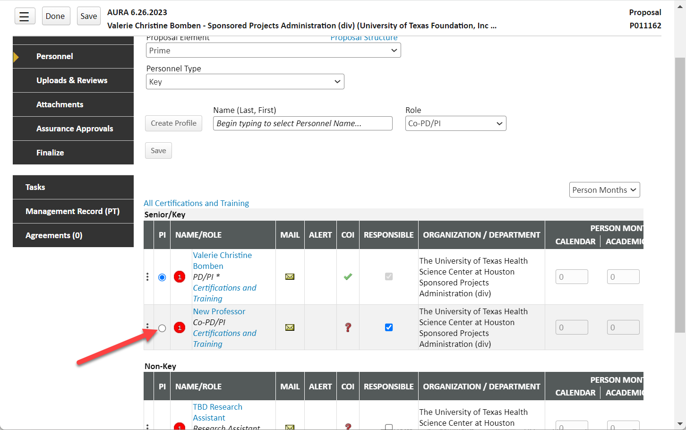

Slide 18
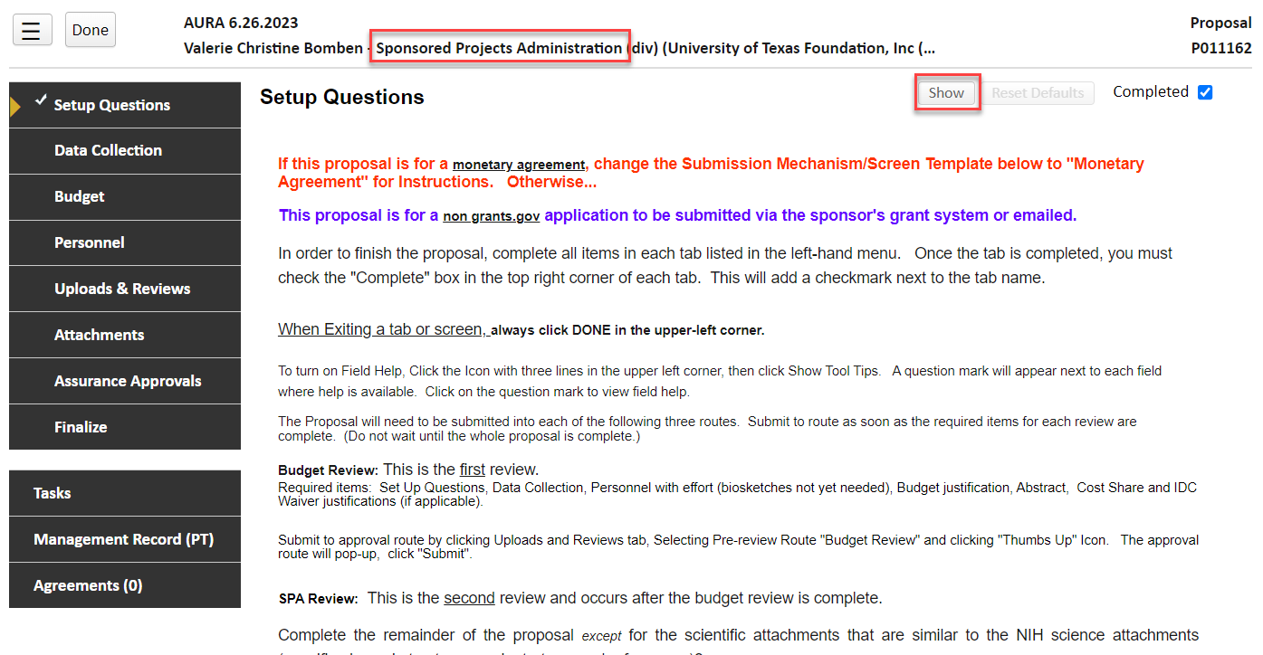
OTHER UTSTART Reminders:
Pay attention to which department your proposal is homed to (it impacts the ability to see it as well as which route steps the approvals go through)

Slide 19
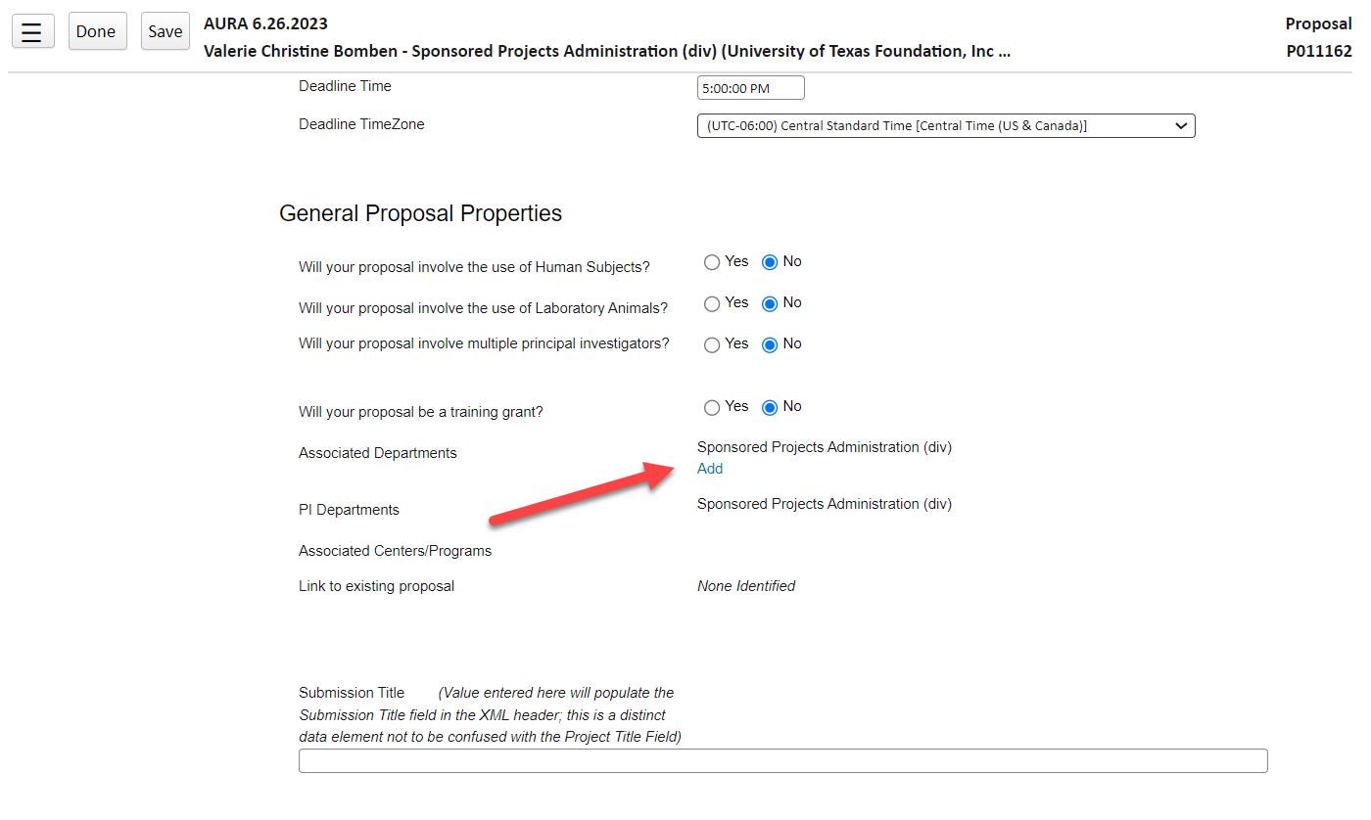

Slide 20
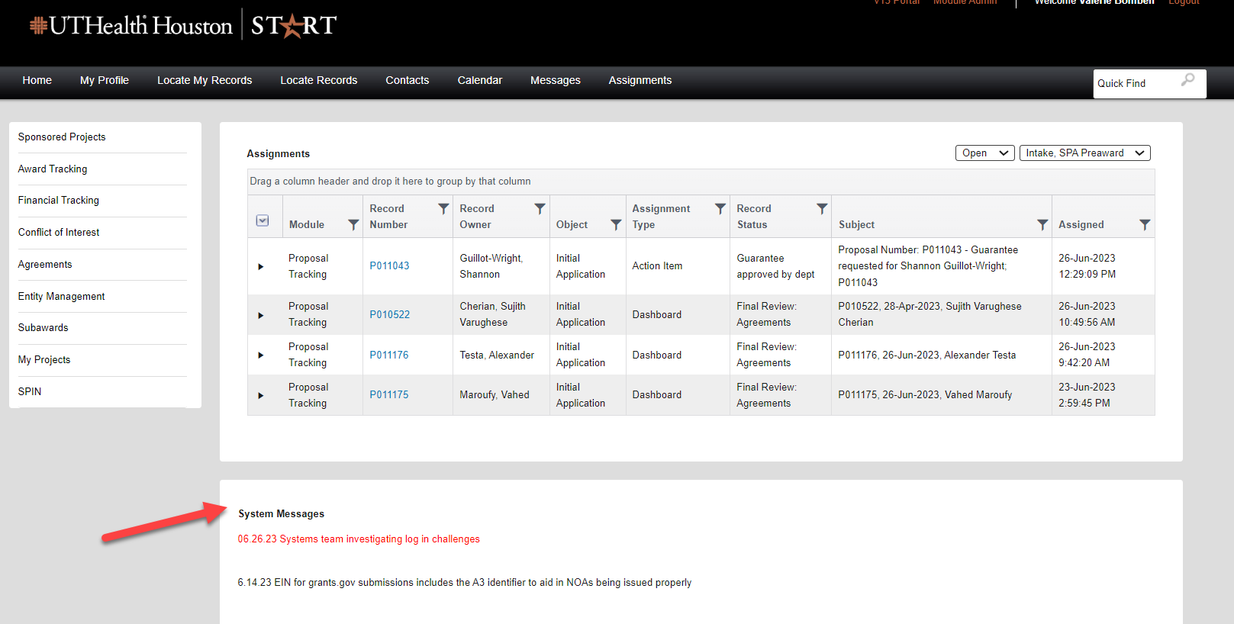
OTHER UTSTART Reminders:
Systems Widget is being updated when there is important information to be relayed

Slide 21
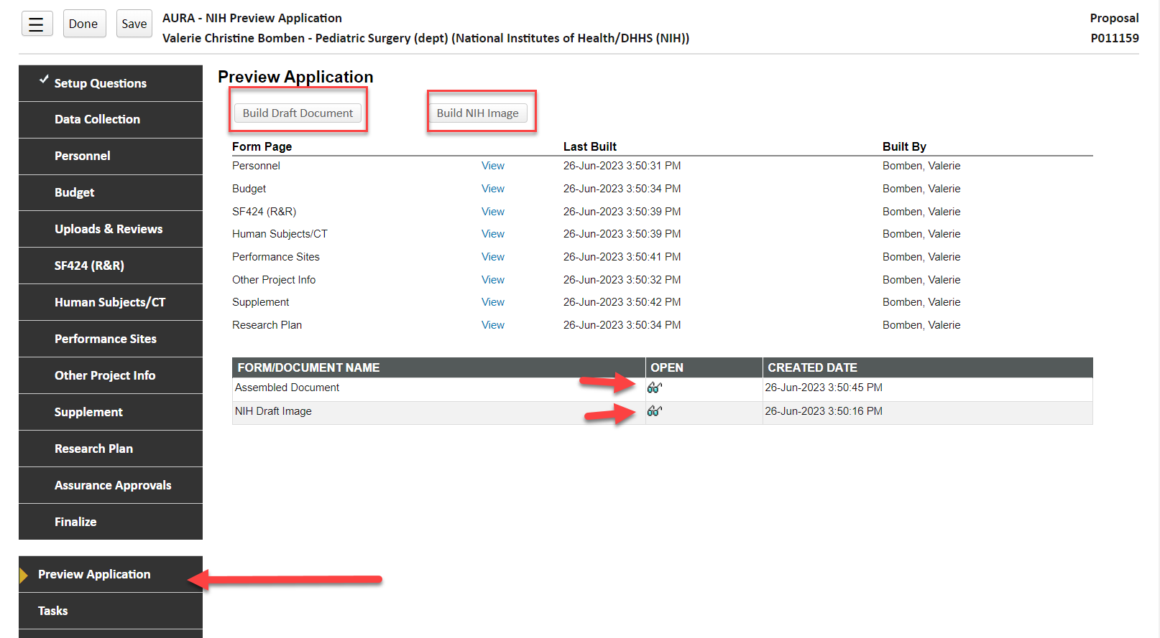
New Feature: PReVIEW Application
Does not run Validations – Builds assembled document preview and NIH Grants Image Preview

Slide 22
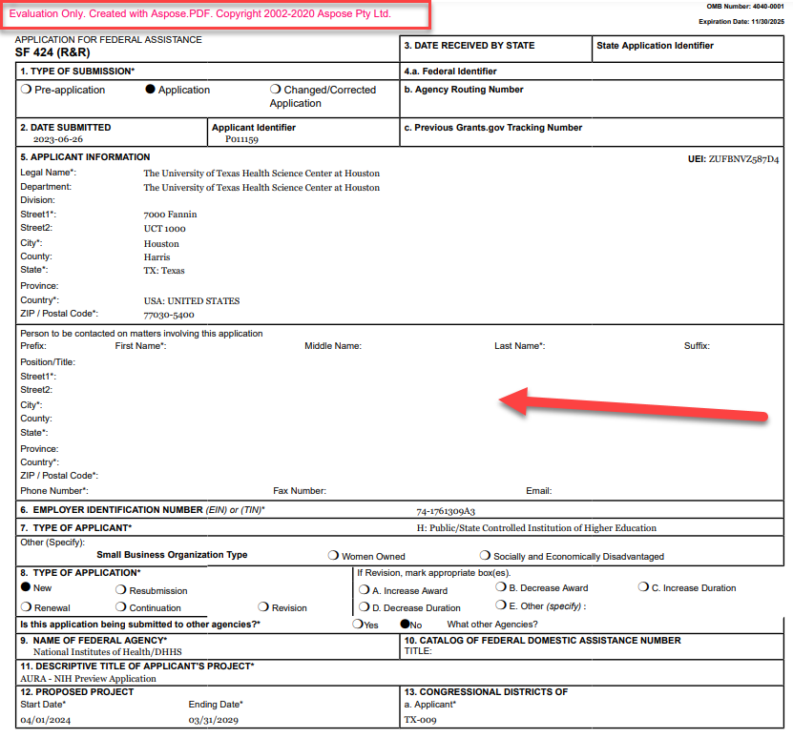

Slide 23
Non-compliant effort escalation process

Slide 24
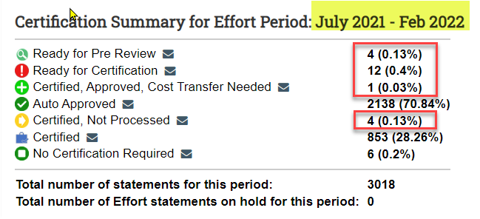
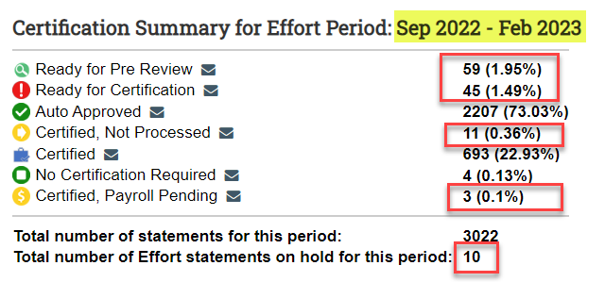
Outstanding effort reports
# of effort reports outstanding:
7/1/21-2/28/22 21
2/1/22-8/31/22 47
9/1/22-2/28/23 128

Slide 25
Outstanding effort reports
Always add a clear and accurate note explaining why an effort statement cannot be certified.
Follow through with the correction and completing certification.

Slide 26
Outstanding effort reports
Why do we have to do this?
Compliance with federal rules (internal controls to show the amount of salary charged is commensurate with the time worked on the project and the commitment the PI made in the proposal).
Effort reports are frequently audited. Audit findings lead to 1) reversal of expenditures and 2) UTHealth being categorized as “higher risk” for subawards.

Slide 27
Effort escalation process
Prior 3 effort periods:
Associate Deans for Management will be receiving list of outstanding effort reports to complete (from CFO).
Ongoing one-on-one discussions between SPA and Department Effort Coordinators
Effective with the 3/1/23-8/31/23:
Outstanding effort escalation process will begin.

Slide 28
Effort escalation process
Once the effort certification period ends, notices of non-compliance will begin for any non-certified effort report that does not have a note indicating a correction is needed.

Slide 29
Effort escalation process

Slide 30
Effort schedule
This is for planning purposes. Schedule may adjust due to unexpected delays, holidays, weekends, etc.

Slide 31
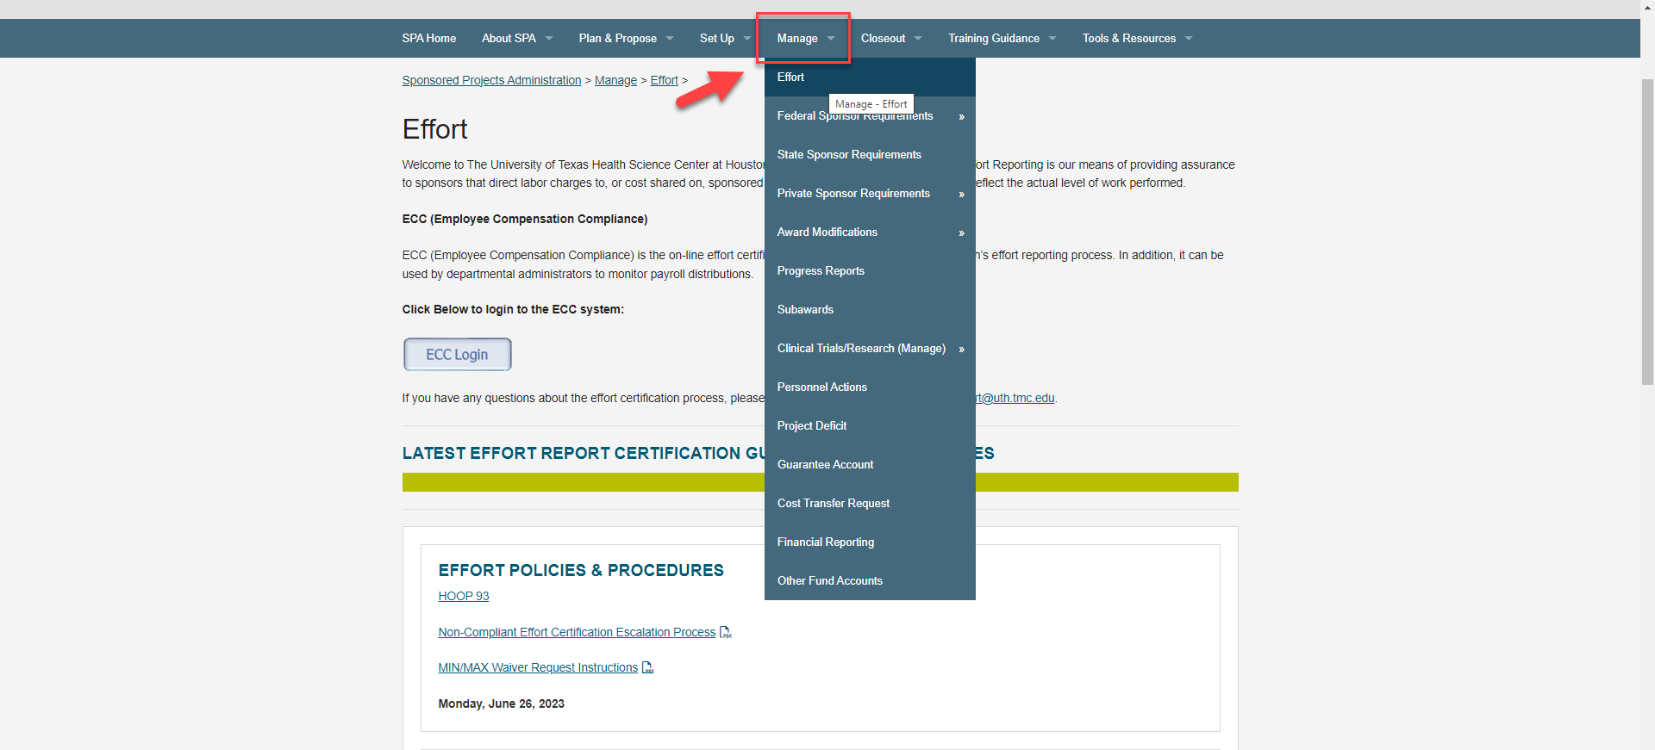
https://www.uth.edu/sponsored-projects-administration/manage/effort-reporting/

Slide 32
How to make effort easier
Appoint Effort Coordinators who have foundational grant knowledge and understand committed effort, salary cap, and cost share.
Submit guarantee requests for pending projects and complete PAs timely.
Review effort reports at least monthly for any potential issues.
What SPA is doing:
Streamlining award set up process
Proactive pending subin status with our PIs
Working on mid-effort cycle certification for PI’s leaving UTHealth
New L2S training module for reports and active effort monitoring throughout the year
SPA financial projects

Slide 33
Transfers to/from state funds
Cost Transfers to/from state appropriated funds (fund code 40000) are not permitted
Transactions are not part of state fund draw thus, cause an imbalance
Only CFO can grant an exception in extreme circumstances
Never “park” salaries on state appropriated funds
Request guarantee projects

Slide 34
Year end cost transfers
FY End Cost Transfer deadline for SDR is August 2, 2023
CTs must be sent to PAF by July 21, 2023 for review/approval
Review your projects for missing/low payroll
Review effort reports – payroll is posted every pay period
Missed deadlines may result in denial of cost transfer. Please don’t wait until the last minute.

Slide 35
Award processing team update

Slide 36
Award Processing Team
Award Processing Team began processing awards in March 2023. It was established to reduce award setup times & create continuity for the departments
Awards are assigned to the Team once a NoA is received
Pending Items typically include:
Assurances/RCOI (Project-specific disclosure)
Most RCOIs are completed via UTStart, the APT Specialist can provide guidance on the need for a PDF RCOI form
Updated Budgets
Confirmation of faculty effort and Work Start Date
Subcontract SOWs
APT Specialist will notify all Faculty/departments by email once the FMS is ready for use
Goal is to reduce CTMs, retro PAs and other “surprises” once an award is received

Slide 37
Award Processing Team
Award Processing Team Award Transition Status
Federal awards – Complete
Federal Subaward – Ongoing
Non-Federal Awards and Other Contract Types – Upcoming
Award Processing Team will be expanding in FY2024

Slide 38
Spa financial improvement projects

Slide 39
retreat
Identify ways to automate, update, improve SPA financial processes. Use RPA and Data Analytics where we can.
Full day with: CFO, PAF, SPA Directors, SDR, IT, Budget and Accounting, Supply Chain, FAST
Identified 20 projects to work on, ranging from easy to challenging. Projects are now being prioritized and assigned to working groups.

Slide 40
retreat
Projects that will benefit departments but we need your help on a few:
Auto Close PO encumbrances (RPA)
Review commitment control rules and allow departments to post their own
re-budget journals? (With a few exceptions.)
3. Update, automate, even eliminate, the Project Closeout Request form.
Define and identify high-risk requisitions before expenses are incurred. (RPA/IDEA)
5. Revise Project Account Summary Report: Add project start date, sponsor and, subtotal direct costs DONE!

Slide 41
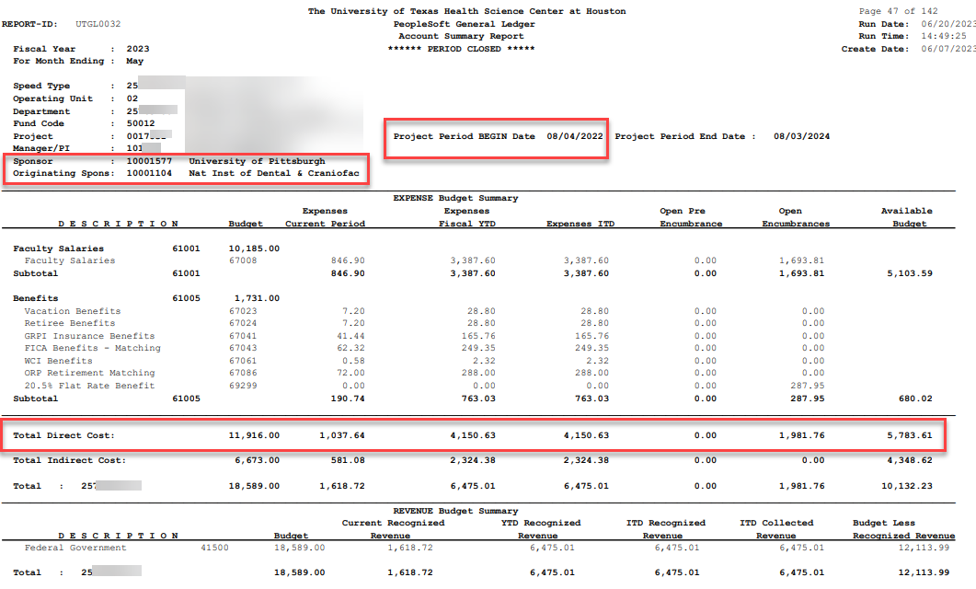

Slide 42
retreat
6. Merge program codes (10,11,12 Instruction and 13,14,15 Research)
7. Budget cash-based projects up front; 20-30% of expected revenue
Add project guarantee flag on project detail tab DONE!
9. Add flag to identify federal contracts (federal minimum wage requirement)

Slide 43
retreat
An Assortment of Projects around PAs, Cost Transfers, and Effort Reporting:
Create report/alert for new projects that are missing payroll expenses (RPA)
Add HCM effort % column to effort reports
compare HCM % effort to START committed effort (RPA to review and flag)
PI report to compare committed effort to HCM effort.
Identify key personnel (per NOA) in effort system
Redesign and automate entire cost transfer process. Can we:
initiate in HCM?
Add retro piece to current pay period PA? (e.g. two pp’s backwards without CTM)
Trigger and calculate a needed cost transfer?
Automate salary cap calculation?

Slide 44
retreat
Volunteers?
Please email me if you want to help with a specific project.

Slide 45
Q & A

