Slide 1
AURA Assembly of University research administrators
Sponsored Projects Administration
May 29, 2024

Slide 2
AGENDA
New Staff Introductions Kathleen Kreidler
Research Administration Internship Tiffany Sagers
FDP Updates and UG Changes Carmen Martinez
Grant Process Updates Carmen Martinez
NIH Progress Report Reminders Caroline Dietz
Agreement Matrix Valerie Bomben
AURA Teams Channel Valerie Bomben
Q & A All

Slide 3
New Staff Introductions

Slide 4
New Staff Introductions
If this is your first AURA meeting:
Unmute yourself, turn on your camera, and please tell us
your name
department
role/title
anything else you’d like to share

Slide 5
TIMELINE
Application Due – June 1, 2024
16 applications received
Candidate Interviews – June 10-21, 2024
Internship begins – September 1, 2024
4 interns in the first cohort.
CURRICULUM
**Classroom and Hands-on Training**
Guest Speakers
Webinars
Mentorship
Networking Opportunities

Slide 6
Are you interested in becoming a trainer?
Classroom Trainer
In-person (half or full day)
Senior Level Role
4+ years of experience
Hands-On Trainer
In-person (job shadowing)
2+ years of experience
All trainers will be paid. Training is in addition to your current workload.
Remote training is not allowed.
Should have manager approval.

Slide 7
FDP Updates & UG Changes
Federal Demonstration Partnership
partnership between the federal funding agencies and research institutions to reduce the administrative burdens associated with research administration
350 member organizations
Membership meets 3x/year to discuss agency updates, process improvements and makes recommendations to federal partners
Notes:
Required per HOOP and is common practice at all AHSC. Identifies patient care costs that should not be billed to insurance/patient. (these will need to be covered by study account )

Slide 8
FDP May 2024
Big changes to Uniform Guidance
Effective for all Federal awards issued on or after October 1, 2024
Financial principles and subrecipient policies reflect major updates
Federal Agencies (NIH, NSF, DoD, etc) have until May 15, 2024 to notify OMB of their implementation plans
Guidance to be released through agency updates (haven’t seen anything yet – agencies are still updating)
Some federal agencies may elect to apply the 2024 Revisions to Federal awards issued prior to October 1, 2024 (still waiting on agency updates)
Notes:
Required per HOOP and is common practice at all AHSC. Identifies patient care costs that should not be billed to insurance/patient. (these will need to be covered by study account )

Slide 9
Summary of Important 2024 UG Changes:
Change | Benefits | Considerations
**(200.100) Increase Capital Equipment to $10,000 | Fewer items listed as capital equipment | May impact budgets with total cost limitations
(200.308) Changes in subcontracts require Prior Approval when changing the scope of activities or if the agency puts it in the T&C of the award | Limits seeking Prior Approval to rebudgeting/changes more closely related to programmatic goals | Subrecipient monitoring now includes how expenditures tie to program objectives and performance
(200.413) Charge Admin Staff salaries to grants (200.472) Charge closeout costs to grants | Charge support staff salaries when it directly benefits the project | Need to document the direct benefit to the project and confirm the costs are not already recovered under F&A
(200.414) Increase de minimus rate from 10% to 15% | Subrecipients without a negotiated rate can collect more IDC | May impact budgets with total cost limitations
Notes:
Required per HOOP and is common practice at all AHSC. Identifies patient care costs that should not be billed to insurance/patient. (these will need to be covered by study account )

Slide 10
Summary of 2024 UG Changes
Change | Benefits | Considerations
(Appendix I) Revised the NOFO to contain important information at the top of the announcement | Provides common/consistent information for funding opportunities | none
**(Appendix II) Increase IDC recovery to first $50,000 on subcontracts | Cover more of the admin costs associated with subcontracts | May impact budgets with total cost limitations
**UTHealth can’t implement until 2026
Agency guidance from NIH, NSF, DOD, etc. will be released before the 10/1/24 effective date.
Notes:
Required per HOOP and is common practice at all AHSC. Identifies patient care costs that should not be billed to insurance/patient. (these will need to be covered by study account )

Slide 11
Grant Updates
1. Forms-I Package to be released for NIH
Effective for applications submitted for due dates on or after January 25, 2025.
FORMS-I will incorporate updates related to multiple NIH initiatives:
• Improvements to the NIH Fellowship Application and Review Process.
• Updates to NRSA Training Grant Applications.
• Adoption of the Common Forms for Biographical Sketch and Current and Pending (Other) Support for submission of applications and RPPRs by May 2025.
Application guide and forms packages will be available in Fall 2024.
Notes:
Required per HOOP and is common practice at all AHSC. Identifies patient care costs that should not be billed to insurance/patient. (these will need to be covered by study account )

Slide 12
2. Common Forms for the Biographical Sketch and Other Support
Common Forms harmonize content requirements for both forms for use by Federal Research Funding Agencies
Both forms include the requisite certification from NDAA 2021, Section 223 regarding information being accurate, current and complete and that the individual is not a party to a MFTRP
Must be created in SciENcv
required for NSF proposals due on or after May 20, 2024
NIH will implement for submission of applications and RPPRs on or after May 25, 2025
Notes:
Required per HOOP and is common practice at all AHSC. Identifies patient care costs that should not be billed to insurance/patient. (these will need to be covered by study account )

Slide 13
3. Changes to Resubmission Applications effective May 25, 2024 (NOT-OD-24-061)
The use of markups should not be used to identify changes in Resubmission applications.
Changes made to a resubmission application should only be outlined in the Introduction attachment.
• Must include a summary of substantial additions, deletions, and changes to the application.
• Must include a response to weaknesses raised in the Summary Statement.
• Unless otherwise indicated in the Table of Page Limits, the Introduction may not exceed one page.
4. Increased Childcare Subsidies for NRSA Fellowships and Training Grants
(NOT-OD-24-116)
4/3/24: NIH announced a $500 increase in childcare subsidies for scholars supported on NIH Kirschstein National Research Service Awards
NRSA fellows may request $3000 (up from $2500) in FY24.
Increase is applicable to all FY24 NRSA awards
NIH will revise eligible training and fellowship awards that were issued prior to this announcement to reflect the increase in support
Notes:
Required per HOOP and is common practice at all AHSC. Identifies patient care costs that should not be billed to insurance/patient. (these will need to be covered by study account )

Slide 14
RPPR Updates

Slide 15
RPPR Due Dates
RPPR Types
SNAP (Streamlined Noncompeting Award Procedures): ≈ 45 days before end of budget period
Non-SNAP: 2 months before end of budget period
Interim and Final RPPRs: 120 days after the end of the period of performance
Multi Year Funded RPPRs: Due annually on or before Anniversary Date
Examples (Read NoA, Section 2 and 4)
SNAP: R01, R21, R35, K01
Non-SNAP: U24, P01
Interim: Renewals and Type 4 continuations (Prefix of 2 or 4)
Final: All completed grants
Multi Year: RF1, some R21 and R03
Best Practice: Route to SPA within 10 days of due date

Slide 16
RPPR Due Dates
RPPR Types
SNAP (Streamlined Noncompeting Award Procedures): ≈ 45 days before end of budget period
Non-SNAP: 2 months before end of budget period
Interim and Final RPPRs: 120 days after the end of the period of performance
Multi Year Funded RPPRs: Due annually on or before Anniversary Date
How to Access RPPRs
SNAP/non-SNAP: RPPR module or PI Status Screen
Interim and Multi Year Funded: PI Status Screen Only
Final RPPR: Status Screen: Initiate Closeout
Best Practice: Route to SPA within 10 days of due date

Slide 17
RPPR Due Dates
RPPR Types
RPPRs due in June | Due | Initiated | With SPA | Submitted
June 1 | 6 | 6 | 0 | 0
June 15 | 20 | 16 | 1 | 1
Best Practice: Route to SPA within 10 days of due date

Slide 18
Reporting Publications
NIH Public Access Policy:
To advance science and improve human health, NIH makes the peer-reviewed articles it funds publicly available on PubMed Central. The NIH Public Access Policy requires scientists to submit final peer-reviewed journal manuscripts that arise from NIH funds to PubMed Central immediately upon acceptance for publication.

Slide 19
Reporting Publications
Identifying issues early
Non-Compliant: Generates a Warning on the RPPR and an automatic email upon RPPR submission
The publication must be made Public Access Compliant before a continuation can be issued
If less than 90 days since publication, the status will automatically update to In Progress once the compliance process is initiated.
If greater than 90 days since publication it can take up to 6-8 weeks before the publication is considered Public Access Policy Compliant

Slide 20
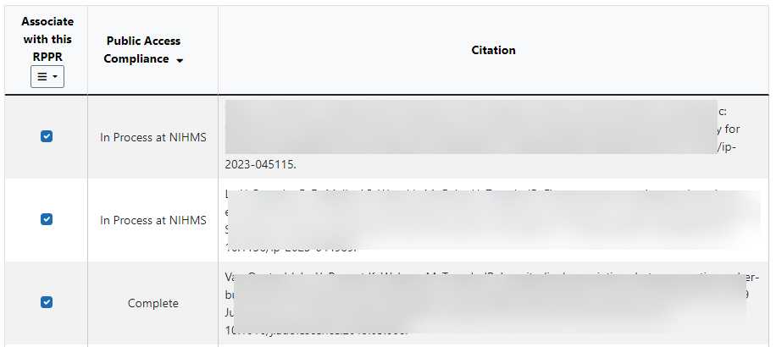
Reporting Publications
Any time a NIH-funded publication is accepted for publication, plan for Public Access Compliance from Day 1
More Information on making publications Public Access Compliant is available at:
https://sharing.nih.gov/public-access-policy
Public Access Policy-Compliant Statuses for Publications Associated with a RPPR:
Complete
In Process at NIHMS
PMC Journal – In Process

Slide 21
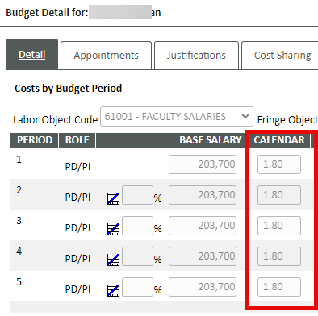
Effort
Section D. Participants: Reported Effort and Other Support
Section D.1 What Individuals have worked on the project?
Provide or update the following information for:
1. program director(s)/principal investigator(s) (PDs/PIs); and
2. each person who has worked at least one person month per year on the project during the reporting period…
Example: Reported effort, .7 CM is greater than a 25% reduction from the committed level of 1.8 CM. Prior approval is needed in advance of effort reductions for named senior/key personnel

Slide 22
Effort
Section D.2c Changes in Other Support
Has there been a change in the active other support of senior/key personnel since the last reporting period?
If yes, upload active other support for senior/key personnel whose support has changed and indicate what the change has been
Other support information should be submitted only for new senior/key personnel and when there has been a change in other support for the PD/PI or those individuals considered by the recipient to be key to the project
Senior/key personnel are those identified by the recipient institution as individuals who contribute in a substantive measurable way to the scientific development or execution of the project, whether or not salaries are requested.
Other Support is reviewed for:
Active projects are listed in alignment with UTStart
Format: NIH template: Active, Pending, In Kind, UTHealth required sections
Participation in active foreign awards/entities
Secondary faculty Appointments (paid or unpaid, list all outside of UTHealth)
Committed effort for current and future years
Maximum and Minimum Effort, per HOOP93: https://www.uth.edu/hoop/policy.htm?id=1448034
Digital Signatures: Institutional Docusign account: https://inside.uth.edu/admin-tech/e-learning/docusign/

Slide 23
Human Subjects
Section G. Special Reporting Requirements
G.4 Human Subjects (Access through RPPR or through ASSIST)
If conducting NIH-defined clinical research, reporting the cumulative enrollment of subjects and the distribution by sex/gender, race, and ethnicity is required:
This requirement includes:
Clinical Research: non-exempt non-clinical trials
Clinical Trials: 1.4a-1.4d answered “Yes”
If the last competing application was submitted for due dates January 25, 2019 or later, recipients must update enrollment data by submitting deidentified individual-level participant data using the spreadsheet template available in the Human Subjects System (HSS). These data include age and must use the Participant Level Data Template.
Age data can not be manually entered = Actual data can not be manually entered any longer.
The template is required.

Slide 24
Unobligated Balance
G.10.a Is it anticipated that an estimated unobligated balance (including prior year carryover) will be greater than 25% of the current year’s total approved budget? If yes, provide the estimated unobligated balance.
The total approved budget equals the current fiscal year award authorization plus any approved carryover of funds from a prior year(s). The numerator equals the total amount available for carryover and the denominator equals the current year’s total approved budget.
Unliquidated obligations (subawards and encumbered expenses through the end of the budget period) are commitments of the recipient and are considered to be obligations and, therefore, should not be reported as unobligated balances.
The Unobligated Balance Tool available on the SPA website is a tool to calculate the unobligated balance and excludes unliquidated obligations
Caveat: NIH can not see our internal finances and will request follow up if the balance seen in the Payment Management System is greater than 25% of the amount awarded in the past year.
Recommendation: If the Overall remaining balance exceeds 25% of the current year award, answer “yes” with an explanation to detail the unliquidated obligations (encumbered subawards and other costs), estimated invoice amount/timing and estimates of what will remain at the end of the budget period

Slide 25
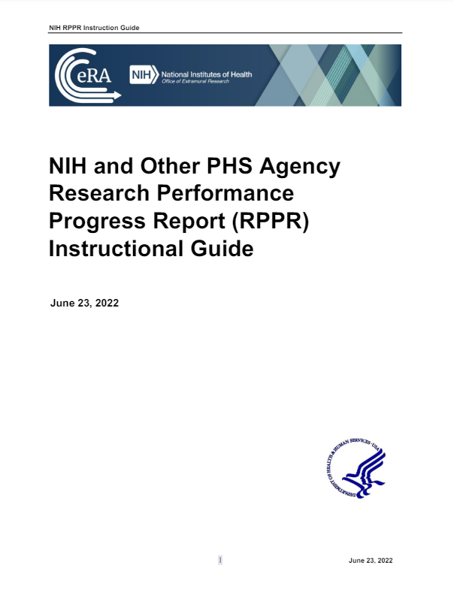
Coming Soon: NIH RPPRs
An updated NIH RPPR Instruction Guide will be posted to the NIH RPPR page upon approval from OIRA, per NOT-OD-24-123, effective for RPPRs submitted on or after October 1, 2024
The updated NIH RPPR Instruction Guide will address the NIH Data Management and Sharing Policy and reporting instructions related to RPPRs
For new awards subject to the Data Management and Sharing Policy with upcoming RPPRs:
Prior to 09/01/2024: PIs will receive a form to complete for DMS Compliance
Starting 09/01/2024: PIs will interact with DEPUT to complete the online form, training to follow
Questions?
Email me:
Caroline.J.Dietz@uth.tmc.edu
https://grants.nih.gov/sites/default/files/rppr_instruction_guide.pdf

Slide 26
Agreement Reminders/Agreement Matrix

Slide 27
Agreement Reminders
Non-monetary Agreement requests require intake information from the department in order to begin a review
- Make sure to “submit” your record otherwise it is not received by the office to begin a review – if the agreement is “Under Development”, SPA doesn’t have knowledge of it
-Confidentiality, Material Transfer, Data Transfer
- Sharing UTHealth CI goes through Tech Management

Slide 28
Agreement Reminders
Monetary Agreement requests require an approved proposal record before negotiation begins
- Logging is more variable (preaward intake, specialists, departments)
- If proposal record is in Agreement in Negotiation, there will be an agreement record linked where SPA is tracking the status of the negotiation
- Agreement status of “Pending PD Budget Approval” implies that the proposal approvals not yet received and the agreement is in a holding pattern

Slide 29
Agreement Reminders
**The title of the contract does not always correlate with the terms and conditions of a contract**
Agreement Matrix created by Sponsored Contracts team
- Agreement Matrix Form
**Cost share approvals may be required for non-monetary contracts where UTHealth is obligated to provide data, reprots or contractually make intellectual property promises
**Industry projects in particular are being looked at closely

Slide 30
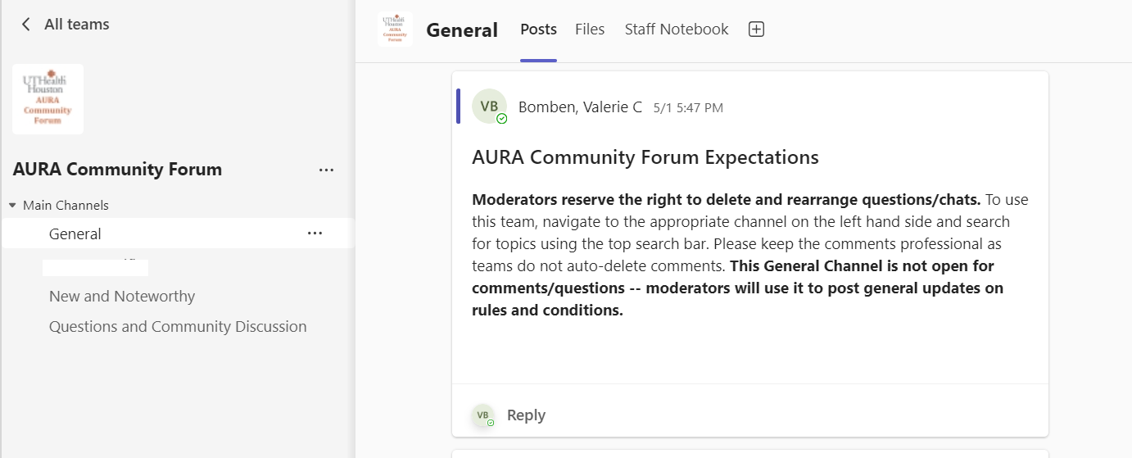
AURA Community Forum
AURA Community Forum | General | Microsoft Teams

Slide 31
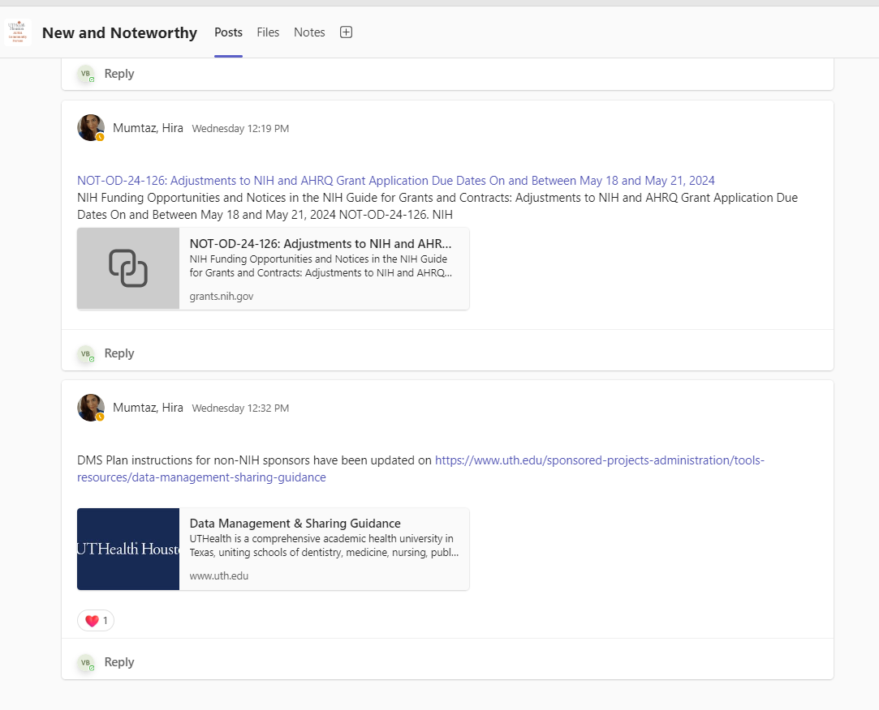
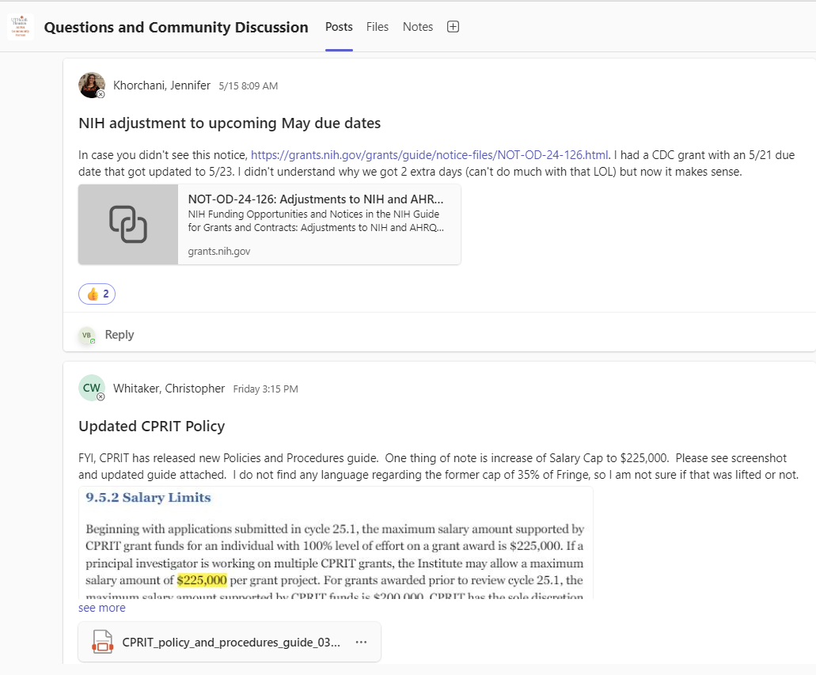

Slide 32
Q & A

