Slide 1
AURA
November 6, 2019

Slide 2
Agenda:
Introductions
UTHealthSTART: System Updates
PI Separation Process
Q & A

Slide 3
UTHealthStart – Interfaces
FMS/PeopleSoft financials:
Completed 11/3/19
Validating data and nightly load 11/4-11/7
Available to all departments Friday, 11/8/19
iRIS:
Finalizing build and testing
Scheduled to go live before holiday break
Show 0013755

Slide 4
UTHealthStart – Historical Data Conversion
Pending proposals DONE
Brand new awards – straight into START – Ongoing
Includes issuing new subawards
Existing Awards as of 9/1/17 – about 10% done
Priority:
1. In Process awards (manual migration from old system)
2. Amendments to existing awards
3. All remaining monetary awards
4. Non-Monetary agreements
Historical Document Links – Early to mid 2020

Slide 5
UTHealthStart – Historical Data Conversion
Existing Awards
if amendment received or change needed, first check to see if project has been loaded into START
  If yes – submit a change request via START
  If no – submit amendment/change to Preaward@uth.tmc.edu
  Do not submit an amendment via START if the initial grant award or agreement is not in START
Savitz, active, P001988

Slide 6
UTHealthStart – Faculty Training
Current faculty members/chairs/DMOs must attend in-person training
SPA will conduct a faculty training session if arranged by the department. Must have at least 6 faculty members attend. (Computer room or laptops.)
Working on training schedule beyond November
On-Line Faculty training
  Develop December, 2019 – March, 2020
  4 – 5 sections of 20-30 minutes each

Slide 7
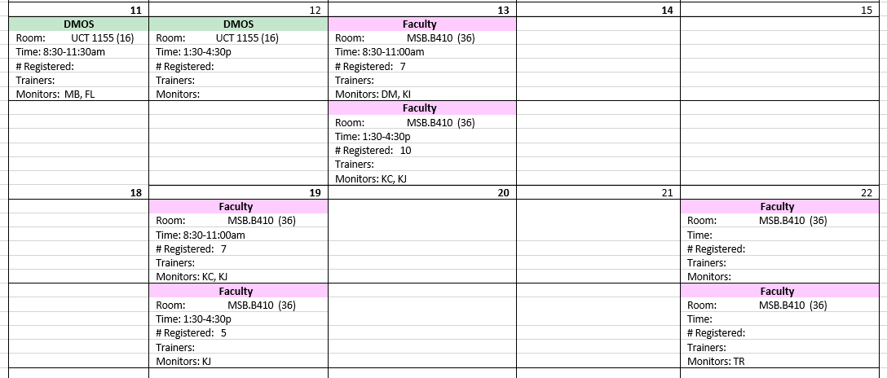
UTHealthStart –Training
November, 2019

Slide 8
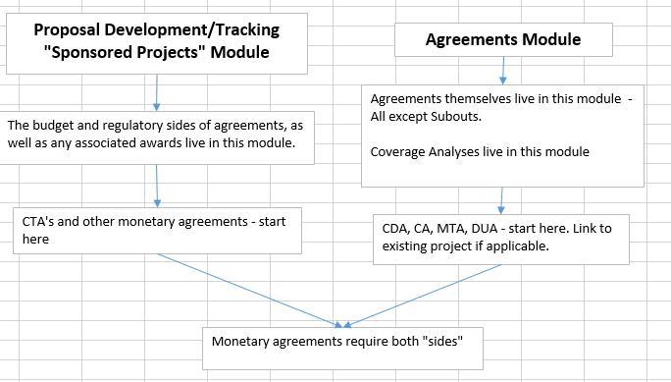
UTHealthStart – Monetary Agreements

Slide 9
UTHealthStart – Monetary Agreements
Create monetary agreement record from the Sponsored Project Record
Submit agreement from the Agreements Tab
Contract negotiation begins when:
Budget submitted for review and,
Coverage Analysis submitted to CRFA (if applicable)
Agreement placed On Hold until budget and CA submitted.
Create new monetary agmt

Slide 10
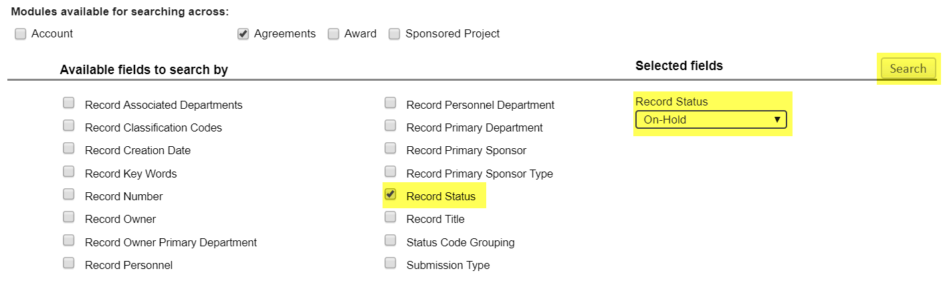
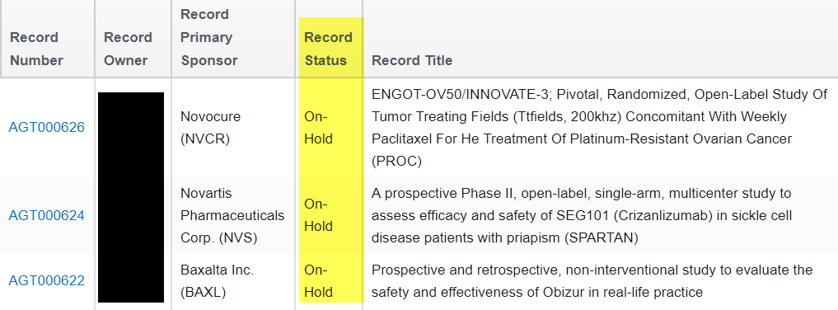
UTHealthStart – Monetary Agreements

Slide 11
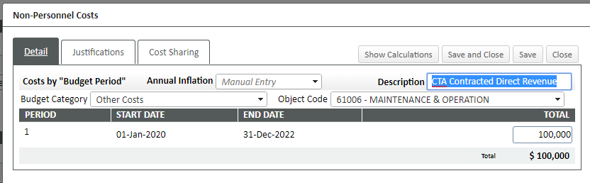
UTHealthStart – Monetary Agreements
Personnel tab: Industry sponsored clinical trials - List only the PI, no effort or salary. All other monetary agreements require all personnel and effort to be listed.
Budget Tab: Industry sponsored Clinical trials – non-personnel - One line for total anticipated
direct revenue. Build full budget for all other agreement types

Slide 12
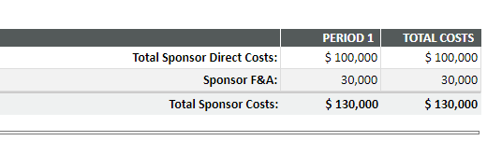
UTHealthStart – Monetary Agreements
Indirect Cost revenue should automatically calculate based on the Program Type selected on Set-Up Questions tab.
Attach Completed CA and budget grid (Excel file) for industry sponsored clinical trials
Submit for budget review

Slide 13
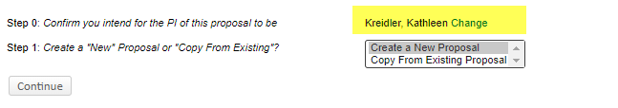
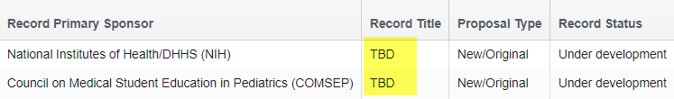
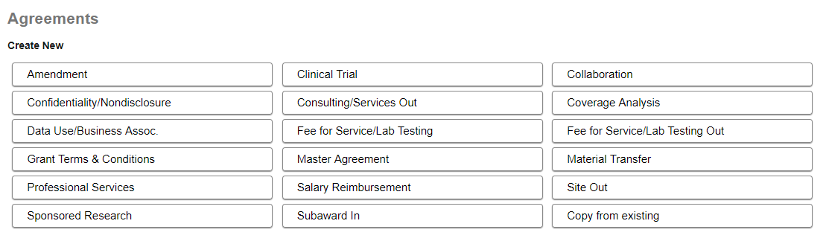
UTHealthStart – Common Errors/Reminders
Update the PI – Step 0
Add a title. A working title is fine. It can be changed at any time. Please not TBD or blank.
One click create in Agreements

Slide 14
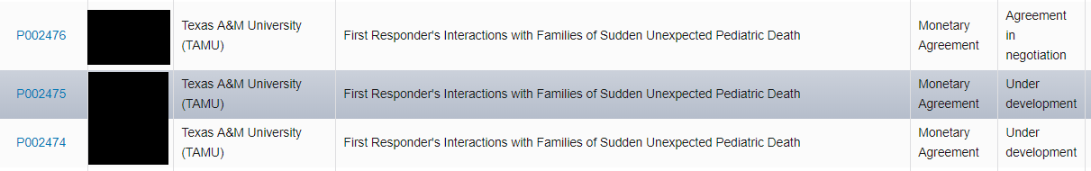
UTHealthStart – Common Errors/Reminders
If you mess up, just let Systems & Reporting know. We will fix or delete. Agreements – single click to create is a little dangerous.
Abandoned proposals and agreements will be deleted after 2 months (under development and no activity)
Budget 100% of project costs, not just the sponsor costs (test P002821)

Slide 15
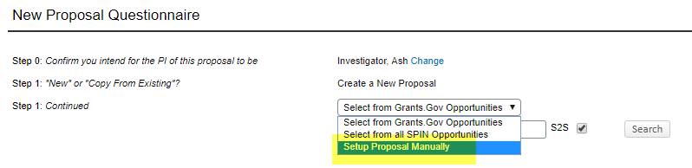
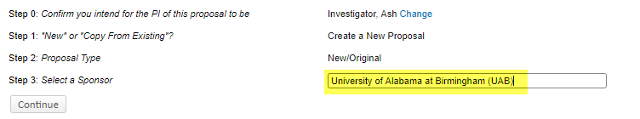
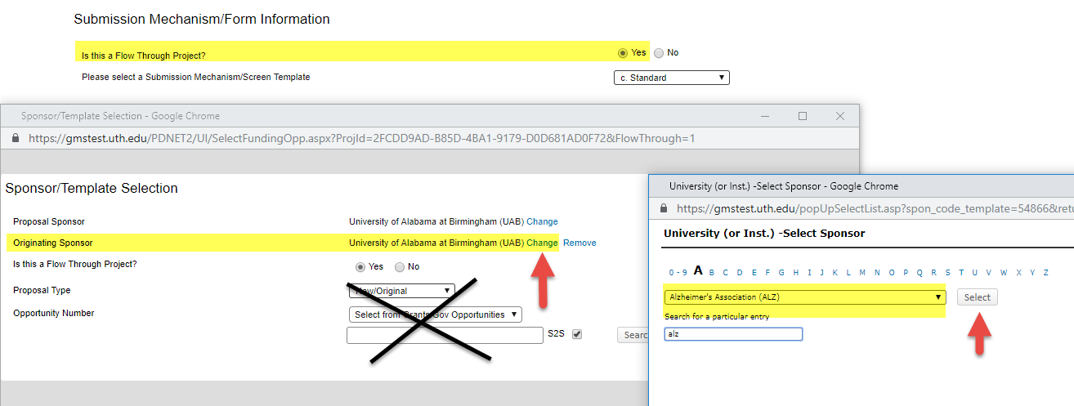
UTHealthStart – Common Errors/Reminders
Sub-In Proposals
- ALWAYS manual proposal
- Sponsor is ALWAYS the prime institution
- Set up Questions – Flow through project? ALWAYS answer YES
Click Save

Slide 16
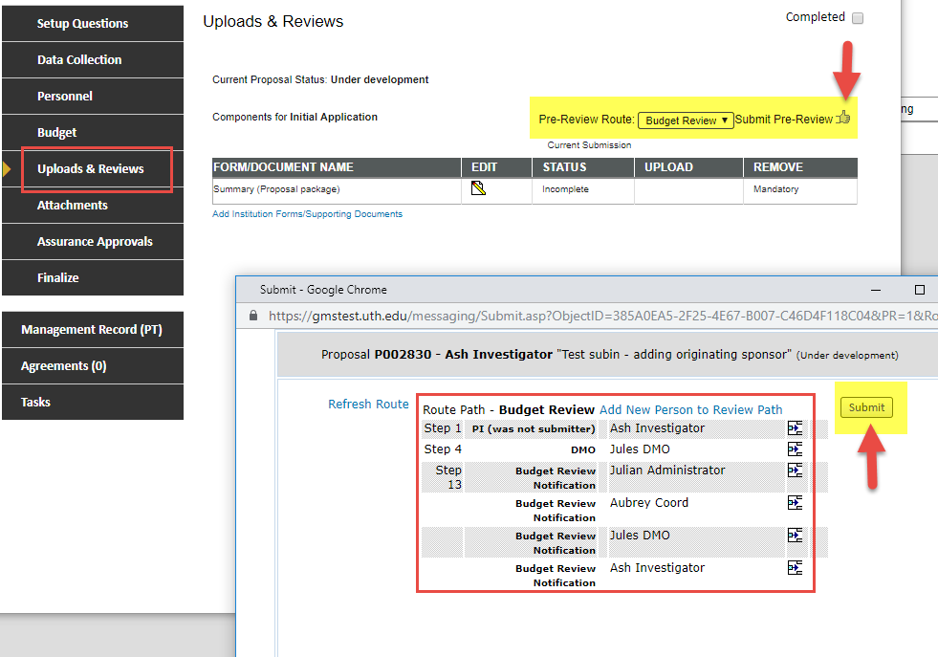
UTHealthStart – Common Errors/Reminders
Review route before clicking submit

Slide 17
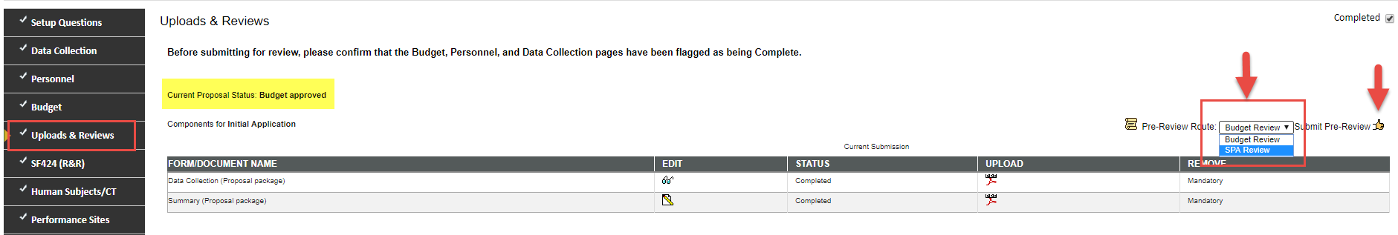
UTHealthStart – Common Errors/Reminders
Change from Budget Review to SPA Review
After receiving budget approval, complete the proposal except for final science, and submit to SPA review. If you don’t change it to SPA review, it will go back into budget review. Check the route to make sure it is going to a SPA specialist before you hit the submit button on the next window.

Slide 18
UTHealthStart – PI Separation
When a PI is leaving UTHealth:
Complete PI Separation Checklist and submit to Carmen Martinez and Sujatha Sridhar
    https://www.uth.edu/research/docs/pi-separation-checklist.docx
    Carmen and Sujatha discuss with EVP, Chief Academic Officer
      What does the PI want to take?
      What is happening with the grants?
    EVP, CAO will discuss PI separation with department chair
    EVP, CAO is the only person who can approve data/materials leaving UTHealth and the only person who can approve grant transfers
    Departing PI should not contact grant sponsors until EVP, CAO has provided approval. But, this will be done by Director, Grants & Contracts upon approval.

Slide 19
UTHealthStart – PI Separation
When a PI is leaving UTHealth:
Once approval is received:
  work with PAF to finalize estimated balances to transfer
    Only current year award dollars can be included on relinquishing statement (without prior year balances.)
    Contact Valerie Bomben for any data/material transfer agreements to the new institution
    Follow UTH Policies and procedures (e.g. transferring a capital asset)
3. Monitor PI spending. Do not decrease grant spending to increase internal funds spending.

Slide 20
Q & A
Next AURA Meeting:
February 5, 2020 9:00am – 10:30am

