Slide 1
AURA Meeting
June 3, 2015

Slide 2
Welcome
Karen Niemeier
Director, Contracts

Slide 3
Housekeeping Items
ITV Groups
Please mute microphones
Presenters
Repeat questions in mic

Slide 4
Website Spotlight
Troy Roberson
Systems & Reporting Specialist

Slide 5
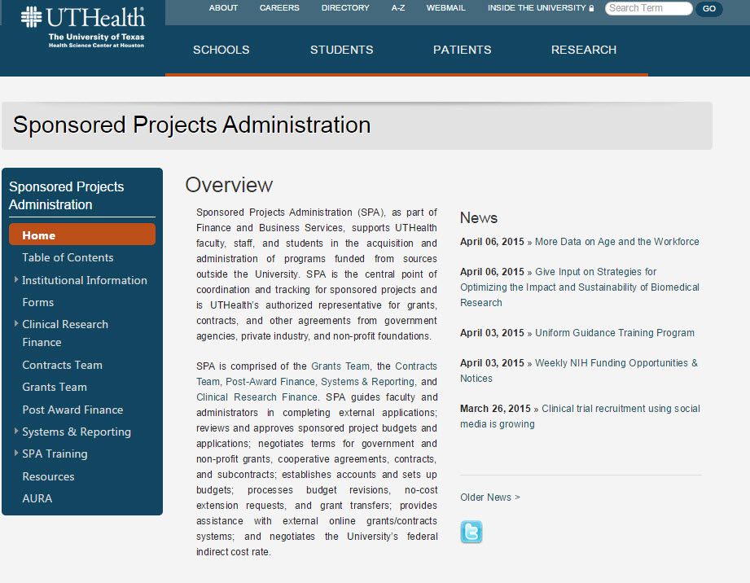
Website Spotlight

Slide 6
Updates
Karen Niemeier
Director, Contracts
Sponsored Projects Administration

Slide 7
Greenphire ClinCard
ClinCard is a secure reloadable debit card
Process/procedure for use under development now
SPA will provide training on handling/use
Roll-out 9/1

Slide 8
Updates
Heather Cody, MHA
Supervisor, Clinical Research Finance

Slide 9
CRF Updates
Budget Tool Update
Lunch & Learn: Wednesday, June 10th
11:00-12:30
Clinical Research Billing Implementation
Questions or issues contact CRF

Slide 10
Effort Reporting
William Mitchell, MPSA
Supervisor, Systems & Reporting
Sponsored Projects Administration

Slide 11
Effort Reporting Dates
Pre-Review Period: July 6-19
Certification Period: July 20-August 20
Travel restrictions on uncertified cards August 24

Slide 12
Effort Reporting Reminders
Please review all cards for accuracy
Initiate Personnel Actions, if needed
Place incorrect cards on hold until fixed
Make adjustments for Cost Sharing (CPRIT)
Guides and forms on Effort website
go.uth.edu/effort

Slide 13
Final Remarks
Jodi S. Ogden, MBA, CRA
Associate Vice President
Sponsored Projects Administration

Slide 14
Internal Review
R&A forms should be thoroughly reviewed before sign-off
IDC waiver vs. cost share
All sponsored projects require min. 2% effort
If budget does not cover PI salary, request a cost share
Don’t wait until the last minute!

Slide 15
Late vs On-time Submissions

Slide 16
Hot Topics

Slide 17
Next Meeting:
July 22, 2015
Presentations & schedule posted at:
go.uth.edu/AURA

