Slide 1
AURA Meeting
May 25, 2016

Slide 2
Welcome
Heather Cody, MHA
Assistant Director,
Clinical Research Finance

Slide 3
Housekeeping Items
ITV Groups
Please mute microphones
Presenters
Repeat questions in mic

Slide 4
Website Spotlight
Troy Roberson
Systems & Reporting Specialist

Slide 5
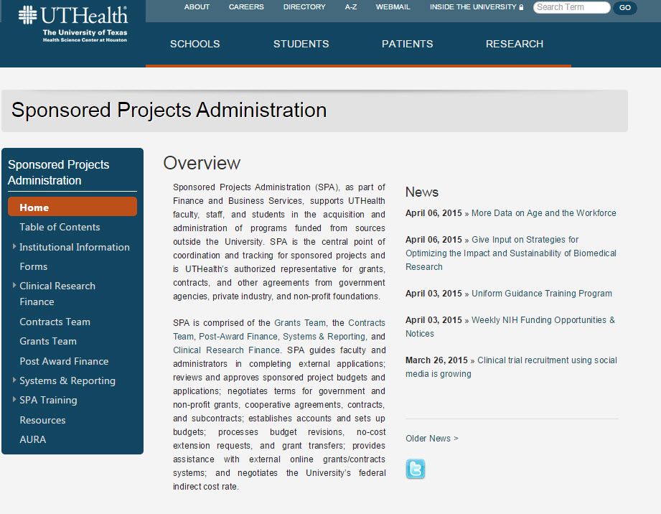
Website Spotlight

Slide 6
Effort Certification
Amaris Ogu, MBA
Supervisor, Systems & Reporting

Slide 7
Effort Reporting Dates
Upcoming Reporting Period:
January 1, 2016 to June 30,2016
Pre-Review Begins:
Tuesday, July 5th
Certification Period:
Tuesday, July 19th –
Friday, August 19th
Travel restrictions on uncertified cards:
Monday, August 22nd

Slide 8
Effort Reporting Reminders & Tips
Please review all cards for accuracy.
Hover over Project Names to check commitments for accuracy.
Initiate Personnel Actions early
Place incorrect cards on hold until fixed
Make adjustments for Cost Sharing (CPRIT)
Please use Chrome to access eCRT
Please use link from effort page to access eCRT

Slide 9
Effort Reporting Reminders & Tips
Review key personnel 1st!
Salary Cap = Effort Calculation Worksheet
(AKA Salary Cap Worksheet )
Will need the HCM Funding History file to complete
Can request access to this file through S&R
If certified effort column falls below payroll, something's wrong!
If a project is missing, something’s wrong!

Slide 10
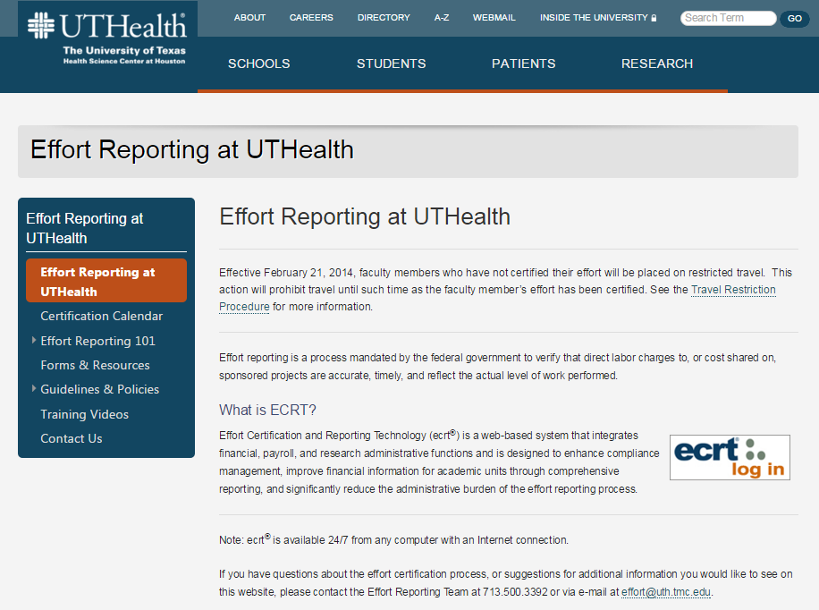
Effort Reporting Resources
Reports & Training are available!
Effort Resources here:

Slide 11
NIH Updates
Silvia Garza
Institutional Wide Grants Specialist
Sponsored Projects Administration

Slide 12
Reminder Form C to Form D Applicants must use FORMS-D for due dates on or after May 25, 2016 and must use FORMS-C for due dates on or before May 24, 2016.
October 2015 | Implementing Rigor and Transparency in NIH & AHRQ Research Grant Applications [NOT-OD-16-011] ; [NIH Staff Training Module]
 | NIH & AHRQ Announce Upcoming Changes to Policies, Instructions and Forms for 2016 Grant Applications [NOT-OD-16-004]
November 2015 | Publication of the Revised NIH Grants Policy Statement (Rev. 11/2015) for FY 2016 [NOT-OD-16-030] [Summary of Significant Changes]
 | Revised SF424 (R&R) Application Guides and Supplemental Instructions Available for Application Due Dates On and Between January 25, 2016 and May 24, 2016 [NOT-OD-16-029] [Summary of Significant Changes]
January 2016 | Reminder: NIH & AHRQ Grant Application Changes for Due Dates On or After January 25, 2016 [NOT-OD-16-058]
 | Notice of Correction to Salary Limitation on NIH Grants, and Cooperative Agreements [NOT-OD-16-059]
Now
October 2015
May 25, 2016
January 2016 | NIH & AHRQ Announce New Form for PHS Awarding Component and Peer Review Requests [NOT-OD-16-008]
 | NIH & AHRQ Change Font Guidelines for Applications to Due Dates On or After May 25, 2016 [NOT-OD-16-009]
February 2016 | Impact of Grant Application Form Update (FORMS-D) on Late and Continuous Submission Applications [NOT-OD-16-064]
 | Plan to Move to Updated Forms (FORMS-D) for Administrative Supplement, Successor-In-Interest and Change of Institution Opportunities [NOT-OD-16-068]
March 2016 | Reminder: NIH & AHRQ Grant Application Changes for Due Dates On or After May 25, 2016 [NOT-OD-16-081]
Soon

Slide 13
Updated FOAs
 | Old Announcement Number | New Announcement Number
Parent R01 | PA-13-302 | PA-16-160
Parent R03 | PA-13-304 | PA-16-162
Parent R21 | PA-13-303 | PA-16-161
http://grants.nih.gov/grants/guide/parent_announcements.htm

Slide 14
Cayuse/Form Updates
Adding a new "Authentication of Key Biological and/or Chemical Resources" attachment and “ Data Safety Monitoring Plan”:
We are adding new questions regarding euthanasia to the following forms in FORMS-D application packages to replace the euthanasia criteria in the vertebrate animals section:

Slide 15
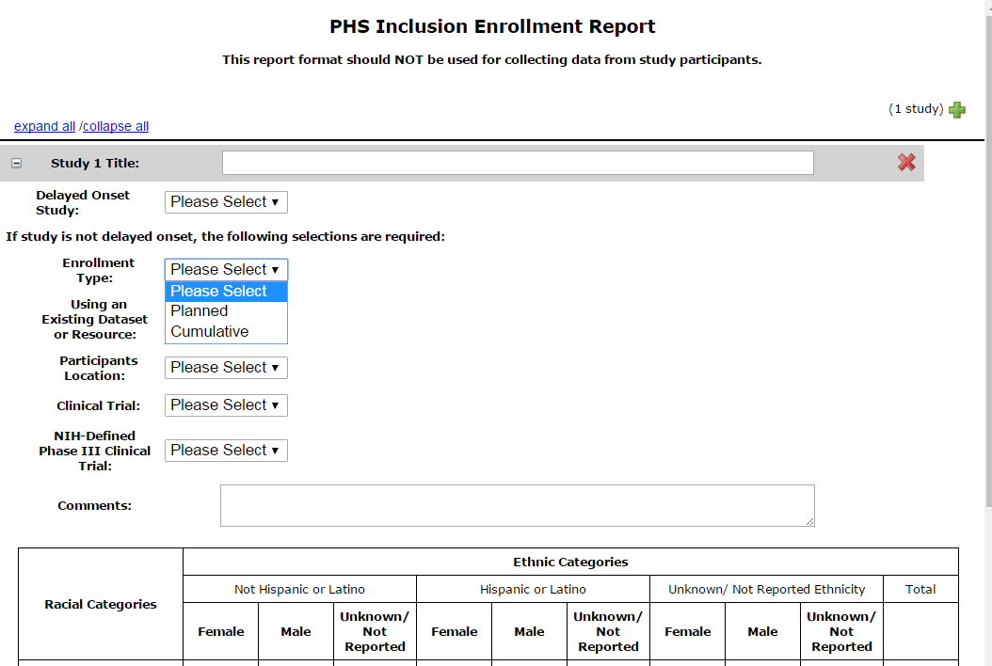
Cayuse/Form Updates cont..
We are adding an optional PHS Inclusion Enrollment Report form to FORMS-D application packages.

Slide 16
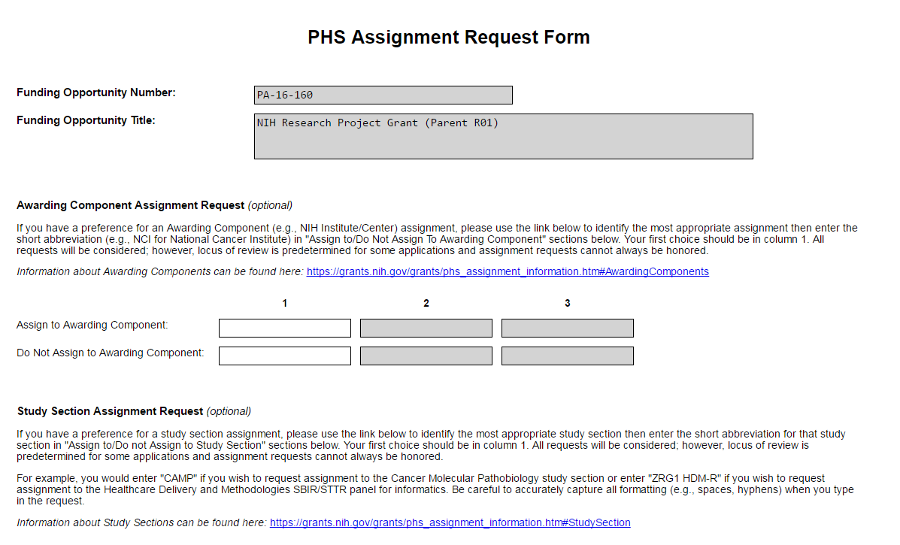
Cayuse/Form Updates cont..
We are adding an optional PHS Assignment Request Form to FORMS-D application packages to provide a consistent way to collect application referral information, including:

Slide 17
Cayuse/Form Updates cont..
New Font Guidelines
We are providing additional flexibility regarding the fonts allowed in PDF attachments included in grant applications.
Although we will continue to recommend specific fonts, we will also allow other fonts (both serif and non-serif) as long as they comply with specific type density and line spacing guidelines.

Slide 18
Cayuse/Form Updates cont..
Biosketch Clarifications
http://grants.nih.gov/grants/guide/notice-files/NOT-OD-16-080.html
We are clarifying biosketch instructions.
Clarifications include:
Indicate that a URL for a publication list is optional and, if provided, must be to a government website (.gov) like My Bibliography.
Allow publications (peer-reviewed and non-peer-reviewed) and research products to be cited in both the personal statement and the contributions to science sections
State that graphics, figures and tables are not allowed.
Remove the requirement that the past 3 years of research support are listed in order of relevance.
Option to add other names used to author research products in section A.
Research products can include conference proceedings such as meeting abstracts, posters, or other presentations.
Research products that are under development, such as manuscripts that have not yet been accepted for publication, can be mentioned in the narrative sections. However, they cannot be cited as one of their citations.
Biographical Sketch Format Page – Forms Version D | March 25, 2016 | MS WORD | MS WORD | MS WORD

Slide 19
Clinical Research Finance (CRF)
Heather Cody, MHA
Assistant Director,
Clinical Research Finance

Slide 20
What is a Clinical Trial?
Has Human Subjects
Prospectively Assigned
To One or More Interventions
On Health Related Biomedical
Or Behavioral Outcomes

Slide 21
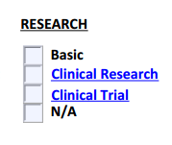
Clinical Trial, R&A
If the previously outlined criteria is met then check “Clinical Trial” on the R&A. Regardless of funding source.
Clinical costs are services or procedures that generate a patient bill. Think “Would I get a bill from the doctor for this service?”

Slide 22
PAF Updates
Victoria Briscoe
Asst. Director, Post Award Finance
Sponsored Projects Administration

Slide 23
Next Meeting:
August 24, 2016
Presentations & Schedule Posted at:
go.uth.edu/AURA

