Slide 1
AURA Meeting
March 25, 2015

Slide 2
Introductions
Victoria Briscoe
Asst. Director, Post Award Finance

Slide 3




Housekeeping Items
ITV Groups
Please mute microphones
Presenters
Repeat questions in mic

Slide 4
Website Spotlight
Anthony Gillum, MBA
Sponsored Projects Specialist
Contracts

Slide 5

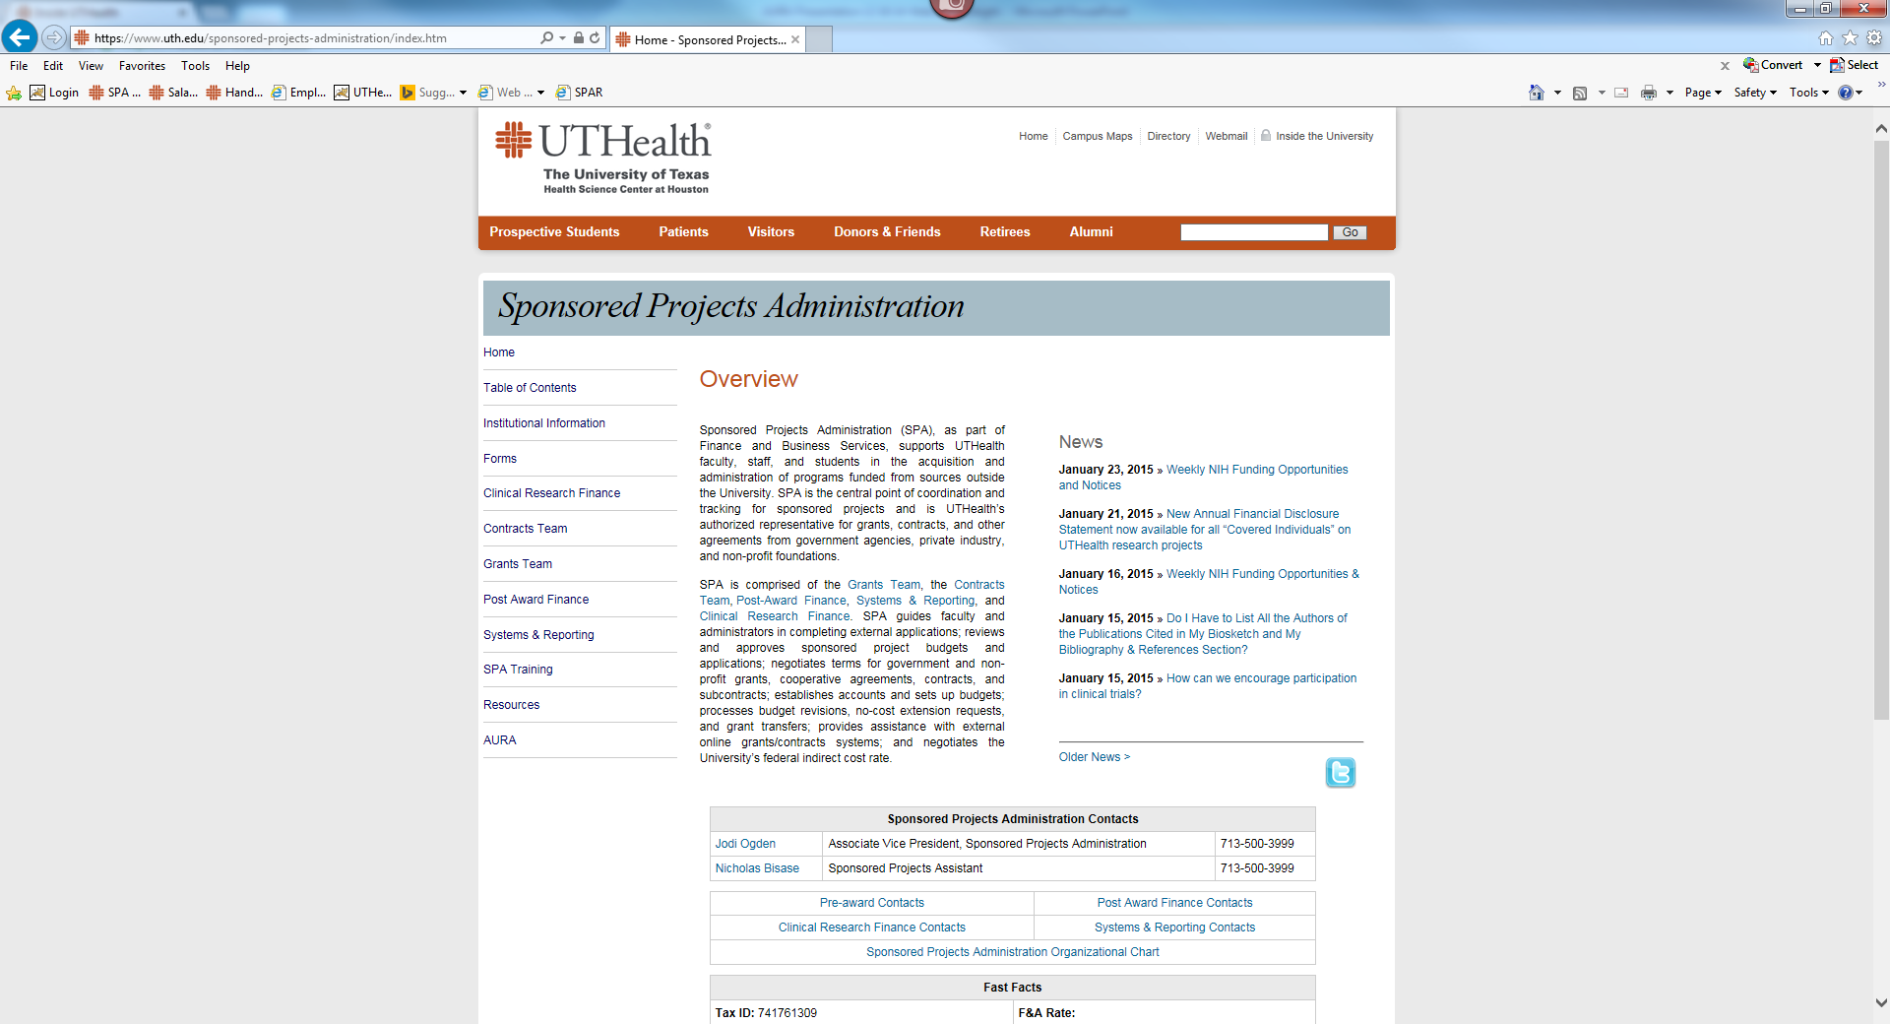
Website Spotlight

Slide 6
Updates
Karen Niemeier
Director, Contracts
Sponsored Projects Administration

Slide 7
Updates
Krystal Toups, CRA
Director, Grants
Sponsored Projects Administration

Slide 8
HOOP 64
HOOP 64 http://www.uthouston.edu/hoop/policy.htm?id=1447976 requires Sponsored Projects Administration(SPA) review proposals prior to their submission to an agency.
The policy request that the administrative and financial portion of the application be submitted 10 days before the deadline.
SPA is very flexible with the 10 day requirement, however we review proposals in the order of receipt.
Late applications (<3 days) should arrive to our office with final A&F and in perfect condition (ex. no missing items or exception to policy)

Slide 9
Updates
Heather Cody, MHA
Supervisor, Clinical Research Finance

Slide 10
CRB Training
Four training classes were offered in March to educate research personnel on the procedure in HOOP 214.
The training is necessary for all research staff that are involved in active clinical trials.
A Separate PI training will be released in myTRC. Online staff training is in the works.

Slide 11
Cost Analysis Template
Revised version of the Clinical Trial Budget Template is available.
New Features
  Summary page for SPA submission
  Print friendly forms
  Merged expense based cost form and coverage analysis form
  Dropdown selections for 300 common procedures in the Expensed Based tab
  Auto population of CPT codes when you select from the common list
  Click button Add columns and rows on the Expensed Based Form

Slide 12
Effort Reporting
William Mitchell, MPSA
Supervisor, Systems & Reporting

Slide 13
Status Update
40 statements outstanding
37 on hold
Retro PAs loaded 3/19/15
Next data load 4/5/15

Slide 14
Journal Entry Upload
Journal Entries will be uploaded in ecrt®
Statements will now reflect correct payroll for JE
Journal Entry documentation provided by PAF
  We will not upload without PAF approval

Slide 15
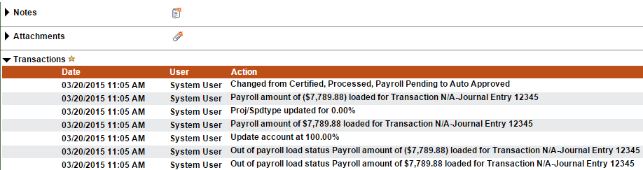
Journal Entry Upload

Slide 16
Post Award Focus
Victoria Briscoe
Asst. Director, Post Award Finance

Slide 17
Residual Accounts Process
Fixed price/fee-for-service agreements require specified work to be performed regardless of actual cost.
The investigator or academic unit must cover excess expenses when costs are underestimated.
All costs for these awards must be expensed directly to the assigned FMS project, and with reasonable budgeting/accurate charging, neither a surplus nor a deficit may occur.

Slide 18
Residual Accounts Process
Upon project termination, any residuals will be transferred to a sponsored project residual account (fund 57050, Contract Residuals)
Any project with a project balance >10% will require justification along with review/approval.
Each PI will be assigned one residual balance project for this purpose.
This project is solely for this purpose, and no other funds may be deposited therein.

Slide 19
Residual Accounts Progress
Due to audit recommendation and our response, PAF is first working on 145 vested federal projects that must be closed out by 8/31/15. (Currently ~ 44% complete)
PAF is moving all FY15 expenses and revenue residuals on these projects to the newly created Residual accounts for each applicable PI
All other vested projects will be completed in FY16. (However, some PAF comes across during this fiscal year may be closed out FY15 as time permits.)

Slide 20
Extended Leave & Sponsored Projects
Federal Awards generally allow up to 3 months of salary/fringe to be charged to a grant/contract for leaves such as sick leave and FMLA.
Private grants and contracts from other agencies do not usually have such allowances, and if extended leave is needed, consider moving the individual off to non-restricted funds during that time.
If extended leave is required for key personnel (most often the PI) agency discussion may be in order regarding the special circumstances and impact on the project.

Slide 21
Contacting PAF for Assistance
Please have pertinent information readily available on the phone or included in your email correspondence (project number, PI, awarding agency, issue at hand, and any prior contact with PAF and with whom)
Please include your contact information in any correspondence sent. The Create Signature function in Outlook allows you to create and automatically have this information added to each of your emails.

Slide 22
Final Remarks
Jodi S. Ogden, MBA, CRA
Associate Vice President
Sponsored Projects Administration

Slide 23
Next Meeting:
May 27, 2015
Presentations & Schedule Posted at:
go.uth.edu/AURA

