Slide 1
AURA Meeting
February 28, 2018

Slide 2


Housekeeping Items
ITV Groups
Please mute microphones
Presenters
Repeat questions in mic

Slide 3
Agenda
Introductions
Single IRB – NIH Mandate and Fees (Edmonds)
Time and Effort Reporting (Ogu/Sagers)
  RPPR Personnel Review
  Effort without salary
  Effort Certification Recap
    HOOP 69–Indirect Cost Policy Changes (Kreidler)
Grants Management System Update (Kreidler)
SPA Annual 3-day training (Sagers)

Slide 4
Single IRB
Reliance and Reciprocity Agreements
Cynthia Edmonds
Director, Office of Research Support Committees

Slide 5
NIH Mandate
Multisite studies will require single IRB (sIRB) review.
  NIH-funded multi-site studies
  Each site conducting the same protocol
  Non-exempt human subjects research
Effective date: January 25, 2018
Grant must include a plan for sIRB
  State IRB of record
  Describe how each site will follow sIRB requirements
  Describe how communications will be handled
  Delayed onset grants can have a more general description that the mandate will be complied with
Budget - direct cost funding should reflect sIRB costs

Slide 6
Single IRB Review
Advantages
  Prevents duplication efforts on multi-site trials
  Review process is more expedient
  Creates efficiencies and simplifies the process
Disadvantages
  Study teams unfamiliar with lead IRB practices and electronic systems

Slide 7
Single IRB Review
Local IRBs/HRPPs still responsible for limited activities
  Local context – state laws, institution specific policies
  Human subjects education
  May be requested to perform audits of the site
Additional institutional approvals still required
  Sponsored Projects Administration
  Research Conflict of Interest
  Memorial Hermann/Harris Health administrative review
  Biological/Chemical/Radiation Safety Committees
  Coverage Analysis

Slide 8
Types of Single IRB Review
Commercial IRBs
  Chesapeake/Schulman → Advarra
  Western/WIRB/Copernicus
  Quorum
  BRANY
Institutional Agreements
Common Agreements
  Texas Common Agreement
  SMART IRB

Slide 9
What is SMART IRB?
Large-scale common agreement
Currently 364 institutions
Relatively vague to get all institutions to agree
Some sites request additional information from relying IRBs.
Process similar to Texas Common Agreement
Call/email Point of Contact for SMART IRB questions.
  Audrey Williams 713-500-7914
  Sujatha Sridhar 713-500-3622

Slide 10
Which Reliance Should You Use?
Commercial IRBs
  Pros:
    Each site can submit documents for review directly
    Many meetings per week for faster review
  Cons:
    Charges for every submission
Common Agreements
  Pros:
    Fees may be cheaper (varies by each site)
  Cons:
    Study team at lead site responsible for all submissions to IRB from all sites

Slide 11
Fees for sIRB Review
For each relying site, add as a direct cost to NIH budgets:
  Full Board Initial Review $1500
  Full Board Continuing Review $ 650
  Expedited/Exempt Initial Review $ 750
  No charge for amendments
  Indirect costs are to be added to these fees in the indirect cost calculation.

Slide 12
Effort Certification
Amaris Ogu
Assistant Director, Systems & Reporting
Tiffany Sagers
Manager, Grants & Contracts

Slide 13
RPPR All Personnel
What should be entered on the Annual Progress Report?
Include (1) the PD/PI regardless of effort devoted to the project and (2) each person who has worked at least one person month per year on the project during the reporting period, regardless of the source of compensation.
If the PD/PI worked 0.5 to 1 person month, round up to 1 person month. If the PD/PI worked 0.1 to 0.4 person month, round down to 0 (zero).
Please note, you are reporting on actual effort spent on the current year.

Slide 14
RPPR All Personnel
How will SPA’s review process change?
SPA will cross check the all personnel report against the effort cards.
If issues are identified, we will contact the department to discuss corrective actions.

Slide 15
Effort Recap
About 2500 statements this period
  Currently 250 outstanding
New Effort Policies
  Reopening of Statements During Effort Period
  Non Payroll Adjustments
  Travel Restrictions for Statements on Hold after 60 days
Technical issues & enhancements
New Training Initiative

Slide 16
HOOP 69 – Indirect Costs
Kathleen Kreidler
Associate Vice President, Sponsored Projects

Slide 17
HOOP 69 – Indirect Costs
IDC Rate Change
FROM: Michael R. Blackburn, Ph.D.
Executive Vice President and Chief Academic Officer
DATE: August 11, 2017
SUBJECT: Changes to Indirect Cost Rates for Bench-Associated Research Contracts
Effective September 1, 2017, we will increase the indirect cost rate for contracts involving bench-associated research from 30% to 54%. Thus, all contracts containing bench-associated research executed after August 31, 2017 should contain this level of indirect cost recovery unless otherwise negotiated.
Updated IDC waiver policy and procedure

Slide 18
HOOP 69 – Indirect Costs
B. Non-Federal Sponsored Projects
Non-federal sponsored projects shall include indirect cost recovery as a percentage of total direct costs as follows:
Clinical Research/Clinical Trials 30%
Basic/Laboratory Research 54%
Foundation/Not For Profit Sponsor’s publicly stated rate
unless the request for proposal or sponsor’s website details a different indirect cost rate.

Slide 19
HOOP 69 – Indirect Costs
C. Request for Waiver of Indirect Costs:
A waiver or reduction of indirect costs may be requested in extraordinary circumstances with adequate justification. Requests for indirect cost waivers are not intended to take the place of direct financial support from the departments or schools. In most cases, cost-sharing may be more appropriate than an indirect cost waiver.

Slide 20
HOOP 69 – Indirect Costs
The university will not allow a waiver or reduction of indirect costs if:
The principal investigator failed to submit the proposal with budget and budget justification to Sponsored Projects Administration for review at least 14 days prior to submitting to the sponsor.
The sponsor is industry/for profit, or
The waiver is solely an attempt to increase the competitiveness of a proposal.

Slide 21
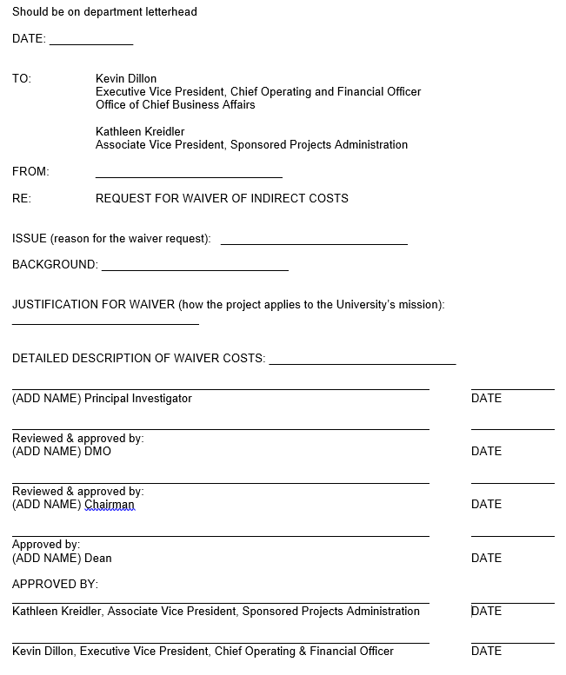
HOOP 69 – Indirect Costs
Notes:
We have this sad little form.
No documentation
No calculations of IDC and waiver requested
Word – no electronic routing

Slide 22
Grants Mangement System
Kathleen Kreidler
Associate Vice President, Sponsored Projects

Slide 23
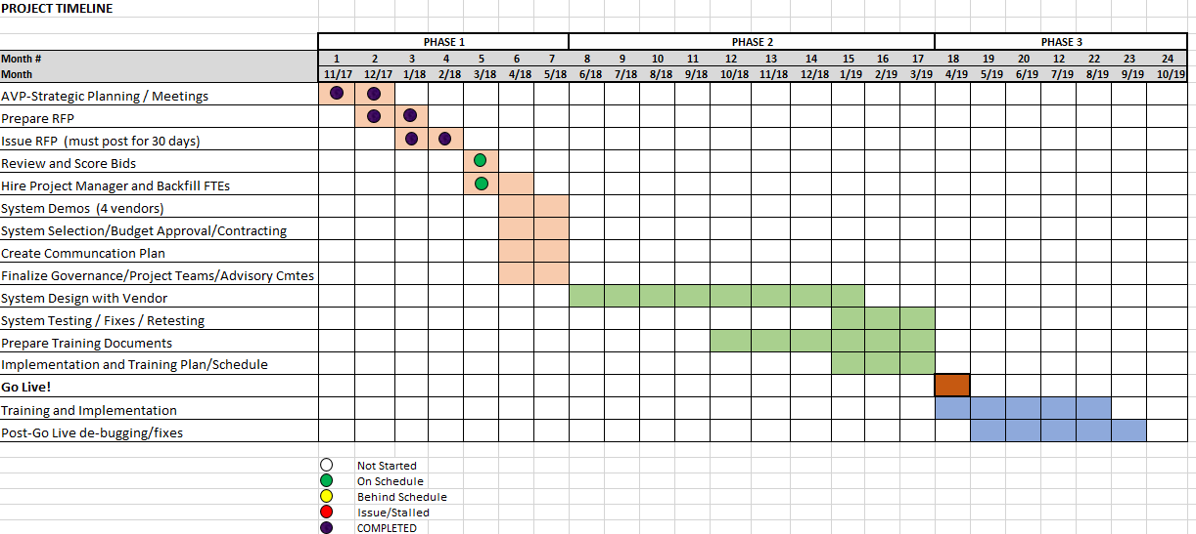
Grants Management System

Slide 24
Grants Management System
1/22/18 RFP was issued
2/12/18 Pre-Bid Conference Call
Next Steps:
3/9/18 Bid deadline
3/13/18-3/27/18 Evaluation/Project Team Scores Bids
4/2/18-4/6/18 Bid Ranking and Vendors “Short-Listed”
4/23/18-5/4/18 Vendor Demos
May, 2018 Vendor Selection and Contracting

Slide 25
Grants Management System
RFP – Key Points:
We require a single electronic solution for creating and submitting grant proposals and for establishing and managing grant awards, subawards, and a variety of contracts from receipt/set-up through project close out.
The University is seeking to leverage the new system to maximize efficiency and to accommodate continued growth and complexity of its Sponsored Projects portfolio.

Slide 26
Grants Management System
Web-based portal to facilitate the complete electronic lifecycle of proposals, grant awards and contracts
Single sign on user account authentication (SAML or LDAP enabled)
Interface with HCM, FMS, Huron ecrt, and IRIS.
System to system proposal submission to grants.gov
Automated workflow for routing and approvals with email alerts
Upload, store, and retrieve all documents associated/linked to a specific project with unlimited storage restrictions
Audit trail of all transactions
Role based access and security
Report creation by individual user based on access and security, all data fields exportable

Slide 27
Grants Management System
In addition to the minimum requirements, we added 49 specific questions to highlight specific functionality and unique system features:
user-configurable dashboard or home page (statuses and user worklist)
Master record to sub-record relationship and numbering
Project deliverables and alerts/reminders
Managing subawards
Personnel profiles
Budget variability (detailed, modular, per-patient)
Financial Tracking

Slide 28
SPA Training
Tiffany Sagers
Manager, Grants & Contracts

Slide 29


Sponsored Projects Administration Training Course
Tues., April 17th through Thurs., April 19th
8:30 a.m. to 4:30 p.m. each day
$160 for all three days
Register at
go.uth.edu/SPAregister
For more information go to go.uth.edu/SPATrain
or email grp-spatraining@uthouston.edu

Slide 30
Next Meeting:
May 23, 2018
Presentations & Schedule Posted at:
go.uth.edu/AURA

