Slide 1
AURA Meeting
February 24, 2016

Slide 2
Welcome
Christopher Denman, MRA, CRA
Assistant Director, Contracts

Slide 3


Housekeeping Items
ITV Groups
Please mute microphones
Presenters
Repeat questions in mic

Slide 4
Website Spotlight
Troy Roberson
Systems & Reporting Specialist

Slide 5

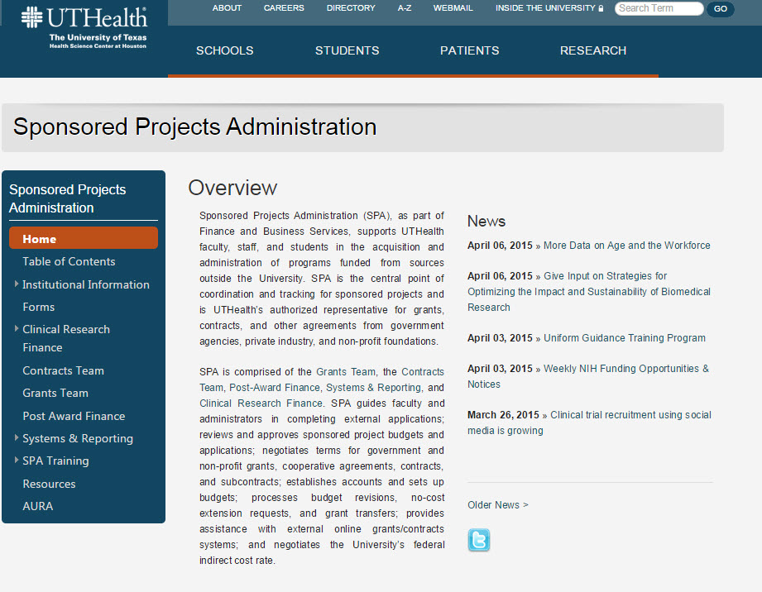
Website Spotlight

Slide 6
SPA Training Course
Amaris Ogu, MBA
Supervisor, Systems & Reporting

Slide 7
SPA Training Course
SPA Training Course is Now An Annual Course!
Held in April
  More information here:
https://www.uth.edu/sponsored-projects-administration/training/internal.htm

Slide 8


SPA Training Course
Tues., April 12th through Thurs., April 14th
8:30 a.m. to 4:30 p.m. each day
$160 for all three days
Register at
go.uth.edu/SPAregister
For more information go to go.uth.edu/SPATrain
or email grp-spatraining@uthouston.edu

Slide 9
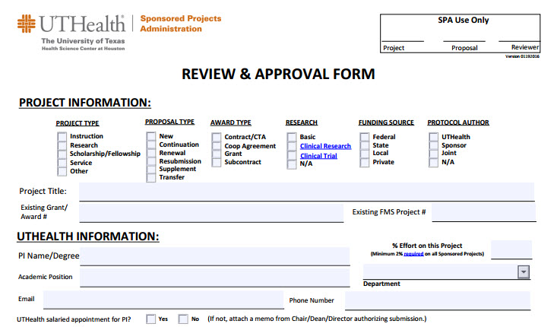
Review & Approval Form
Review of updates

Slide 10
Updates
Krystal Toups, CRA
Director, Grants
Sponsored Projects Administration

Slide 11
HOOP 64
HOOP 64 http://www.uthouston.edu/hoop/policy.htm?id=1447976 requires Sponsored Projects Administration(SPA) review proposals prior to their submission to an agency.
The policy request that the administrative and financial portion of the application be submitted 10 days before the deadline.
SPA is very flexible with the 10 day requirement, however we review proposals in the order of receipt.
Late applications (<3 days) should arrive to our office with final A&F and in perfect condition (ex. no missing items or exception to policy)

Slide 12
Best Practices
Best Practices
  Do not shop for answers
  Please be patient (we will respond to your voicemail and email)
  Do not submit incomplete items
  Designate a backup for urgent items if you are unavailable
  Do research your questions

Slide 13
NIH Updates
October 2015 | Implementing Rigor and Transparency in NIH & AHRQ Research Grant Applications [NOT-OD-16-011] ; [NIH Staff Training Module]
 | NIH & AHRQ Announce Upcoming Changes to Policies, Instructions and Forms for 2016 Grant Applications [NOT-OD-16-004]
November 2015 | Publication of the Revised NIH Grants Policy Statement (Rev. 11/2015) for FY 2016 [NOT-OD-16-030] [Summary of Significant Changes]
 | Revised SF424 (R&R) Application Guides and Supplemental Instructions Available for Application Due Dates On and Between January 25, 2016 and May 24, 2016 [NOT-OD-16-029] [Summary of Significant Changes]
January 2016 | Reminder: NIH & AHRQ Grant Application Changes for Due Dates On or After January 25, 2016 [NOT-OD-16-058]
 | Notice of Correction to Salary Limitation on NIH Grants, and Cooperative Agreements [NOT-OD-16-059]
Now
October 2015
May 25, 2016
January 2016 | NIH & AHRQ Announce New Form for PHS Awarding Component and Peer Review Requests [NOT-OD-16-008]
 | NIH & AHRQ Change Font Guidelines for Applications to Due Dates On or After May 25, 2016 [NOT-OD-16-009]
February 2016 | Impact of Grant Application Form Update (FORMS-D) on Late and Continuous Submission Applications [NOT-OD-16-064]
 | Plan to Move to Updated Forms (FORMS-D) for Administrative Supplement, Successor-In-Interest and Change of Institution Opportunities [NOT-OD-16-068]
Soon

Slide 14
Clinical Research Finance (CRF)
Trae Rohan, MBA, CHRC
Sr. Clinical Research
Financial Analyst

Slide 15
CRF Training
Lunch & Learn Sessions
  Occur monthly
  Financial topics / CRF matters
  Email notification distribution list
  Request for topics and speakers welcome

Slide 16
CRF Training
CTRC New Employee Orientation Training
  Occur quarterly
  Open to all, however registration required due to limited seating
  Cover financial matters: Billing Risk Review, Coverage Analysis, Patient Registration, Billing, Reconciliation, and REDCap
  Email notification distribution list

Slide 17
CRF Monitoring
CRF is currently monitoring 3 clinical trials in two different departments
Plan to monitor 2 to 3 studies each month for the remainder of the fiscal year
Initial notification includes PI and DMO
Following notice is sent to the research teams with a request for a meeting

Slide 18
CRF Update
Coverage Analysis will now only be accepted when the study has been submitted to iRIS for review
  IRB approval is not required

Slide 19
Hot Topics
Statewide Single Audit results
  Effort certification
  Period of Availability – Guarantee accounts
    SPA will more diligently follow-up on unreceived subawards. The department should do the same.

Slide 20
Hot Topics
Connect, Collaborate, Create
http://influuent.utsystem.edu
Created by UTS to promote and expand research and innovation of UT faculty, promote increased collaboration, and facilitate public-private partnerships
Can search 15,000 faculty research profiles, find content experts, explore collaborative networks, and find funding opportunities

Slide 21
Hot Topics
Faculty/staff required to disclose research sponsors
  HB 1295 requires faculty to “conspicuously” disclose sponsors of research in public communications
  Intent is to prevent anonymous sponsors from funding specific research activities; applies to research started before the bill was passed
  Includes all types of sponsored research conducted under a grant/contract where payments or value of materials received through all grants/contracts is at least 50% of the cost of the research
  Public communications means oral or written communication intended for public consumption
  For questions, contact Christina Solis, Office of Legal Affairs, at Christina.F.Solis@uth.tmc.edu

Slide 22
Next Meeting:
May 25, 2016
Presentations & Schedule Posted at:
go.uth.edu/AURA

