Slide 1
AURA Meeting
December 2, 2015

Slide 2
Welcome
Krystal Toups, CRA
Director, Grants

Slide 3
Housekeeping Items
ITV Groups
Please mute microphones
Presenters
Repeat questions in mic

Slide 4
Website Spotlight
Troy Roberson
Systems & Reporting Specialist

Slide 5
Website Spotlight

Slide 6
Updates
Krystal Toups, CRA
Director, Grants

Slide 7
NIH Notices
Revised SF424 (R&R) Application Guides and Supplemental Instructions Available for Application Due Dates On and Between January 25, 2016 and May 24, 2016 (NOT-OD-16-029) National Institutes of Health Agency for Healthcare Research and Quality
Major changes to the application instructions include:
Instructions for changes described in NOT-OD-16-004 under the implementation of Phase 1.
Incorporation of the instructions for Individual Fellowship applications into the general application guide (it will no longer be maintained as a separate document).
New Form D or due dates on or after May 25, 2016
Resources: High-level list of FORMS-D pre-award form changes
Do I Have the Right Form Version For My Application?
Form Update 2016 - Frequently Asked Questions
NIH Upcoming Changes in Grants Administration (Timeline)

Slide 8
NIH Notices Cont.
Publication of the Revised NIH Grants Policy Statement (Rev. 11/2015) for FY2016 (NOT-OD-16-030) National Institutes of Health
Document that summarizes the significant changes implemented November 2015 NIHGPS: http://grants.nih.gov/grants/policy/nihgps/Significant_Changes_NIHGPS_Oct2015.pdf.
8.1.1.3 Extension of Final Budget Period of a Previously Approved Project Period without Additional NIH Funds
With the exception of grant programs that have an effort requirement, or where terms and conditions prohibit such reductions, NIH will not require prior approval for the reduction in effort for Senior/Key personnel. The recipient is reminded that active awards must have a measureable level of effort.
IMPORTANT: MUST:
Applicable for budget periods on or after Oct. 1, 2015
Comply with 2% minimum effort for HOOP 93.
Notify PAF & provide documentation to be recorded in the grant file.
Notify PAF at the time of the NCE request for any reduction in effort.

Slide 9
SPA Holiday Coverage
Proposals w/Agency Due Date Dec. 24th- Jan. 6th
Due to SPA Dec. 16th those received after will be reviewed in order received & at the availability of skeleton crew staff.
SPA will have a representative for each team available during skeleton crew Dec. 24th – Jan. 1st

Slide 10
Effort Reporting
Amaris Ogu, MBA
Supervisor, Systems & Reporting
Sponsored Projects Administation

Slide 11
Effort Reporting Dates
Pre-Review Certification Period:
Tuesday, January 5th – Monday, January 18th
Certification Period:
Tuesday, January 19th – Friday, February 19th
Travel restrictions on uncertified cards:
Monday, February 22nd

Slide 12
Effort Reporting Reminders
Please review all cards for accuracy
Initiate Personnel Actions, if needed
Place incorrect cards on hold until fixed
Make adjustments for Cost Sharing (CPRIT)
Guides and forms on Effort website
go.uth.edu/effort

Slide 13
Effort Reporting Tips
Review key personnel 1st!
Salary Cap = Effort Calculation Worksheet
(AKA Salary Cap Worksheet )
Will need the HCM Funding History file to complete
Can request access to this file through S&R
If certified effort column falls below payroll, something's wrong!
If a project is missing, something’s wrong!

Slide 14
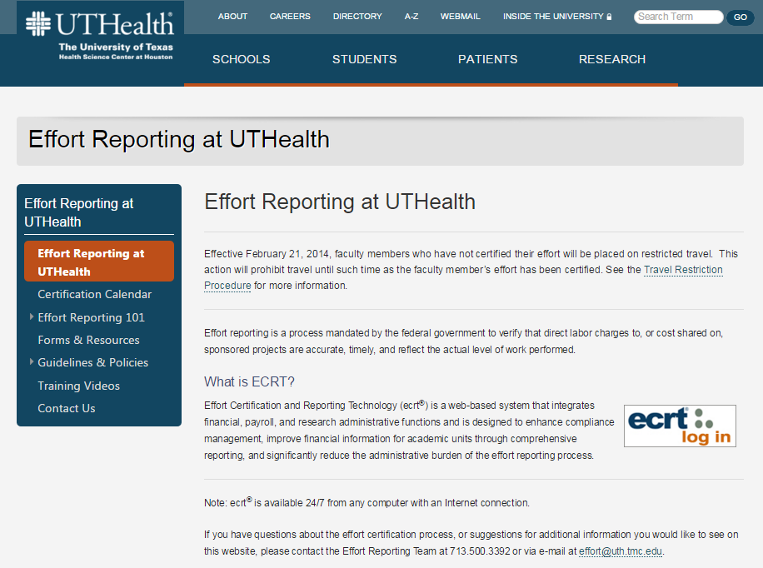
Effort Reporting Resources
Reports & Training are available!
Effort Resources here: https://www.uth.edu/effort-reporting/index.htm

Slide 15
Preview of New R&A Form
John Valenta,
Institutional Wide Contracts Specialist II

Slide 19
A-133 Audit Update
Karen Niemeier
Director, Contracts

Slide 20
Next Meeting:
January , 2016
Presentations & schedule posted at:
go.uth.edu/AURA

