Slide 1
AURA
August 22, 2018

Slide 2


Slide 3
Agenda
Introductions
Review of Biosketch Format and Common Errors
Review of the NIH Human Subjects Attachment
Clinical Trial Account Changes for 9/1/18
Preview the new SPA website
InfoEd – Grants Management System Update

Slide 4
BioSketches
Carmen Martinez, Director Grants & Contracts

Slide 5
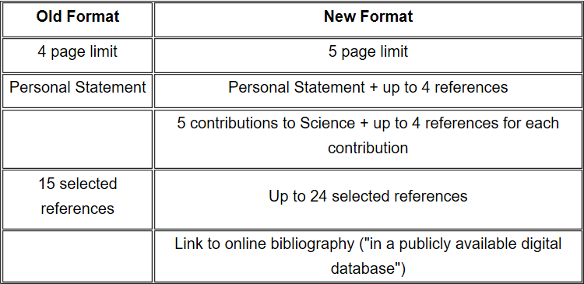
Summary of Changes

Slide 6
New Requirements
Biosketch format includes 4 major sections:
Personal Statement (updated)
  Include up to four publications and/or research products that highlight experience and qualifications for the project.
  May include a description of factors e.g. family care responsibilities, illness, disability, active duty military service to explain impediments to past productivity
Positions and Honors (unchanged)

Slide 7
New Requirements
Contributions to Science (new, required)
  Up to five contributions to science
  Up to four references for each contribution
  Link to a full list of their published work (optional); must have a .gov url
Research Support (unchanged)
  Current and Completed research support only
  Completed research within 3 years
  DO NOT list Pending support, % Effort, Direct Costs

Slide 8
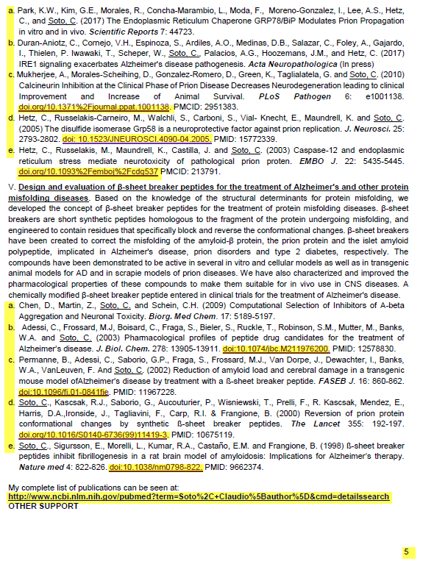
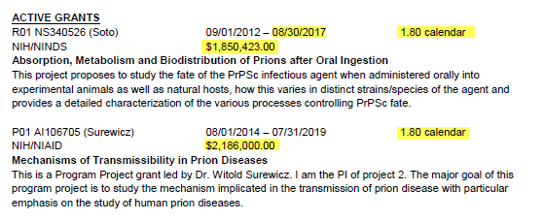
Common Errors
Too many citations
Using links/URLs outside of Bibliography
Broken Bibliography link
Page Numbers/Footers
Including Direct Costs, Effort, and Expired
Projects

Slide 9
NIH Human Subjects Attachment
Carmen Martinez, Director, Grants & Contracts
Audrey Williams, Senior Coordinator, IRB

Slide 10
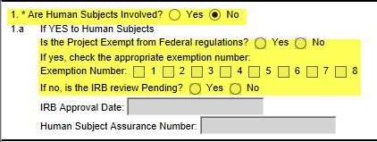
Gathering Data
Complete the Research and Related (R&R) Other Project Information Form to indicate:
  Whether your project involves Human Subjects
  If your project is exempt from Federal Regulations
Responses are auto-populated onto the PHS Human Subjects and Clinical Trials Information Form

Slide 11
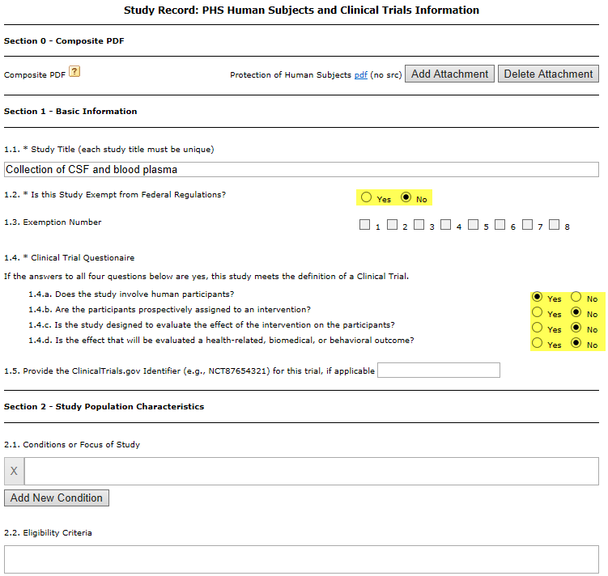
Human Subjects and Clinical Trial Information Form
Form is composed of 5 sections:
Basic Information
Study Population Characteristics
Protection & Monitoring Plans
Protocol Synopsis
Other Attachments

Slide 12
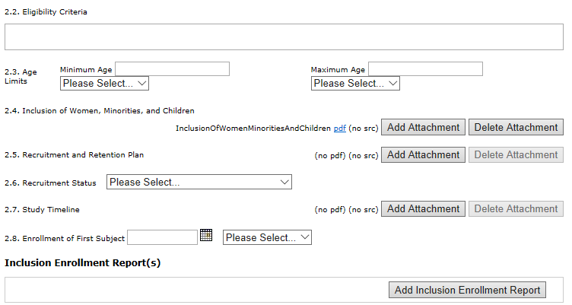
Human Subjects and Clinical Trial Information Form
Form is composed of 5 sections:
Basic Information
Study Population Characteristics
Protection & Monitoring Plans
Protocol Synopsis
Other Attachments

Slide 13
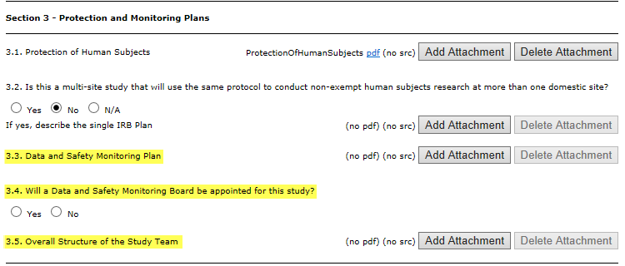
Human Subjects and Clinical Trial Information Form
Form is composed of 5 sections:
Basic Information
Study Population Characteristics
Protection & Monitoring Plans
Protocol Synopsis
Other Attachments *
*required for clinical trials

Slide 14
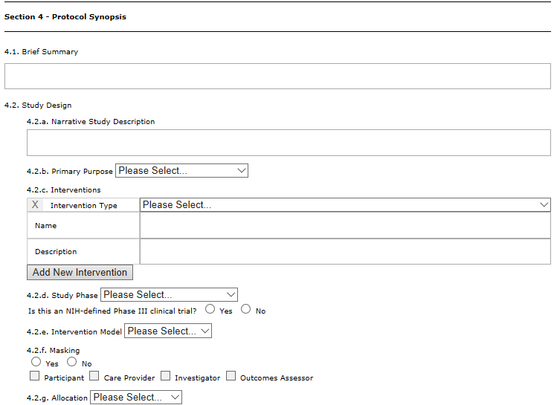
Human Subjects and Clinical Trial Information Form
Form is composed of 5 sections:
Basic Information
Study Population Characteristics
Protection & Monitoring Plans
Protocol Synopsis (CT only)
Other Attachments

Slide 15
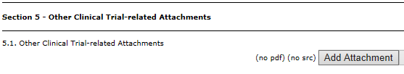
Human Subjects and Clinical Trial Information Form
Form is composed of 5 sections:
Basic Information
Study Population Characteristics
Protection & Monitoring Plans
Protocol Synopsis
Other Attachments
*only if required by FOA

Slide 16
Clinical Trial Accounting Changes
Kathy Kreidler, Assoc. VP, Sponsored Projects

Slide 17
Indirect Costs – Current State
Indirect costs of 30% are assessed as study expenses post:
Revenue Received $100,000
Salary Expensed: $ 20,000
Indirect cost Assessed: $ 6,000
Indirect Funds distributed: 52.5% School $ 3,150
47.5% Central $ 2,850
No IDC on remaining $80,000 until spent.

Slide 18
Indirect Costs – Current State
As of 6/30/18:
435 open clinical trial accounts
$9.7 million fund balance
$2.2 million undistributed indirect funds going back to 2002

Slide 19
Indirect Costs – Future State
Indirect costs of 30% are assessed on revenue received:
Revenue Received $100,000
Salary Expensed: $ 20,000
Indirect Cost Assessed $ 6,000 $23,077
Indirect Funds Distributed: 52.5% School $ 3,150 $ 12,115
47.5% Central $ 2,850 $ 10,962

Slide 20
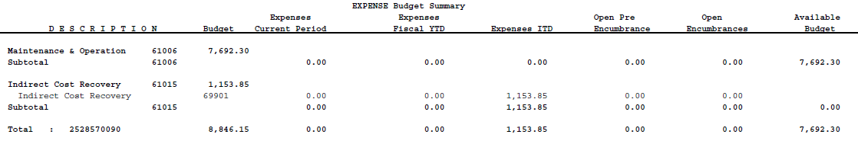
Indirect Costs – Future State
Departments do not have to wait years to receive indirect costs.
Fund balance is a true statement of what the PI has available to spend.

Slide 21
Salary Expense – Current State
Sponsor paying $10,000 per patient x 10 patients = $100,000 potential revenue:
Study Budget (2 years)
PI Salary (2%) $ 8,000
Coordinator Salary (25%) $ 30,000
Non-Salary Expenses $ 25,000
Indirects @ 30% $ 23,077
Total Expense $ 86,077
Residual Balance $ 13,923
Budgets and effort are based on 100% enrollment.
80% of our studies enroll less than 50%

Slide 22
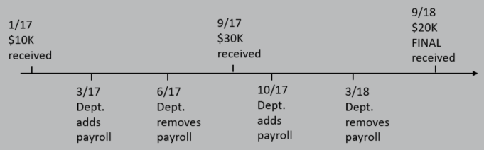
Salary Expense – Current State
Study Budget (2 years)
PI Salary (2%) $ 8,000
Coordinator Salary (25%) $ 30,000
$60,000 TOTAL REVENUE RECEIVED
Burdensome to department admins
  Either don’t charge salary at all or,
  Move staff around in bulk to wherever the money is.
  Misstates effort reports

Slide 23
Salary Expense – New process
Dept Project CT study team
Study Budget (2 years)
PI salary (2%) $ 8,000
Coordinator Salary (25%) $ 30,000
SC sal $60,000
RN sal $80,000
SC credit $3,000
Clinical Trial Project
Dept Faculty Salary
10% PI $ 800
10% SC $3,000
IDC $2,308
$10,000 rev received
PI Sal $200,000
PI credit $ 800
60% of revenue received = 60% of budgeted salary charged.

Slide 24
Salary Expense – New Process
Dept Project CT study team
SC credit $3,000
SC sal $60,000
RN sal $80,000
Credits for salaries charged to studies will post each month based on study revenue is received.
True up each half against contract residual accounts
$140,000
$ 130,000

Slide 25
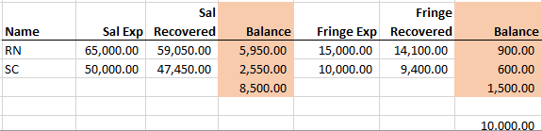
Salary Expense – New Process
  Benefits:
  Properly assesses salary/fringe expenses to studies
  Eliminates effort reporting on industry clinical trials
  Eliminates need to move study staff payroll around
  Simplifies study close and balance transfer
  Quick and easy view of who is fully covered and who is not

Slide 26
Clinical Trial Accounting Changes
Industry Sponsored Clinical Trials Only
Both go into effect 9/1/18
IDC will be manually recalculated for all revenue received through 8/31/18
First year will involve addressing “bumps along the way” and maintaining communication.

Slide 27
SPA Website Preview
Amaris Ogu, Asst. Director, Systems & Reporting

Slide 28
InfoEd Grants Management System Update
Kathy Kreidler, Associate VP, Sponsored Projects

Slide 29
InfoEd Global
InfoEd Global is the world’s leading provider of software to support Electronic Research Administration.
  27 year history – eRA is all they do
  Based in Albany, New York
  Five Modules will be implemented:
  Proposal Development/SPIN Opportunity Database (S2S with Grants.gov)
  Proposal Tracking
  Award Tracking
  Subawards and Contracts
  Financial Tracking

Slide 30
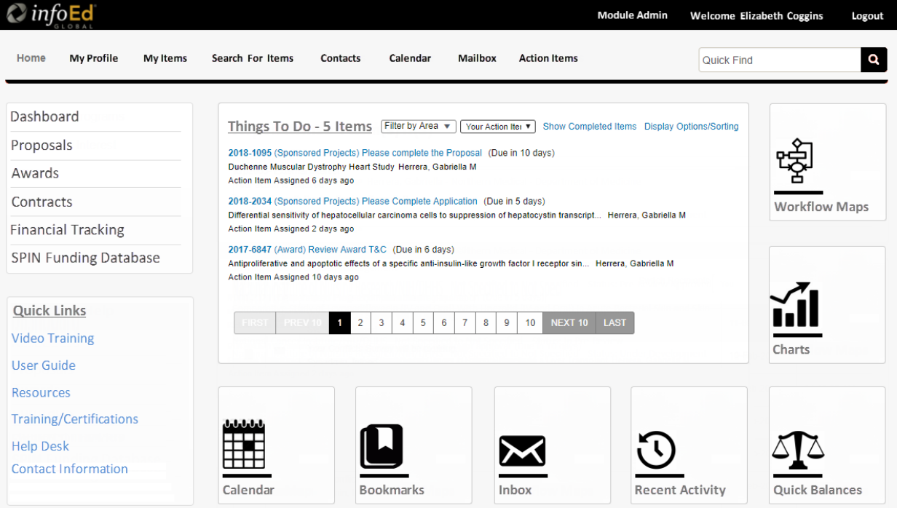

Slide 31
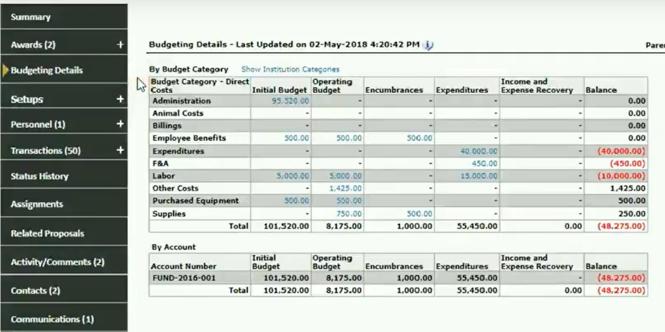

Slide 32
InfoEd Global
Target go-live is 8/20/2019
Project Team working on:
  System design via weekly calls with InfoEd Team
    Organizational Hierarchy
  Full Communication Plan Drafted (Finalize by 8/31/18)
    Sneak Peaks
  Training Plan – Being Drafted
  Reports – Reviewing available widgets and “wish list” of reports
  Single Sign On Interface (6-8 weeks)
  Document Storage – process and file naming convention

Slide 33
Next Meeting: Nov 14, 2018
THANKS!

