Slide 1
AURA Meeting
January 28, 2015

Slide 2
Introductions
Ronnie Perez
Director, Post Award Finance

Slide 3
Housekeeping Items
ITV Groups
Please mute microphones
Presenters
Repeat questions in mic

Slide 4
Website Spotlight
Anthony Gillum, MBA
Sponsored Projects Specialist
Contracts

Slide 5
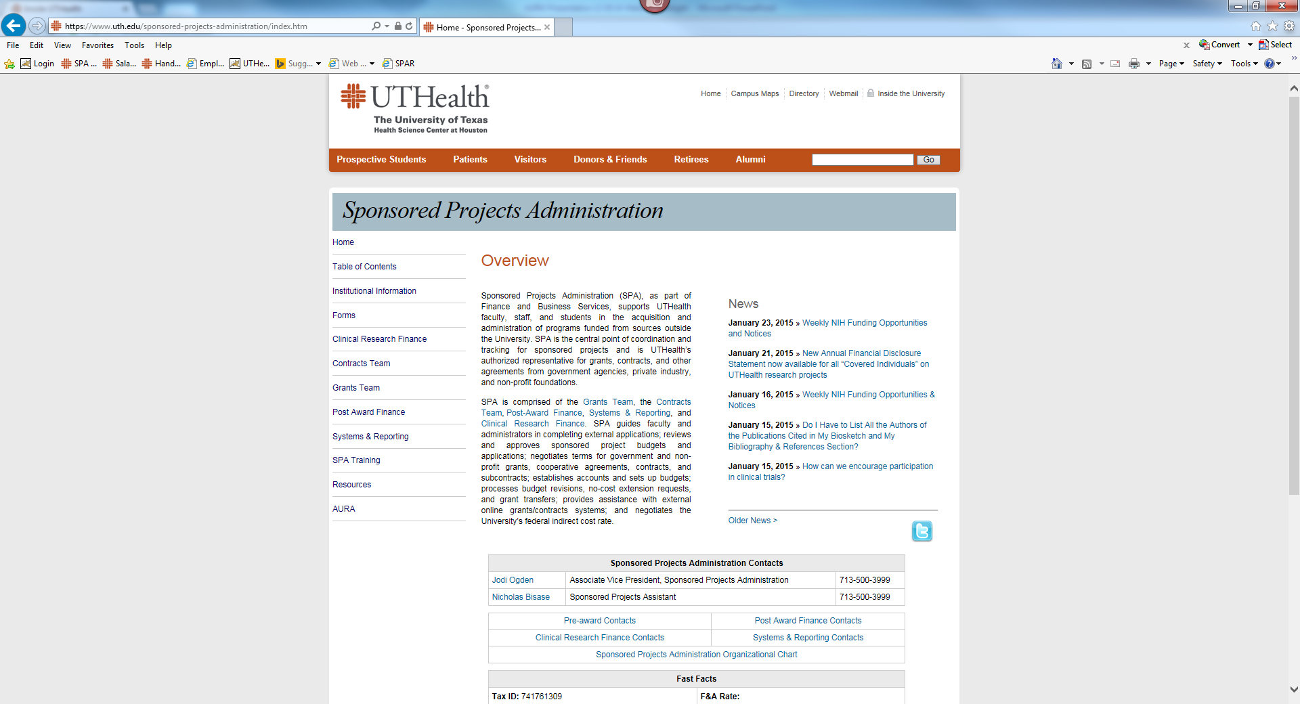
Website Spotlight

Slide 6
Equipment Transfers
James Vitt,
Assistant Vice President, Finance

Slide 7
{Section Title}
EXTERNAL TRANSFER OF EQUIPMENT FROM UTHealth
If you are planning to remove UTHealth equipment for transfer to another entity, there is an approval process that MUST be followed.
Email Capital Assets Management (CAM) at capital.assets@uth.tmc.edu with your transfer request which should include a listing of equipment with tag numbers.
CAM will provide an External Transfer of Equipment form to the department to complete and return to CAM for processing.
Equipment may be legally transferred to another entity and removed from the university only after all approvals have been obtained.
Further details regarding this process can be found on CAM’s website (Handbook Section F). https://inside.uthouston.edu/finance/capital-assets-management/handbook-section-f.htm
If you have additional questions or inquiries regarding this policy, please contact CAM at (713)500-4701.

Slide 8
External transfer of equipment purchased with active sponsored project funds to another institution
Equipment purchased with active sponsored project funds is eligible for transfer IF project is being transferred with PI to another institution.
No charge to the receiving institution for the equipment.
Procedures differ depending on the type of contract or grant.
PI must contact the Contracts and Grants Management and CAM to prepare and process request.
Requires approval of dean, Contracts and Grants Management, and the Property Manager.
Final approval rests with the Property Manager.
The equipment shall not be removed from UTHealth until all approvals have been obtained and the UTHealth bar code tags have been removed by CAM or the department.
PI is responsible for arranging transport of the equipment with the receiving institution.

Slide 9
External transfer of equipment purchased with expired sponsored project funds to another institution
Equipment purchased with sponsored project funds that originated at UTHealth and have since expired is eligible for transfer with the PI to another university.
Department chair and the dean must approve the transfer.
Receiving institution must agree to purchase the equipment from UTHealth at a depreciated cost.
Requesting PI must submit a letter to the Property Manager requesting transfer of equipment purchased with expired sponsored project funds signed by department chair or administrative head and dean.
PI must include with the letter the receiving institution's written agreement to purchase the equipment.
Receiving institution is required to provide UTHealth a Purchase Order or Check to purchase the equipment.
Equipment shall not be removed from UTHealth until all approvals have been obtained and the UTHealth bar code tags have been removed by CAM or the department.
PI is responsible for arranging transport of the equipment with the receiving institution.

Slide 10
Clinical Research Finance
Heather Cody, MHA

Slide 11
Clinical Research Finance
HOOP 214 – Clinical Research Billing
New Tools available
CPT Cheat Sheet
Resource for clinical trial budget tool

Slide 12
Updates
Karen Niemeier
Director, Contracts
Sponsored Projects Administration

Slide 13
Updates
Krystal Toups, CRA
Director, Grants
Sponsored Projects Administration

Slide 14
Updates
Pre-award Contacts
NIH Notice Reminder
NIH/AHRQ Salary Cap 183,300 effective January 11,2015 (NOT-OD-15-049) & (NOT-OD-15-039)

Slide 15
Effort Reporting
William Mitchell, MPSA
Supervisor, Systems & Reporting

Slide 16
Effort Reporting Period
Certification Period: Jan 19th - Feb 19th
First reminder email sent Thursday 1/29
Travel restrictions on uncertified statements: Feb 20th

Slide 17
Effort Reporting Reminders
Please review all cards for accuracy
Initiate any Personnel Actions, if needed
Place incorrect cards on hold until fixed
Comment any changes on the statement
Guides, forms, & new training videos at:
go.uth.edu/effort

Slide 18
FY14 - A-133 Audit Findings
Jodi S. Ogden, MBA, CRA
Associate Vice President
Sponsored Projects Administration

Slide 19
FY14 - A-133 Audit Findings
Unallowable Costs
Project related travel reimbursement included $12 for alcohol
Project related meal reimbursement included $60 expense for PI’s spouse
Consumable office supplies included $12 in food items
Monthly phone line charged to a federal project that wasn’t related to the project

Slide 20
FY14 - A-133 Audit Findings
Period of Availability
UTHealth does not have a process to close out expired federal projects
Correcting the finding:
One sponsored project residual balance account will be setup with fund 57050 for each PI impacted
Both excess revenue and expense deficits will be transferred
The remaining IDC balance will be earned on the original project
All FY 2015 expenses, including payroll, will be moved to the “residual” account with a journal entry processed by PAF
Department administration will be contacted to close encumbrances and move encumbered salary to the new project
All transactions will be completed in FY 2015
Decisions regarding PIs no longer with UTHealth will be managed by the Associate Dean for Management

Slide 21
Hot Topics
FDP Updates
Krystal Toups, CRA
Director, Grants

Slide 22
Next Meeting:
March 25, 2015
Presentations & Schedule Posted at:
go.uth.edu/AURA

